Slide 1
The Analytic Network Process
Decision Making with Dependence and Feedback

Slide 2
Hierarchic
Thinking
GOAL
CRITERIA
Prestige
Price
MPG (miles
per gallon)
Comfort
ALTERNATIVES
Acura TL
Toyoto Camry
Honda Civic

Slide 3
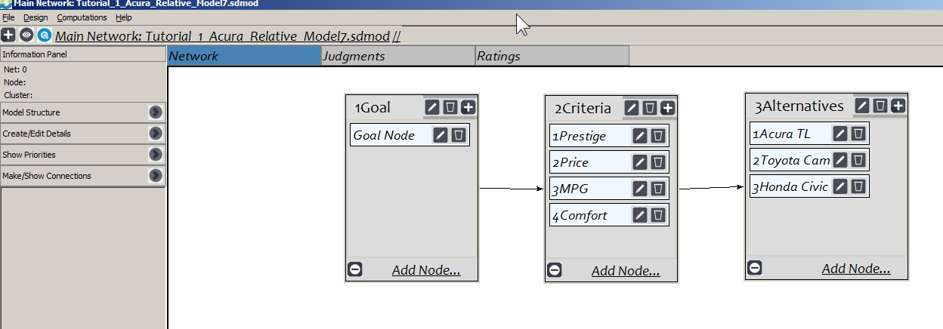
Changing from a Hierarchical Model to a Network Model

Slide 4
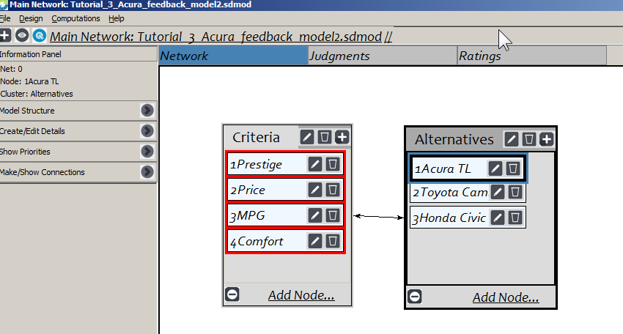
Network Models do not have Goals
A network model has a criteria cluster and an alternatives cluster, but no goal.
Step 1. Compare the alternatives with respect to each criterion (like we do in AHP models).
Step 2. Compare the criteria with respect to each of the cars to get a profile of how important the criteria are for each car.
Step 3. Synthesize to get the overall priorities for the cars, and, incidentally, for the criteria (for these cars)

Slide 5
Establishing Priorities for Criteria
In AHP one answers the question: “How important is Criterion1 compared to Criterion2 with respect to the goal?”
  Sometimes too abstract a question to answer.
In ANP criteria are prioritized by asking how important they are in the alternatives being considered.
  Usually an easier question to answer when looking at actual alternatives that have the properties in question.

Slide 6
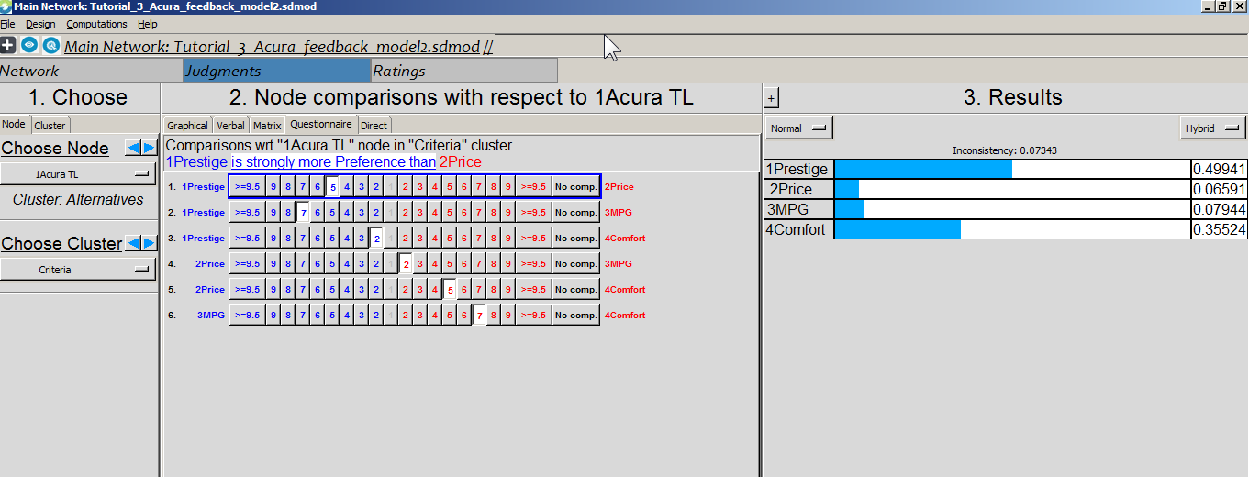
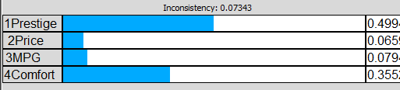
Pairwise compare the importance of the criteria for the Acura
This is the profile of the criteria as they appear in the Acura

Slide 7
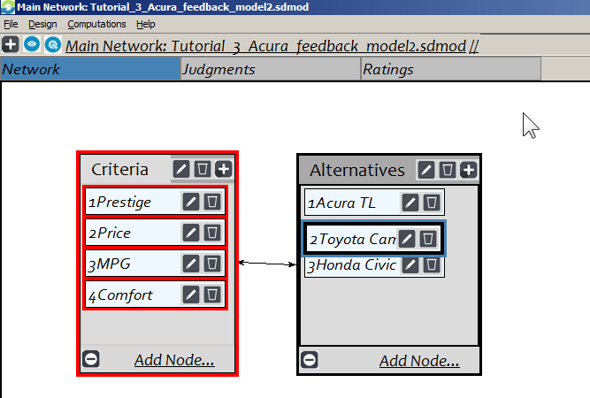
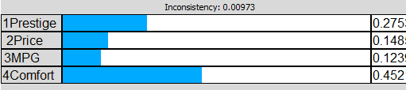
Profile of the criteria for the Camry

Slide 8
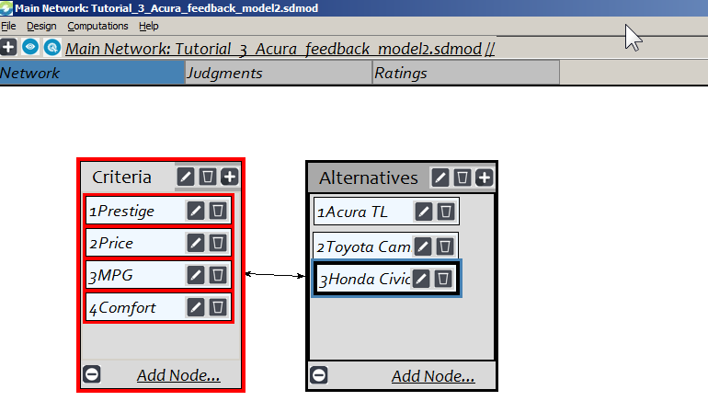
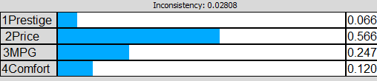
Profile of the criteria for the Honda Civic

Slide 9
Make Comparisons
For each car pairwise compare the criteria for importance to establish the priorities of the criteria in that car:
  Prestige,
  Price,
  MPG, and
  Comfort
This results in a vector of priorities of the criteria for each car.

Slide 10
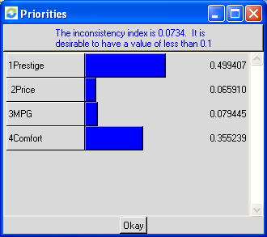
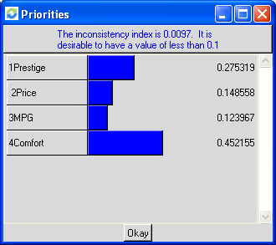
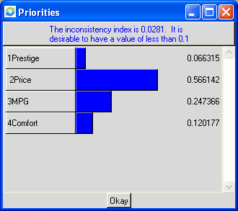
Pairwise Compare Criteria for each Car
Results for Acura TL
Results for Toyota Camry
Results for Honda Civic

Slide 11
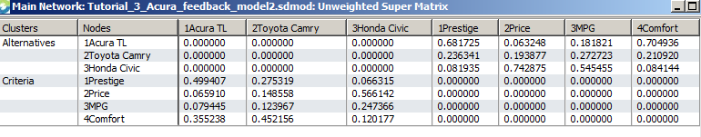
The Unweighted Supermatrix
For example, the priorities in the first column come from comparing the criteria with respect to the Acura. That is, what we value most about the Acura is its prestige.

Slide 12
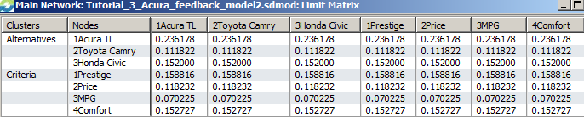
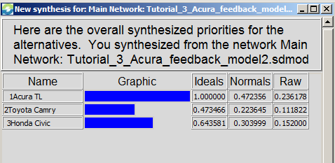
The Limit Supermatrix
The limit supermatrix is obtained by raising the weighted supermatrix to powers until it converges (in this case all columns are the same, though not always true).
The final answer, the synthesis, below is obtained by normalizing the raw values for the alternatives from the limit supermatrix:
RESULTS
ANP AHP
Acura TL .472 .344
Toyota Camry .224 .200
Honda Civic .304 .455

Slide 13
Why are the results different?
In AHP – the user, going top-down making comparisons, when asked without referring to actual alternatives, over-estimated the importance of cost.
In ANP – the user learned through feedback comparisons that his/her priority for Cost is not nearly as high as originally thought when asked the question abstractly, while Prestige gets more weight.
This is why a husband and wife, setting out to the dealership to buy a “sensible” low priced car, walked out with something entirely different and much more costly. When they saw the shiny cars on the showroom floor they revised their priorities.

Slide 14
Inner and Outer Dependence
Outer dependence - the parent node and the nodes to be compared are in different clusters. A directed link appears from the parent node cluster to the other cluster.
Inner dependence - the parent node and the nodes to be compared are in the same cluster. The cluster is linked to itself and a loop link appears.

Slide 15
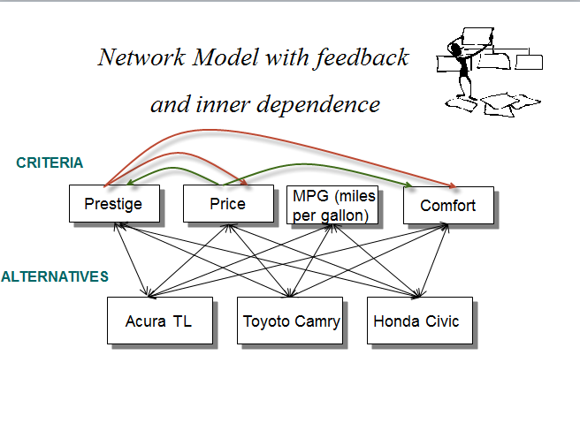

Slide 16
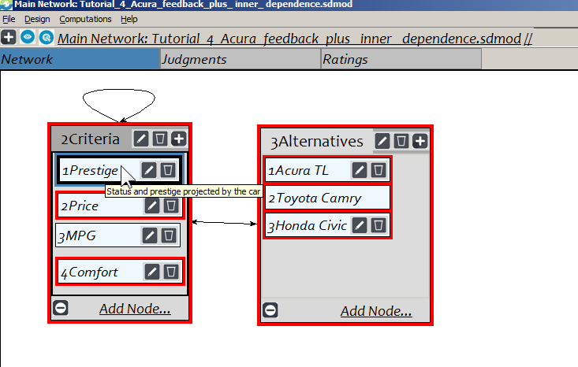
Inner and Outer Dependence
Prestige is inner connected to Price and Comfort. The question is: Which influences Prestige more? Price or Comfort.

Slide 17
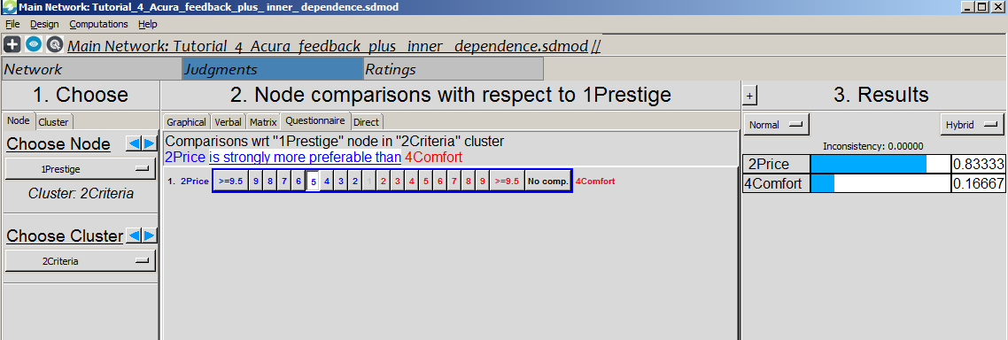
An Example of an Inner Dependent Comparison is shown below
Which influences Prestige more, Price or Comfort? The judgment is that Price influences it 5 times as much as Comfort.
Which influences Prestige more, Price or Comfort?

Slide 18
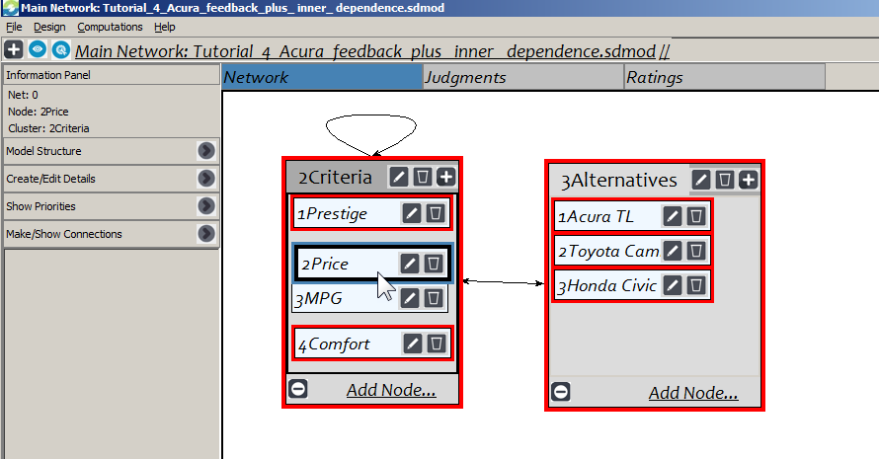
Another Inner Dependent Comparison
Price is connected to Prestige and Comfort. The judgment is that Prestige influences Price 3 times as much as Comfort.
Which influences Prestige more, Price or Comfort?

Slide 19
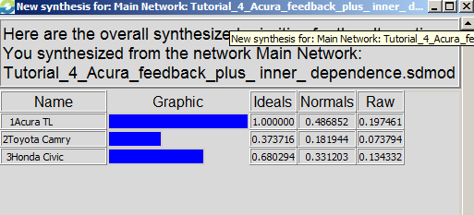
The results with the interdependencies in place are:
ANP ANP AHP
(With inner (No inner
dependencies) dependence)
Acura TL .487 .457 .344
Toyota Camry .182 .173 .200
Honda Civic .331 .369 .455

