Slide 1

The Analytic Network Process for decision making with dependence and feedback
The SUPER DECISIONS Software
By Creative Decisions Foundation
4922 Ellsworth Avenue
Pittsburgh, PA 15213
Phone: 412-621-6546
Fax: 412-681-4510

Slide 2
The Parts of a Complex ANP Model with Benefits, Opportunities, Costs and Risks
Top level network containing the BOCR merit nodes: benefits, opportunities, costs and risks; and the strategic criteria hierarchy.
Four second level subnetworks containing the control hierarchies and control criteria for the BOCR nodes.
Many third level decision subnetworks, one for each of the high priority control criteria (sometimes 10 or 12). These are called the decision subnets and each MUST contain a cluster of alternatives.

Slide 3
IMPORTANT CONCEPTS
Benefits, Opportunities, Costs and Risks nodes (the merits of the decision)
Control Criteria Hierarchies (for each merit node)
Decision subnets containing the alternatives for the high priority control criteria
Strategic Criteria against which the BOCR nodes are rated to determine their priorities.

Slide 4
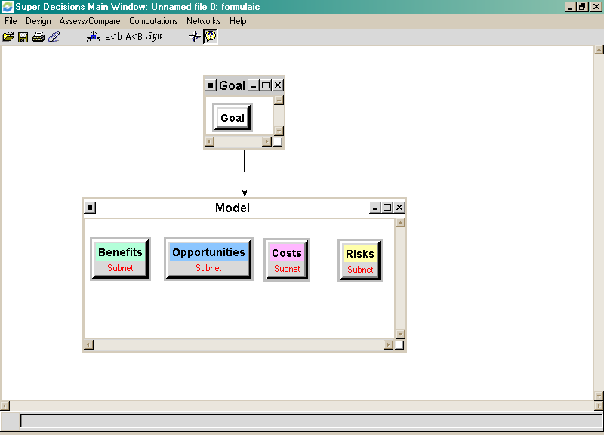
Benefits, Opportunities, Costs and Risks Top-level Network

Slide 5
Hierarchy of Control Criteria for each Merit Node
Create or access the subnet of a merit node by right-clicking it to select Make/Show Subnet
Control criteria subnets have a goal cluster with a goal node, a criteria cluster with criteria nodes and perhaps subcriteria in other clusters.
The criteria are connected to the goal (and subcriteria to criteria)
Pairwise compare criteria and subcriteria, pick high priority control criteria and build decision subnets for them

Slide 6
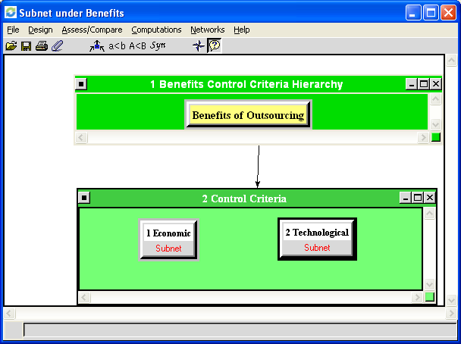
Benefits Control Hierarchy Subnet
.8333
.1667

Slide 7
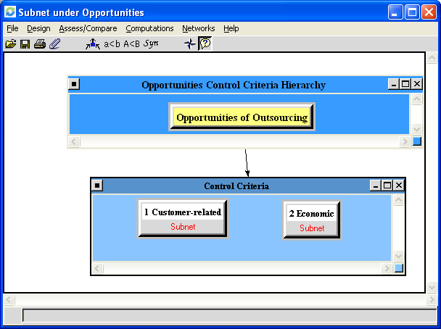
Opportunities Control Hierarchy
.25
.75

Slide 8
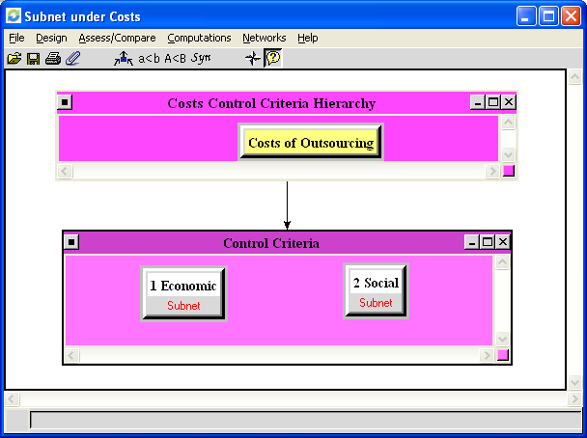
Costs Control Hierarchy
.8333
.1667

Slide 9
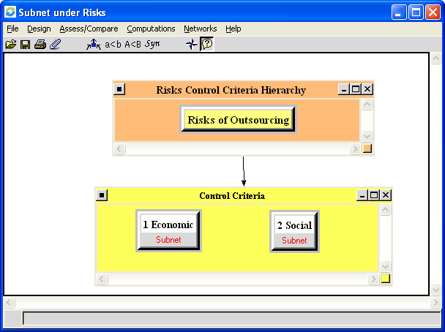
Risks Control Hierarch
.75
.25

Slide 10
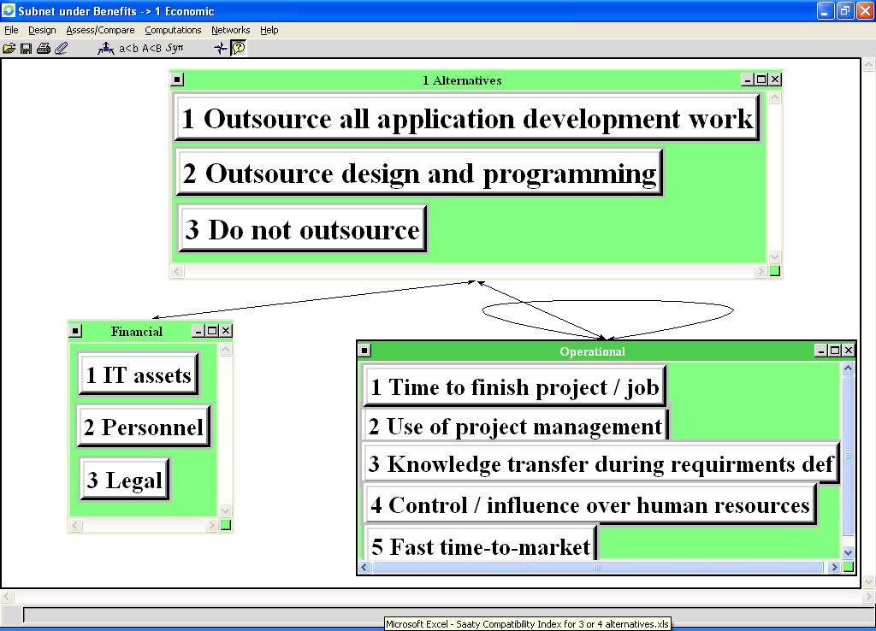
There is a Decision Subnet for each Benefit Control Criterion; the one for Economic Benefits is shown below

Slide 11
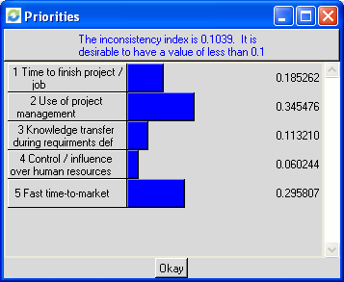
Perform all Pairwise Comparisons, e.g.: What is most important Operational Criterion for “Outsource All Application Development Work”

Slide 12
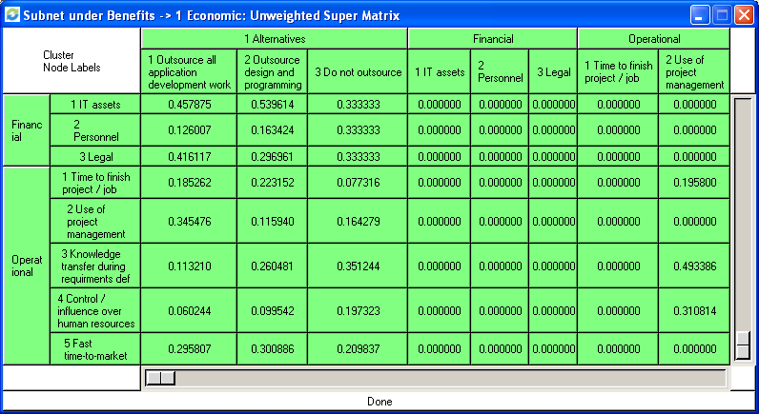
Results of all pairwise comparisons are arranged in unweighted supermatrix

Slide 13
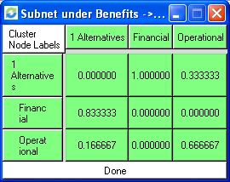
Pairwise compare the clusters connected from a cluster for influence on that cluster.

Slide 14
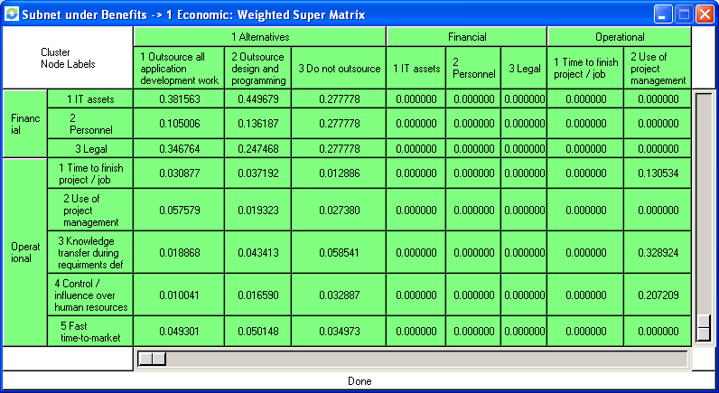
Multiply values in Unweighted SuperMatrix Components by corresponding Cluster Matrix Value to get Weighted Supermatrix. Example: All 9 numbers in (Financial, Alternatives) component of unweighted supermatrix are multiplied by .833 from (Financial,Alternatives) cell in the Cluster matrix to yield values in (Financial, Alternatives) component in weighted supermatrix below. All columns then sum to 1 in weighted supermatrix.
=1

Slide 15
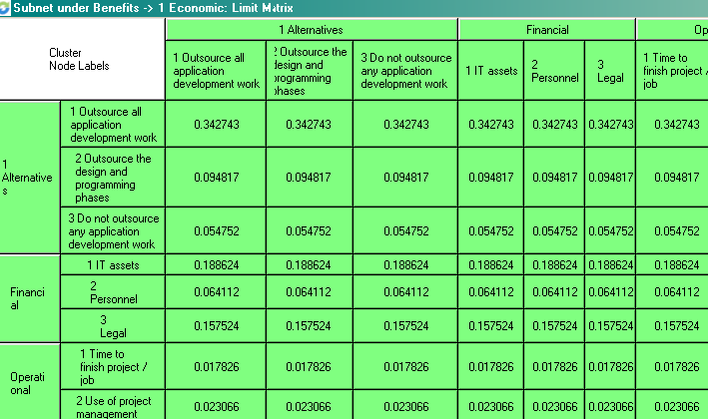
The Weighted Supermatrix converges to the Limit Supermatrix
All columns may be the same in the limit matrix, although not always the case.
Synthesized results for alternatives come from raw values in limit supermatrix

Slide 16
Synthesized results in Economic Benefits Decision Subnet
Alternatives under Economic Benefits | Ideals | Normals | Raw
1 Outsource all application development work | 1.0000 | 0.6962 | 0.3427
2 Outsource the design and programming phases | 0.2766 | 0.1926 | 0.0948
3 Do not outsource any application development work | 0.1597 | 0.1112 | 0.0548

Slide 17
Synthesized results in Technological Benefits Decision Subnet
Alternatives under Technological Benefits | Ideals | Normal | Raw
1 Outsource all application development work | 1.0000 | 0.4411 | 0.2189
2 Outsource the design and programming phases | 1.0000 | 0.4411 | 0.2189
3 Do not outsource any application development work | 0.2669 | 0.1178 | 0.0584

Slide 18
Combining Economic and Technological to get overall Benefits Weight Economic by .833 and Technological by .167 and add to obtain:
Alternatives under Benefits Overall | Ideals | Normals | Raw
1 Outsource all application development work | 1.0000 | 0.6350 | 1.0000
2 Outsource the design and programming phases | 0.3972 | 0.2522 | 0.3972
3 Do not outsource any application development work | 0.1776 | 0.1128 | 0.1776

Slide 19
Results under Benefits, Opportunities, Costs and Risks
 | Benefits | Oppor. | Costs | Risks
Alternatives | Ideals | Ideals | Ideals | Ideals
1 Outsource all application development work | 1.0000 | 1.0000 | 0.8518 | 1.0000
2 Outsource the design and programming phases | 0.3972 | 0.8277 | 0.7653 | 1.0000
3 Do not outsource any application development work | 0.1776 | 0.4908 | 1.0000 | 0.3570
Positive
Negative

Slide 20
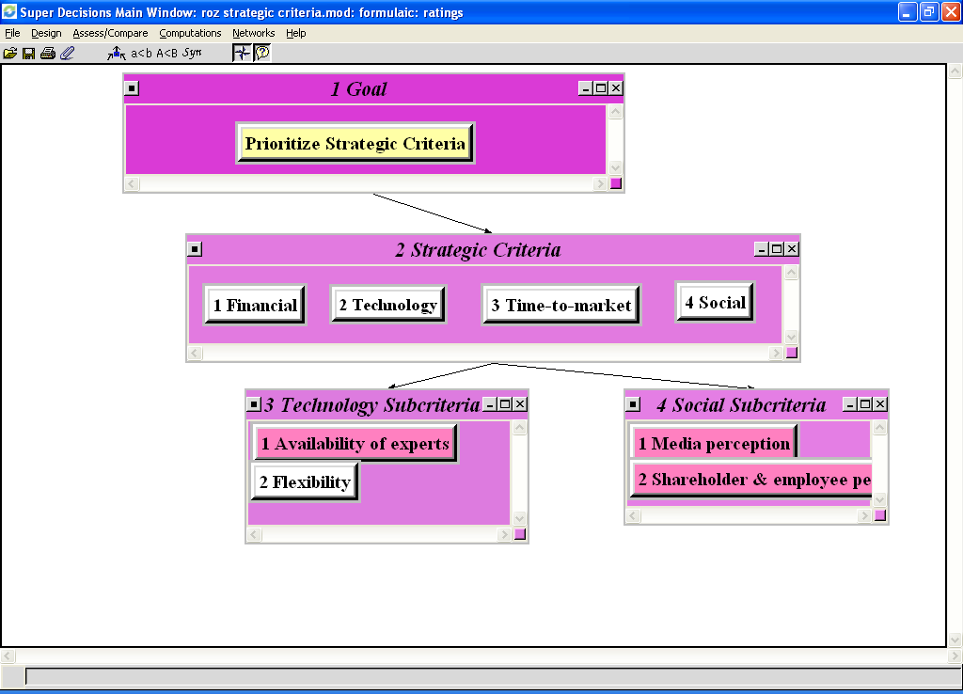
Weight the BOCR by rating the top alternative for each merit against the Strategic Criteria

Slide 21
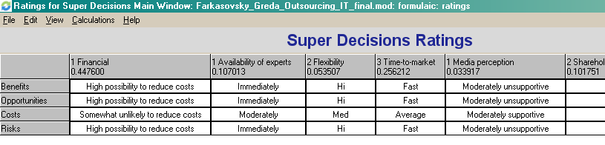
Rating the BOCR What is the highest valued alternative for Benefits? To determine what it is synthesize in the Benefits control subnet which will rank the Alternatives under Benefits. Keep that highest alternative in mind and perform ratings across the Benefits row as to how it impacts the strategic criteria. Repeat across the Opportunities row for Opportunities’ highest valued alternative…and so on. For Costs and Risks the highest valued alternative will be the worst one so you will be rating by asking the question “How does this worst alternative for Costs (Risks) impact the strategic criteria?”

Slide 22
Final Step is to Combine the BOCR Using a Formula
Additive negative formula – generally best for long term results: bB+oO-cC-rR
Multiplicative formula – equivalent to marginal cost/benefit analysis and generally best for short term results: BO/CR

Slide 23
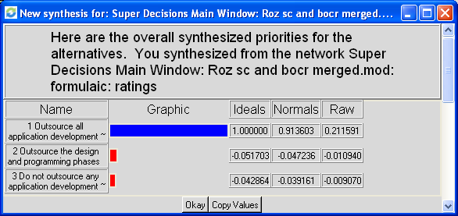
Combine BOCR results using Additive (negative) formula: bB+oO-cC-rR

Slide 24
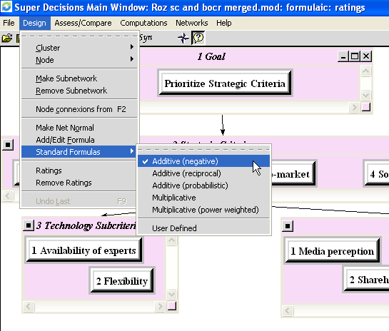
To change formula use the Design > Formula command

Slide 25
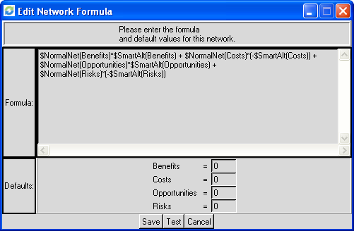
This is the Additive (negative) formula as the software expresses it

Slide 26
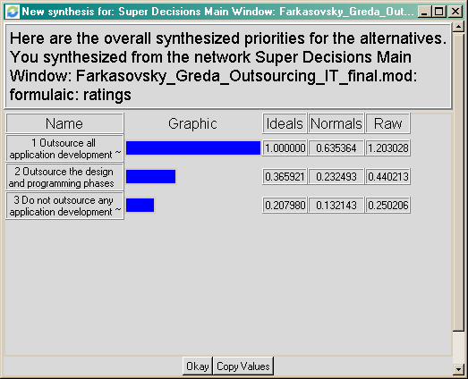
Combine BOCR results using Multiplicative formula: BO/CR

Slide 27
When to use what formula
Additive (negative) gives best alternative for the long-term
Multiplicative gives the best alternative for the short-term
In practice one usually looks at both. Often they give the same best alternative, but not always.
Not possible to do sensitivity for multiplicative formula as the b,o,c and r cancel out.

Slide 28
Performing Sensitivity on the BOCR Nodes
Select the Additive (negative) formula using the Design>Sensitivity command
Select Computations>Sensitivity
Select Edit>Independent Variable (the initial graph is usually not the one you want – because the software starts with the first node in alphabetical order as the independent variable). You need to select the correct Independent Variable (to do sensitivity for the Risks, for example, choose Risks)

Slide 29
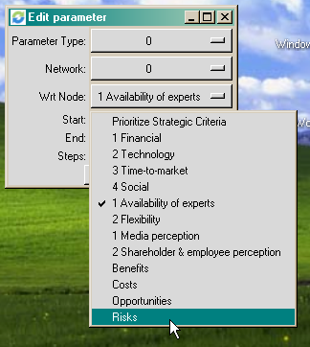
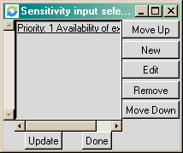
Set the Sensitivity Parameters
Click on the node “Priority: 1 Availability of …” to select it, then select Edit to get to the Edit Parameter dialogue box. Change the Wrt Node to Risks.

Slide 30
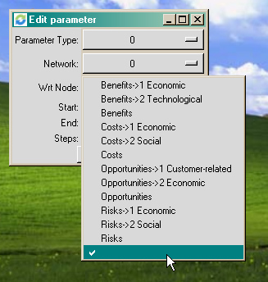
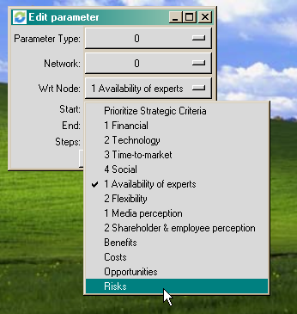
Parameter Settings for Risks Sensitivity
In the Edit Parameter dialogue box set the Parameter Type to 0 for priorities and the Network to 0 for the top-level network (it is the bottom position as shown below – there is no name on it) and select Risks for the Wrt (with respect to) Node.

Slide 31
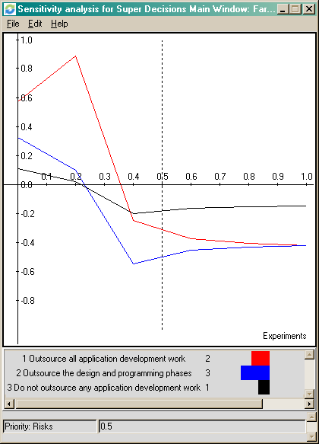
Display the Sensitivity Graph
Click the Done button then the Update button to display the graph shown below
As the priority of Risk increases above about 40% the best option changes from Outsource All to Do Not Outsource
The “with respect to” variable is shown at the bottom

Slide 32
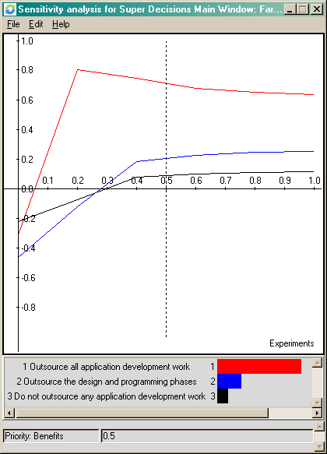
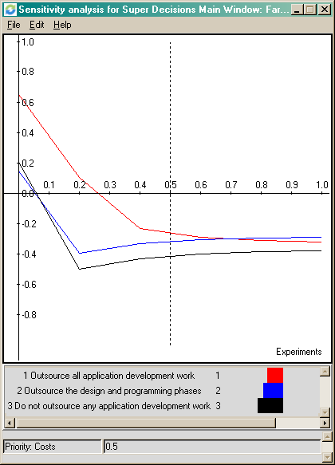
Investigate Sensitivity for the other nodes: Benefits and Costs shown below
Benefits
Costs

