Slide 1
ANP Market Share Models
ANP can be used very successfully to estimate market share.
But why should we use ANP? Why not just go to the internet and find the market share from data there?
The purpose of creating market share models is to validate the ANP, to show that we can get results using judgment that can be validated against independent data sources.
For market share examples go to superdecisions.com and choose sample models from the top level menu

Slide 2
Market Share Modeling Tips
Pick something you are quite familiar with to estimate market share
Select items that are comparable.
  Don’t include a Lexus, a Corolla and a Ford F150 pickup as alternatives in the same model. You could do that in a “personal decision” model, but not in a market share model. Try to pick items that are true competitors: Nike, Adidas, True Balance
Before you choose your alternatives see if you can get market data to compare your results.
  Choosing to do Pizza places in Pittsburgh such as Domino’s, Papa John’s and Pizza Hut may not work because you may not be able to find data. You could do the estimate nationwide or worldwide if you have the expertise and the data.
Brainstorm and make a list (in Word) of things that come to your mind when you think of your alternatives.

Slide 3
Brainstorm Factors for Sport Shoes
List everything that pops into your mind
Advertising
Magazines
TV
Sports Events
Celebrities Using
Availability
Wide Variety?
Do many stores carry the brand
Are there many sizes?
Design of shoe – comfort
Design of shoe – stylish
Durability
Modern or dated
Is everybody wearing them?
Who wears them? School kids, parents of school kids, weekend athletes, professional athletes, oldsters

Slide 4
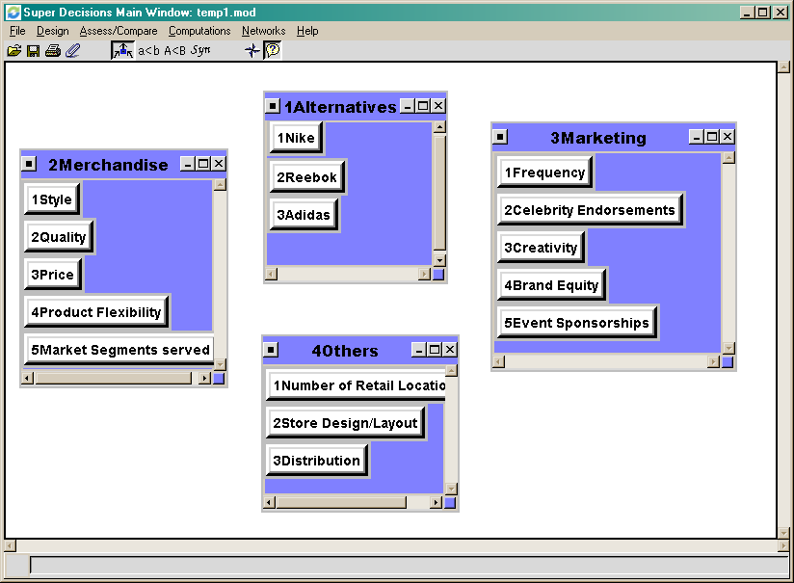
Group Factors and Create Clusters and Nodes

Slide 5
Start Making Links
Pick a cluster to start with (the alternatives cluster is usually a good one)
Pick a node in the cluster to serve as a parent node, Nike for example.
Examine another cluster, Marketing for example, and ask if you can form a comparative question for the nodes in that cluster with respect to the parent node. If you can, link Nike to some of all of the nodes in Marketing.

Slide 6
Link Nike to Nodes in Marketing Cluster
Formulate the question you will ask. What is better about Nike’s marketing:
  Frequency or Celebrity Endorsements?
  Frequency or Creativity?
  Frequency or Event Sponsorship?
Make links to the nodes for which you can answer the question by clicking to depress the “make connections” icon Left click on Nike, right click on Frequency, etc.

Slide 7
Add the other links
---Link Nike to 4 of the Marketing cluster nodes. It is not connected to the Brand Equity node because that factor does not seem to fit with this set of comparison questions.
---When Nike is left clicked while the “make connections” icon is depressed, the nodes it is connected to show up in red and a black arrow appears from the Alternatives cluster to the Marketing cluster. The black arrow indicates at least one node in Alternatives is connected to at least one node in Marketing.
---When the “show connections” icon is on, merely moving the cursor over a node that is a parent causes nodes it is connected to to be outlined in red

Slide 8
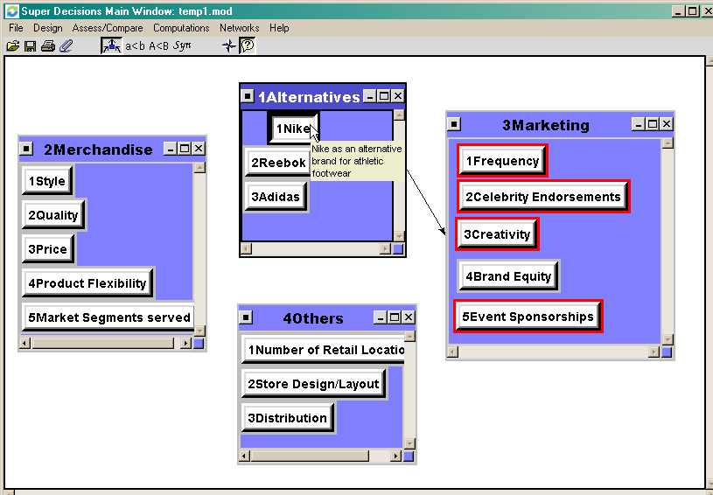
Showing what Nike is connected to

Slide 9
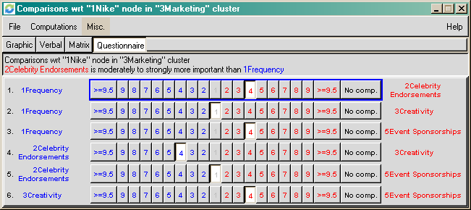
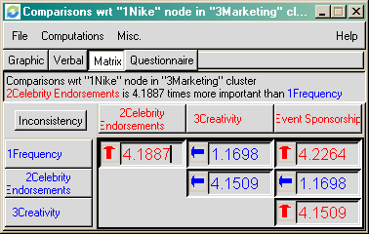
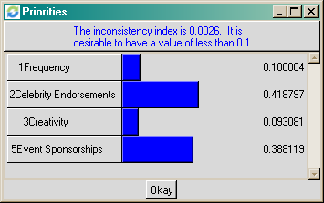
Comparisons
The question: Which is the more important marketing activity for Nike so far as gaining market share is concerned? Use any comparison mode to make judgments. Do results make sense?

Slide 10
Results of Nike Marketing Factor Comparisons
These results may be interpreted to mean that celebrity endorsements are the most important thing Nike does or what it does best to maintain and increase market share. Event sponsorships are a close runner-up. This seems reasonable. If the results don’t seem reasonable, review judgments and see if you made an “inversion” or clerical error.

Slide 11
Making More Connections
The order in which you make connections is not important, but I usually find that since I understand the question for Nike, I can go ahead and connect the other competitors to the same nodes. Usually all the connections are created before making comparisons.
Then with Nike again in mind move to another cluster and connect to the nodes in that cluster for which you can formulate a comparison question. Proceed through all the clusters.

Slide 12
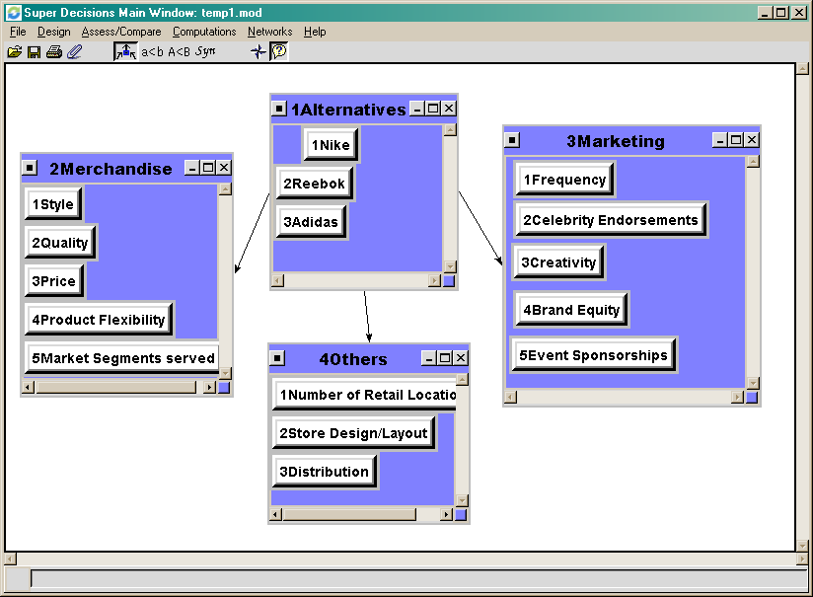
The situation after connecting the Alternatives out to the other clusters
Note that the arrows all go out from the Alternatives cluster. This means no priority is flowing back to the Alternatives, so their priority would be zero!

Slide 13
Making Connections back to the Alternatives
Making connections back is easier in a way, because you are asking which alternative you prefer with respect to a factor.
For example, when Frequency of Marketing is connected to the alternatives Nike, Reebok and Adidas, the pairwise comparison question is phrased this way:
  In your judgment does Nike, Reebok or Adidas advertise more frequently? How much more frequently? Moderately, Strongly, Very Strongly?

Slide 14
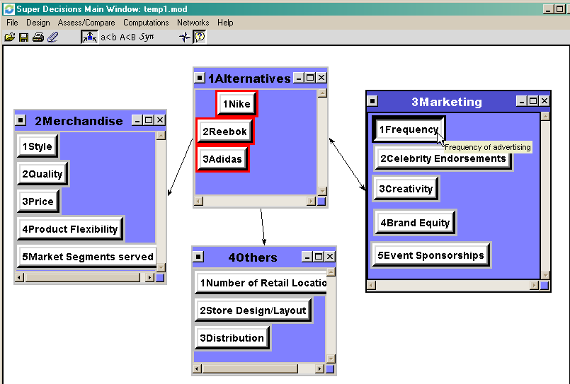
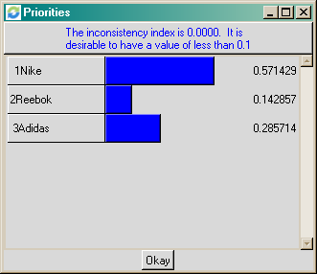
Frequency connected to the Alternatives
Results of comparing the alternatives for which has the most frequency of advertising

Slide 15

Make the connections throughout the model back to the alternatives
This results in priorities for the alternatives with respect to Frequency.

Slide 16
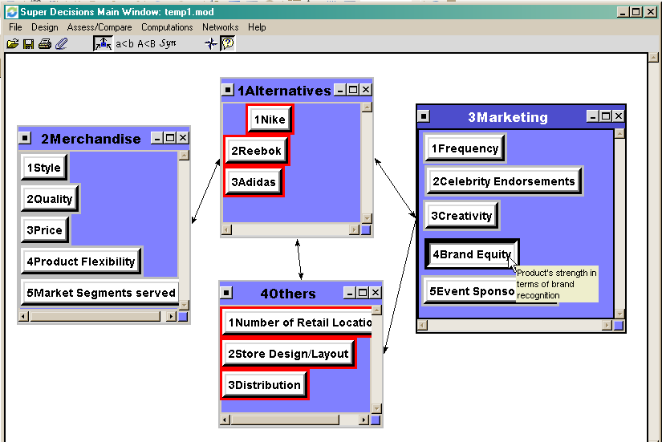
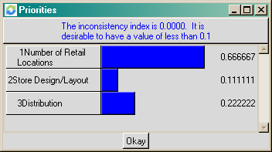
Make other node connections where relevant
It seems to make sense to connect some of the marketing factors to the Others cluster nodes. For instance, one could compare Number of retail locations, Store Design/Layout and Distribution from the Brand Equity node. So an arrow now goes from Marketing to Others.
The comparisons with respect to Brand Equity result in the following priorities

Slide 17

Do not allow sinks and sources
Example of a sink cluster. Arrows only go in. No priority can flow out to the alternatives. All comparisons among nodes in this cluster are meaningless and have no effect.

Slide 18

Source cluster – better not to allow this!
A source cluster only has arrows pointing out from it. This means the nodes in the source cluster have to all be treated as equal, as there is no way to compare and prioritize them. Better not to have this in general though it is not as bad as a sink cluster.

Slide 19
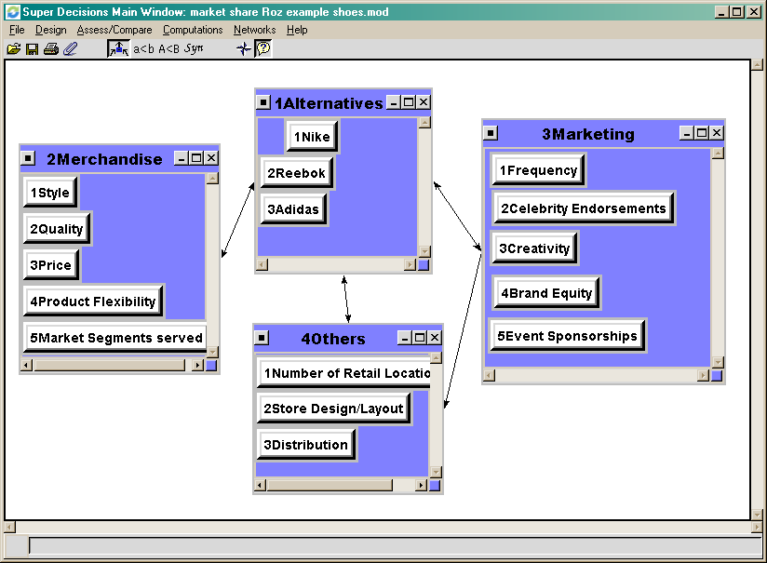
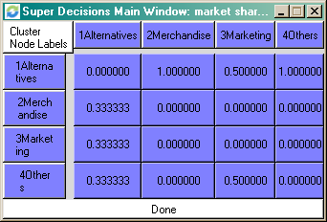
Cluster Comparisons
Clusters connected from another cluster (that is, those at the ends of arrows pointing away from the cluster) must be pairwise compared for their impact on that cluster. Use Computations>Cluster Matrix command to show the Cluster Matrix. The column element is the parent of the comparison and the clusters listed under it which have non-zero priorities must be compared with respect to it. In this example for the Alternatives cluster pairwise compare the Merchandising, Marketing and Others clusters for impact. For the Marketing cluster pairwise compare the Alternatives and the Others cluster for impact on it.

Slide 20
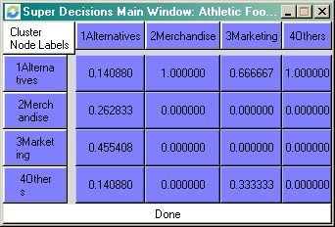
Cluster Comparison Matrix
To launch cluster comparisons click this icon To see the Cluster matrix with the priorities of the clusters use the Computations>Cluster Matrix command
Cluster Matrix with default equal priorities before comparing
Cluster Matrix with priorities after pairwise comparing
The Cluster Matrix priorities are multiplied times all the cells in their respective components in the unweighted supermatrix to yield the weighted supermatrix which is raised to powers to yield the limit supermatrix.

