Slide 1
Create an AHP Ratings Model
Ratings models save time in making pairwise comparisons. Standards of performance are established for each criterion and the alternatives are rated one at a time on each criterion using its standards.
Relative models: In a relative model such as the car model all nodes are pairwise compared against each other to establish priorities requiring n(n-1)/2 comparisons.

Slide 2
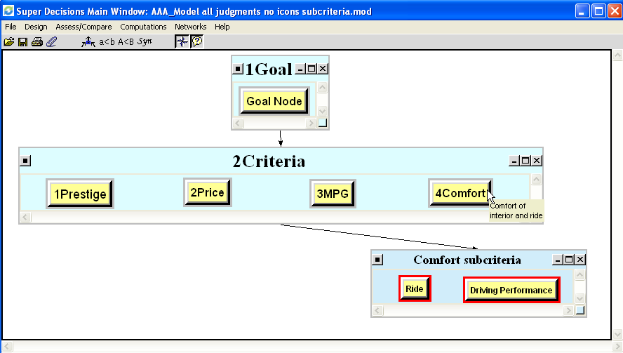
Create a Ratings Model
Build a hierarchical model as shown below and enter judgments as before, but do not include the alternatives in the main screen of the model. The model has 4 criteria and the Comfort criterion has subcriteria of Ride and Driving Performance.
Select Design>Ratings to open the Ratings screen where the Alternatives will be evaluated.
This Ratings model is available in the file Tutorial_1_Acura_RATINGS_Model.sdmod

Slide 3
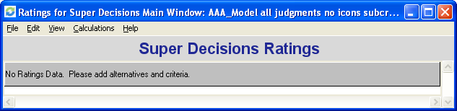
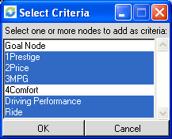
Starting Ratings
1. Blank screen appears
Select Edit Criteria New and click on the criteria/subcriteria to appear as column headings. You must start by adding Criteria (trying to add Alternatives first will result in a software crash at present). Select the lowest level of covering criteria. Do NOT select Comfort; instead select its subcriteria, Driving Performance and Ride.

Slide 4
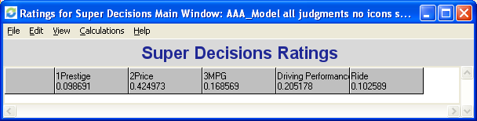

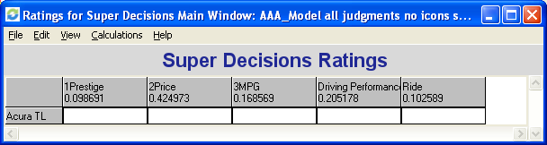
Ratings Spreadsheet
3. Ratings spreadsheet now has selected criteria with their priorities in it as shown below:
4. Select Edit>Alternatives>New and enter name for each alternative:
5. The Ratings Spreadsheet now has one alternative; continue adding alternatives:

Slide 5
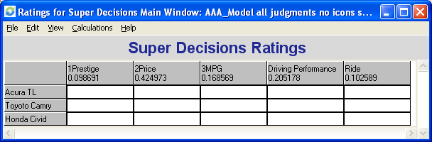
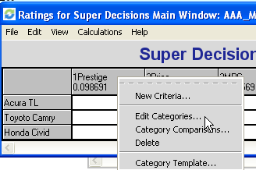
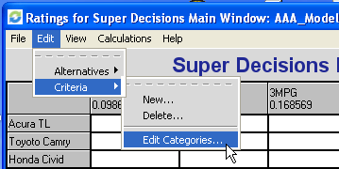
Ratings Spreadsheet (cont’d)
5. Ratings Spreadsheet in which alternatives have been entered (you can enter as many as you like and they do not have to have been in the original model.
6. Select Edit>Criteria> Edit Categories from menu or right-click on a column heading, for example, Prestige, to get the dropdown menu and select Edit Categories.

Slide 6
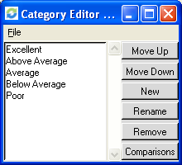
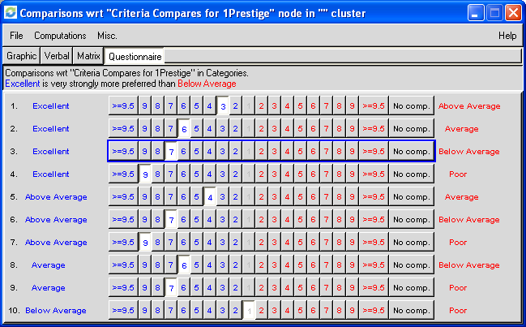
Ratings Spreadsheet (cont’d)
7. Category Editor will appear. Enter names of Categories for the Prestige criterion (use New command)
8. Click Comparisons in Category Editor to bring up pairwise comparison screen
Change comparison word to “preferred” (select Misc>Comparison words)
Enter judgments – questionnaire mode appears but you can use any mode.
Improve inconsistency to less than 0.10

Slide 7
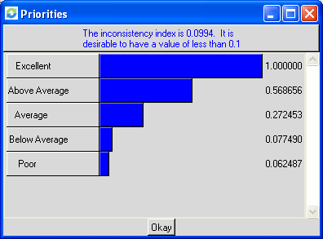
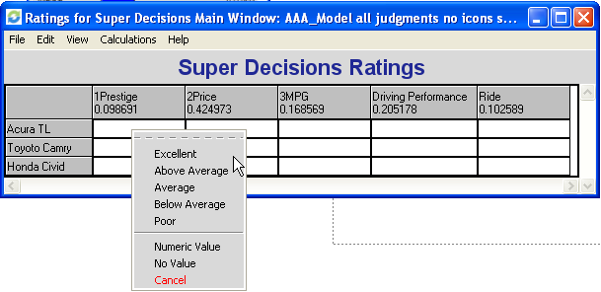
Ratings Spreadsheet (cont’d)
9. Compute priorities with Computations>Ideal Priorities command. The Ideal priorities are computed from the usual Priorities by dividing each priority by the largest.
Close the Comparisons screen in the usual way to return to the Ratings Spreadsheet. The categories have been established and pairwise compared for Prestige.
Click on the (Acura, Prestige) cell and choose one of the categories, e.g. Excellent..

Slide 8
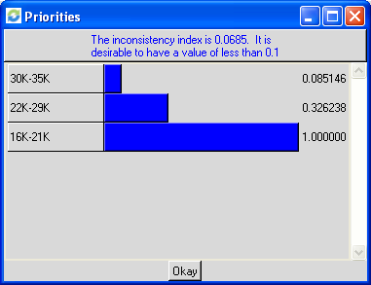
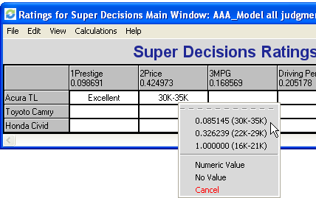
Ratings Spreadsheet (cont’d)
10. Repeat the process to create the categories for Price and pairwise compare them. Note that we have made the Price categories ranges of prices and that the lowest price range is the most preferred and gets the highest priority.
11. To display the priorities associated with the categories as shown here, turn on View>Category Display>Names and Priorities
12. Click on the (Acura, Price) cell and select its price range (30k-35k)which has a priority of .085.

Slide 9
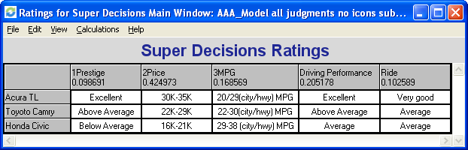
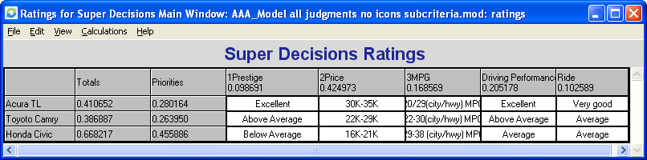
Ratings Spreadsheet (cont’d)
13. Create categories for the remaining columns and rate the alternatives
14. Display Totals and Priorities columns with the View command

Slide 10
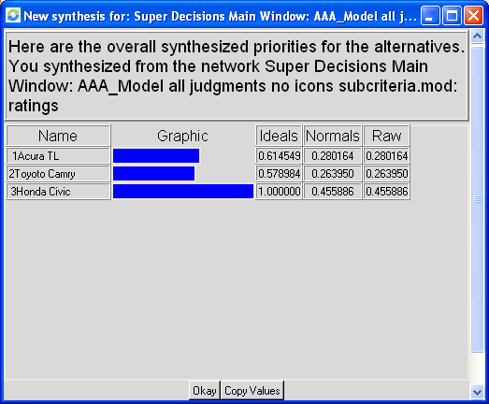
Results in Ratings
15. Final rated alternatives. The Priorities are the results equivalent to the synthesized results in a relative model. The totals are most often used for resource allocation.
16. Priorities can also be displayed with the Calculations>Synthesize command
Ratings Relative Model
Acura TL .280 .344
Toyota Camry .264 .200
Honda Civic .456 .455

