Slide 1
Tutorial 1
AHP Relative Decision Model
Demo of a simple relative hierarchical model for selecting the best of three cars.
  In a relative model the alternatives are pairwise compared against the criteria.
  In a ratings model the alternatives are rated against standards for the criteria. See Tutorial 2 for Ratings models.

Slide 2
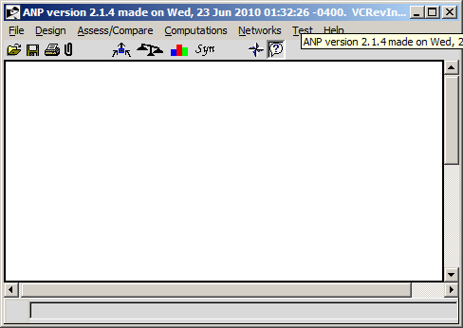
SuperDecisions’ Opening Screen upon launching the software
* File > New command leaves the same blank opening screen

Slide 3
Main Menu Commands
File – New – brings up templates, Open file, Close file, Recent Files, Backups, Import model in .txt format, Export supermatrices to .txt files, Print model report, Old files have .mod extensions, new files have .sdmod extensions
Design – Build a network by creating clusters and nodes and making node connections
Assess/Compare – Perform pairwise comparisons, access the Ratings spreadsheet if there is one
Computations – Synthesize results, look at supermatrices, perform sensitivity, do sanity check for errors and incomplete comparisons
Network – quickly transit around the sub-networks in a complex model and go going directly into a selected subnet
Test – Programmer menu for development work
Help – Sample models, including some in other languages, Help, for now use this old Help file: http://www.superdecisions.com/SuperDecisions_Help.pdf

Slide 4
A Three-Level Hierarchy to Choose the Best Car
Goal
Buy Best Car
Price
MPG
(Miles per gallon)
Prestige
Comfort
Acura TL
Toyota Camry
Honda Civic

Slide 5


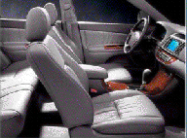
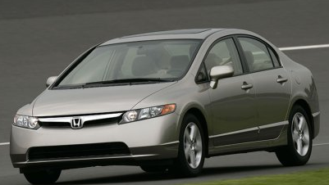
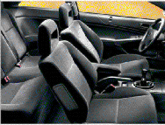

The Cars
Acura TL
  Cost $30,000-$35,000
  Miles per Gallon 20/29 (City/Hwy)
  Prestige is very good
  Comfort is excellent
Toyoto Camry
  Cost $22,000 - $28,000
  Miles per gallon 22/30 (City/Hwy)
  Prestige is good
  Comfort is good
Honda Civic
  Cost $16,000 - $20,000
  Miles per gallon 29/38 (City/Hwy)
  Prestige is good – “green” car
  Comfort is medium to low

Slide 6
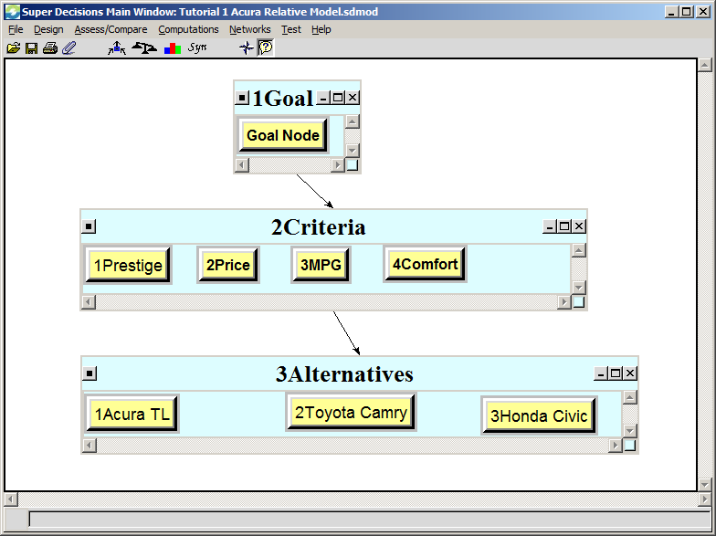
The Decision Hierarchy as it appears in the SuperDecisions Software
Cluster
Node
All links are among nodes: the cluster link is automatically created because some node(s) in the Criteria cluster are connected to some node(s) in the Alternatives cluster
See the SuperDecisions software model: Tutorial_1_Acura_Relative_Model.sdmod

Slide 7
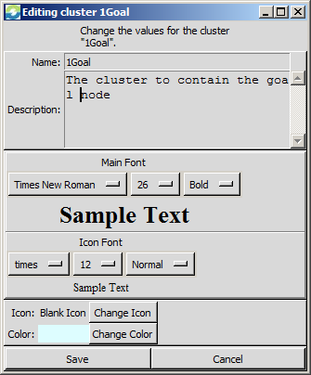
Building the Decision Hierarchy
File>New and choose Simple Network
(simply leaves you with a blank window) or just
start building on the blank opening screen
To create the Goal Cluster select the
Design command:
Design>Cluster>New brings up
the cluster editing window. Type a name
and description for the cluster and set the
parameters: font, text size, color,
icon (if you want) and save.

Slide 8
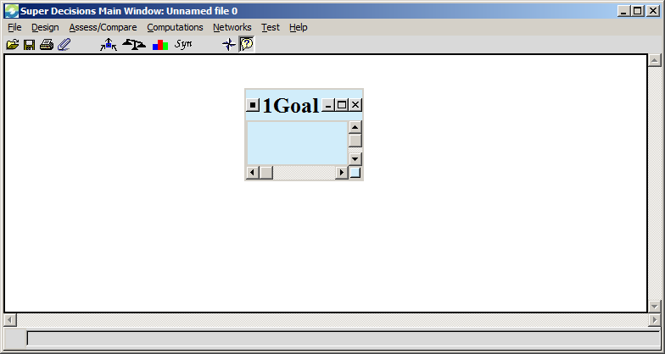
Decision Hierarchy with a new cluster to hold the Goal Node
Double-click on a cluster to minimize it to an icon or expand from an icon.

Slide 9
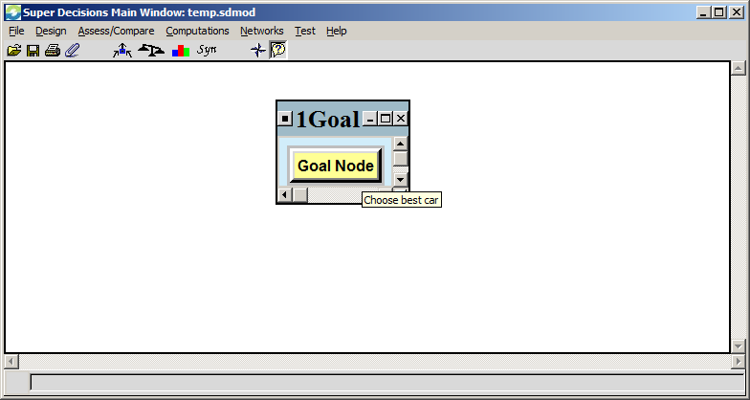
Add Goal Node to Goal Cluster
Design>Node>New to get to the node editing window. Select cluster to add node to, enter goal node name (and description if you wish) selecting parameters as before, and save. For convenience, just use the word Goal again.
To display descriptions make sure the
Icon on the top menu bar is depressed then hold cursor over node or cluster.

Slide 10
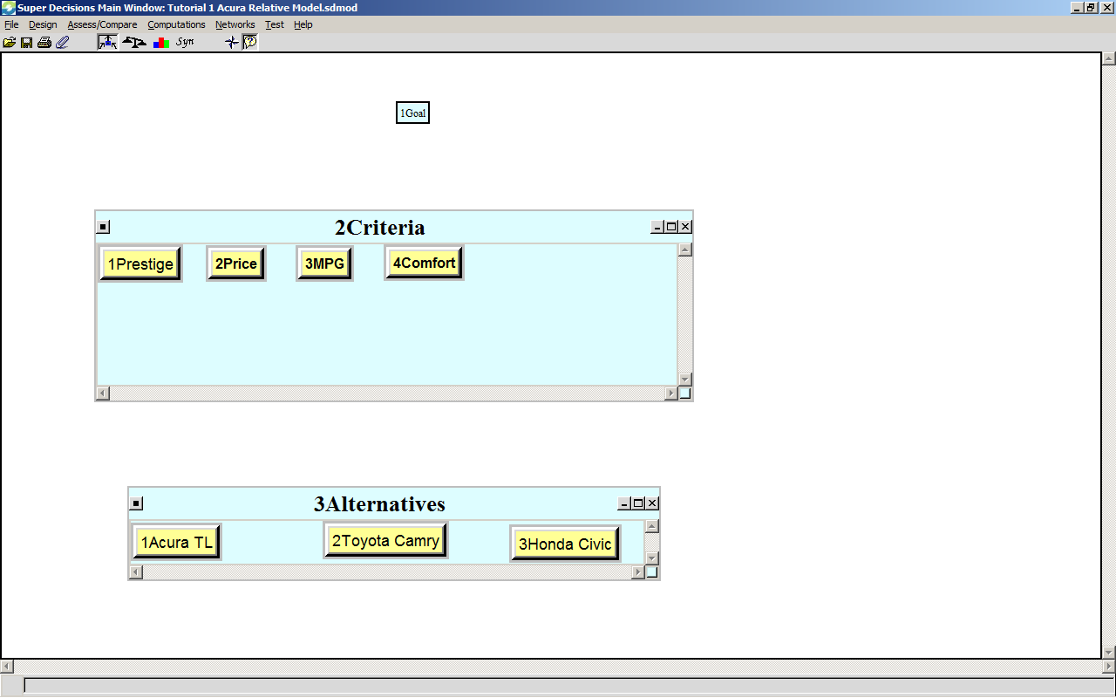
Add the Rest of the Clusters and Nodes
Double-click a cluster to minimize or expand
To re-size a cluster click on bottom right hand button on a cluster and drag.
IMPORTANT!
The cluster holding the alternatives must be named with some version of the word Alternatives
(prefacing with a number is OK)
Note: Prefacing Cluster and node names with numbers allows you to control their order in the supermatrices as they are appear in alphabetical order there.

Slide 11
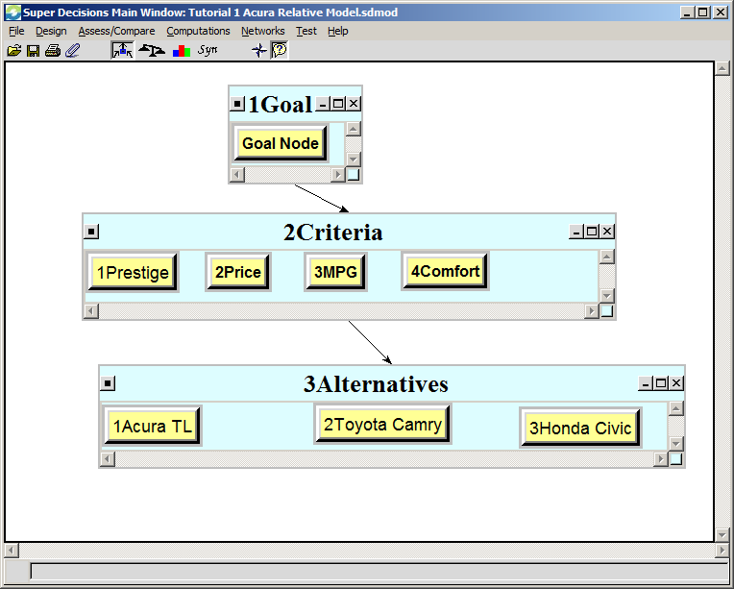
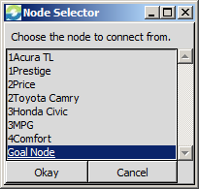
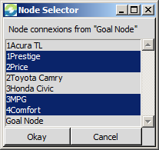
Build the Hierarchy in SuperDecisions
Step 1. Create the clusters and nodes shown below
Or use the shortcut to connect nodes
Use the Design>Node Connexions from menu command to connect the Goal Node to the Criteria:
To turn on the connection shortcut mode left-click the “connections” icon.

Slide 12
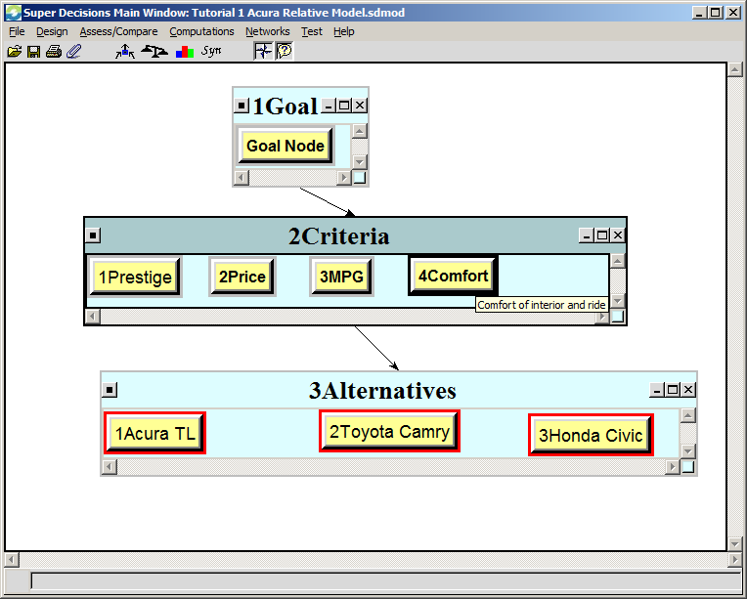
Complete the Rest of the Connections
Turn on the fan-shaped “Show Connections” icon by clicking it
Connect each of the four nodes in the Criteria cluster to all three of the alternative nodes.
Hold your cursor over a node – such as “Comfort” -, to display nodes it is connected to outlined in red.
When the judgments for these nodes with respect to Comfort have been marked as completed, their window will also
appear with a red outline.

Slide 13
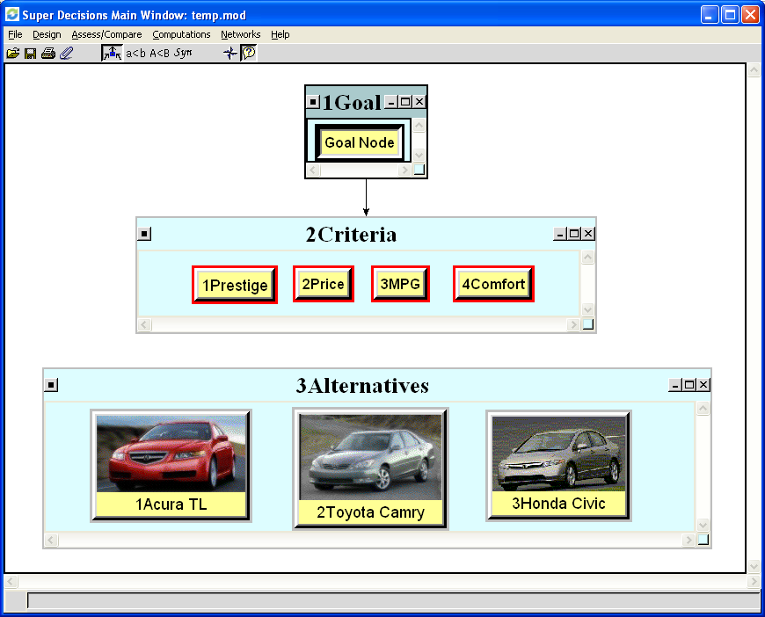
Connecting Nodes: Menu or Shortcut
1
Click the “Make connections” icon to depress it and enter the shortcut “make connections” mode.
2
Left-click the “from” node Selected nodes are depressed and outlined in black
3
Right-click each “to” node (which outlines them in red)
4
Line then automatically appears from Goal cluster to Criteria cluster
To input a picture for a node or cluster icon use the Design>Node>Edit command , click, the Change Icon command and select a picture. To add your own pictures to the available collection, copy your picture files into the C:/Program Files/Super Decisions/Icons folder (*.gif files work pretty well).

Slide 14
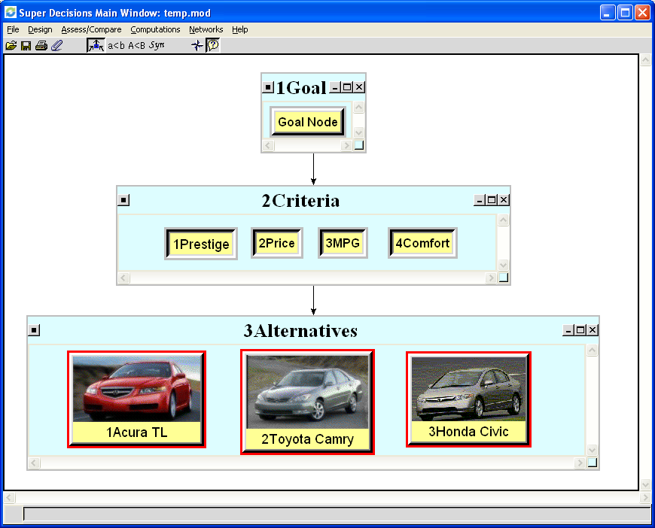
Connect Criteria Nodes to Alternative Nodes
SHORTCUT to connect many nodes at once
Shift left-click on any “from” node in a cluster - selects all nodes
Shift right-click on any “to” node connects all “from” nodes to all “to” nodes
Line automatically appears between clusters

Slide 15
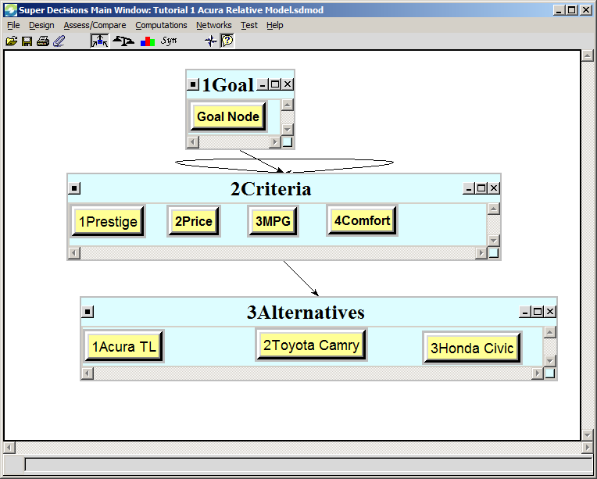
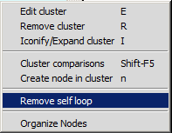
Remove Unintended Loops
A loop will appear on a cluster when a node or node(s) are connected to other node(s) in the same cluster.
REMOVING LOOPS
Right click on the background of the cluster with the loop and select the Remove self loop command.

Slide 16
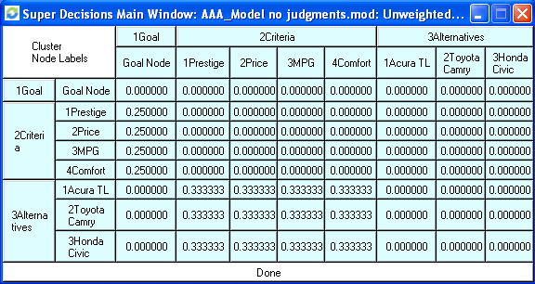
Unweighted Supermatrix before making any pairwise comparisons
The nodes connected from a node are shown in the column below that node; for example, the Goal node is connected to the criteria nodes and they are equally weighted at .25 before making pairwise comparisons. Supermatrices are square; every node appears as a column and a row. The priorities, that add up to 1.0, are read from the columns.
Cluster names
Node names
Priorities of Criteria nodes

Slide 17

Making Pairwise Comparisons
Click on the Goal Node to select it.
Click the pairwise comparison/assessment icon on the menu bar to enter the assessment mode or use the Assess/Compare command.
The Questionnaire Pairwise Comparison Mode opens by default. Click on the Matrix tab to switch to the Matrix Mode.

Slide 18
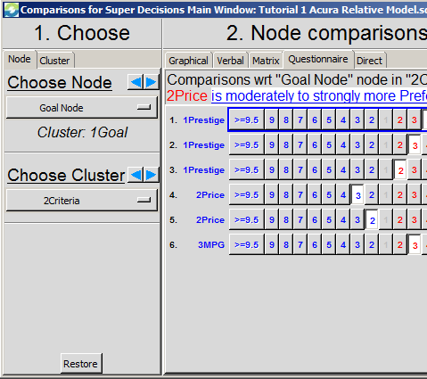
More About the Compare/Assess Mode
There are 5 possible modes for entering assessments;
judgments entered in one mode will appear as the
equivalent judgment in any other mode.
Choose tab indicating whether comparing nodes or clusters (cluster comparisons not possible in hierarchies)
Selector for parent node of comparison
Selector for cluster containing nodes linked from parent node, to be compared with respect to it
Restore button will bring back original judgments for selected comparison group when revisiting comparisons

Slide 19
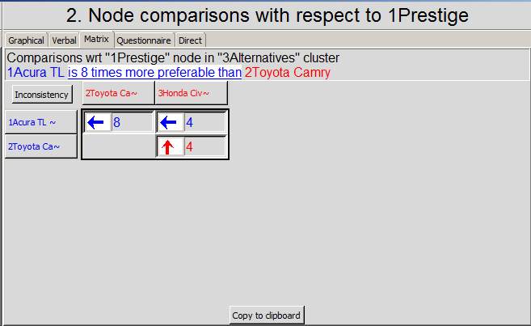
Example of a Pairwise comparison Matrix in SuperDecisions and in traditional AHP
In the AHP Theory
view you see 9 judgments
Only 3 judgments
are necessary
 | Acura | Civic | Camry
Acura | 1 | 8 | 4
Civic | 1/8 | 1 | 1/4
Camry | 1/4 | 4 | 1
Diagonal elements are always 1, so they do not need to be displayed. The elements below the diagonal are always inverses of the judgment in the reciprocal cell above, so they do not need to be displayed (e.g. 1/8 8).
a_{ij} = 1/ a_{ji}
AHP reciprocals are shown in red in SuperDecisions. For example, 4.0 means for1/4.

Slide 20
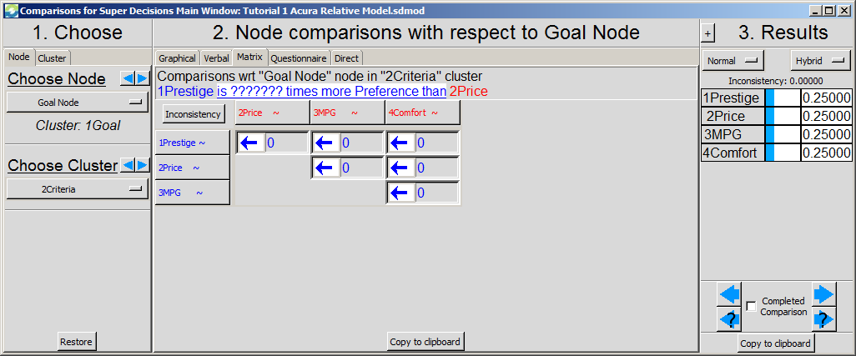
Start Making Pairwise Comparisons
Left-click on Goal node to select it
Left-click on “make assessments” icon Comparison/Assessment Questionnaire mode appears.
Switch to the Matrix mode by clicking on matrix tab. Change the comparative phrase 1Prestige is ????times more Preference than 2Price by left-clicking on it and choosing importance.
.
Note the copy commands. You can then paste into Excel or Word.

Slide 21
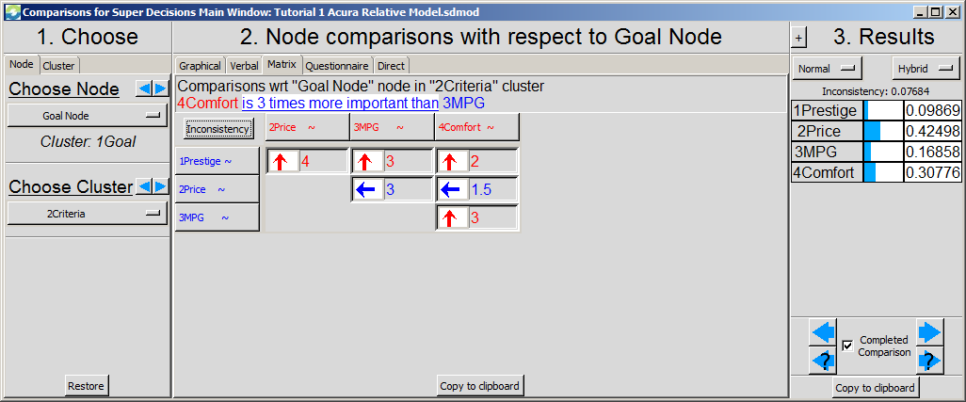
Enter Judgments (Matrix Mode)
Enter judgments in cells by typing numbers from Fundamental Scale. The direction of the arrow indicates which criterion is more important. Double-click on arrow to change dominance direction. The first element in the comparative phrase is the dominant one. Up arrows are red, down arrows are blue.
The current parent node is the Goal node and the Criteria nodes are being compared with respect to it for importance. The inconsistency should be less than 0.10.
Inconsistency=0.07685; Derived Priorities
Mark completed and move to next comparison

Slide 22
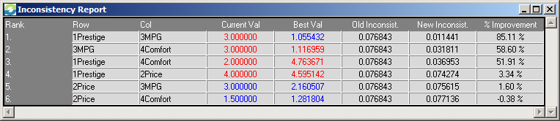
Improve Consistency
(available only from Matrix Mode)
Click on the Inconsistency button (at top left corner of matrix)
Choose Basic Inconsistency Report; the first cell, Prestige versus MPG, currently has a red 3 in it meaning that MPG are more important than Prestige (see previous view of matrix), but the Best Value of 1.05 (in blue) means Prestige is a little more important than MPG and the inconsistency would be improve down to 0.01 if that were the judgment
Left-click on either the Current or Best Value cell to return to the matrix and input a new value . You can use the suggested value, or a value between it and the original value, or leave it as it is and go to the number 2 most inconsistent judgment (MPG versus Comfort) and change that, and so on. See next slide.

Slide 23
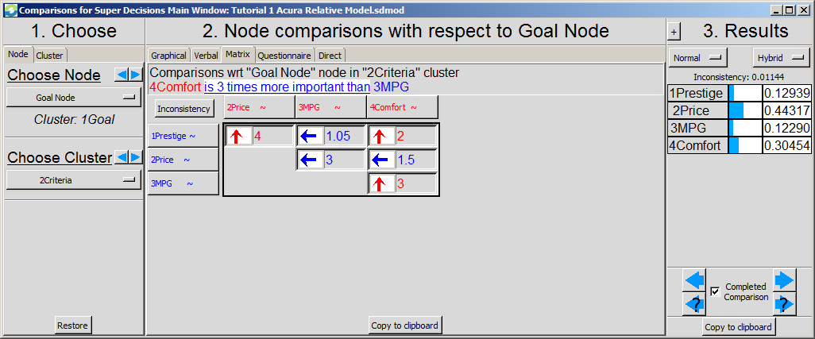
Matrix View after Improving Judgment of MPG vs Prestige
Although the original inconsistency of 0.07 passes the .10 test, it can be improved.
New judgment
Better Inconsistency of 0.01.

Slide 24
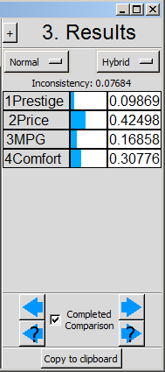
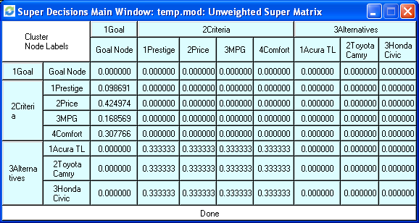
Derived Priorities are placed in Supermatrix

Slide 25
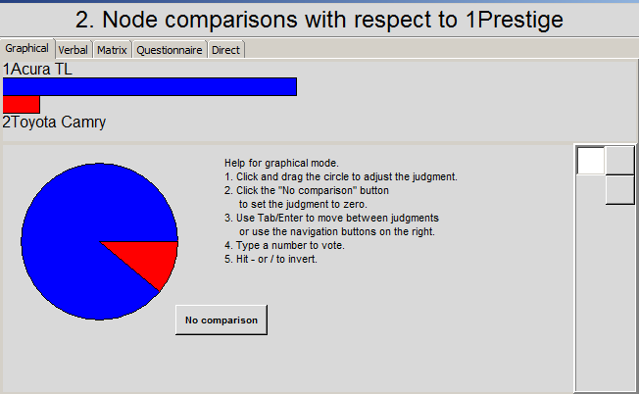
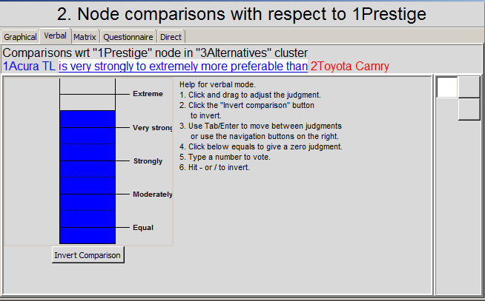
Other Comparison Modes
Graphical
Click and drag on circle (NOT the bars) to change judgment
Verbal
Tracking ☹ – shows which judgment you are on in equivalent matrix view
Click button to invert dominance

Slide 26
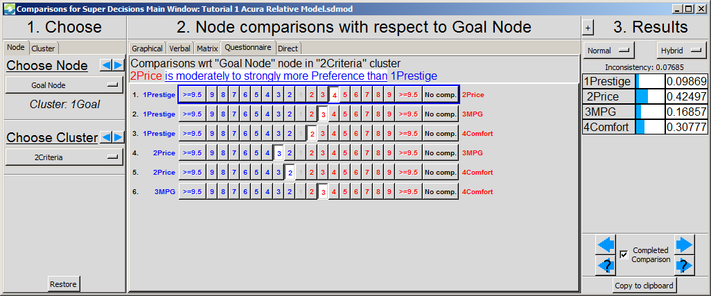
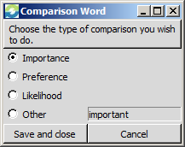
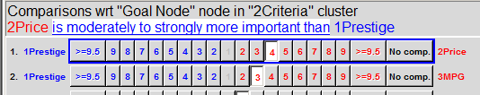
The Questionnaire Mode
The Assessment/Compare command opens the pairwise comparison mode by default. Choose the judgment on the left or right side of the zero on the questionnaire line that is nearest to the more important, more preferred, or more likely, node. Here price is more important than prestige. If necessary, and it is here, change the verbal phrase so it reads correctly, as explained below.
In the view above the questionnaire opened with the wrong dominance word, “moderately to strongly more Preference”. Left click on the dominance phrase itself to get the menu of possible phrases and select the most appropriate word.

Slide 27
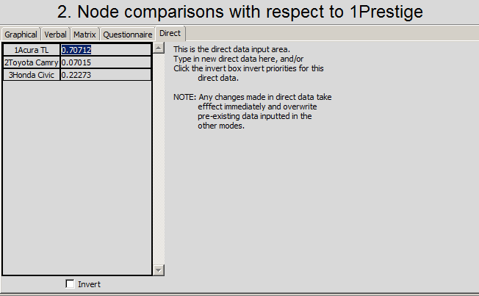
Direct Data Assessment Mode
Enter direct data in the Direct mode. It may be already normalized, as shown here, or it may be numbers representing costs or distances.
Important! Click <Enter> or move away from last judgment entered to make sure it has registered
Click the Invert box when the priorities are inversely related to the data such as distance, farther is lower priority, or cost, more expensive is lower priority.

Slide 28
Weaknesses of using Direct Data
Data may not be as good as judgments in determining your personal priorities. It would usually be better to use your judgment about what the price of a car means to you rather than use the the data directly. Suppose you are a poor college student. See the two results below. Which do you think more accurately reflects the reality?
Comparing cars for price using judgments
Priorities from judgments
Priorities from data

Slide 29
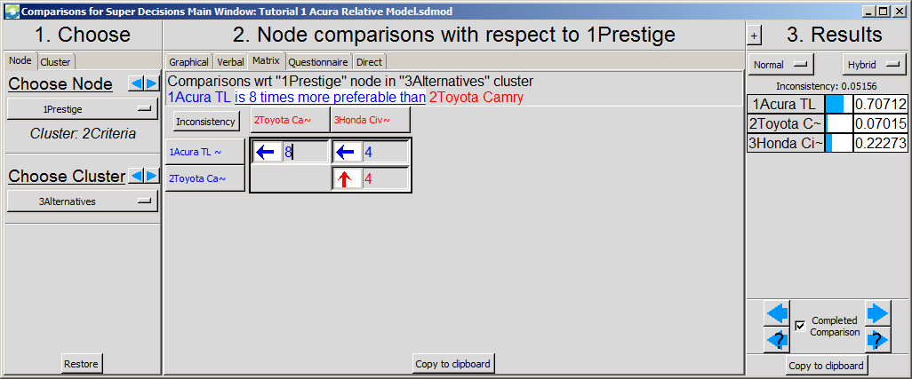
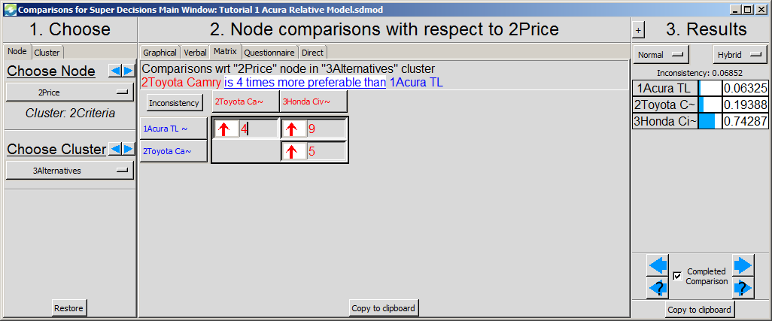
Compare Cars for Prestige and Price
Prestige Comparisons
Price Comparisons

Slide 30
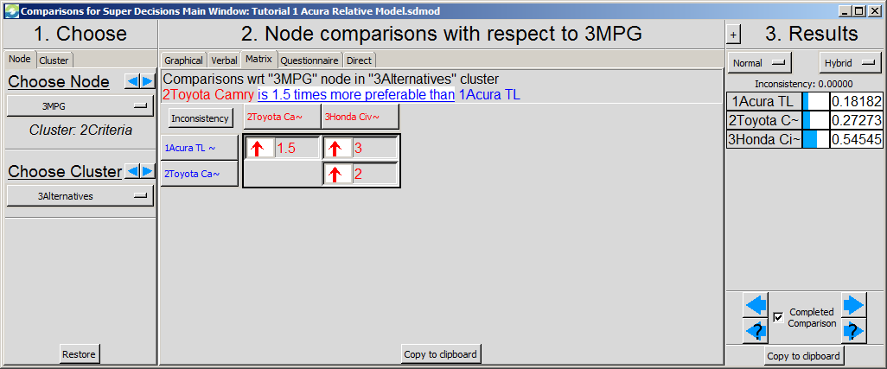
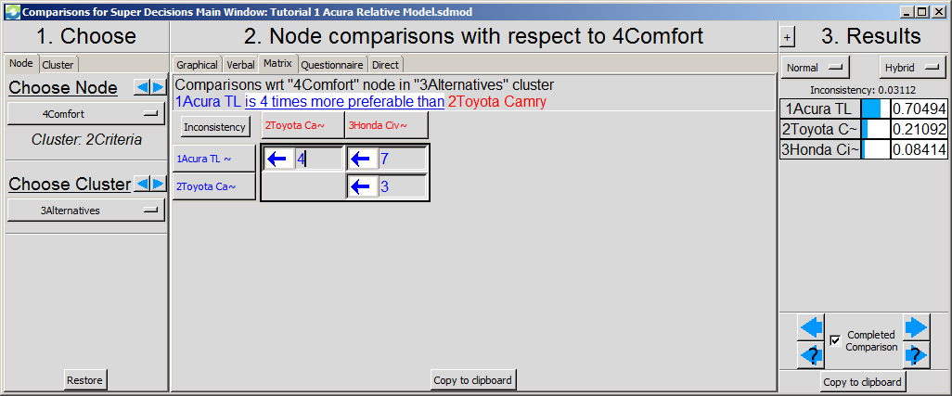
Compare Cars for MPG and Comfort
MPG Comparisons and Priorities
Comfort Comparisons and Priorities

Slide 31
The Supermatrices
Computations>Unweighted Supermatrix: matrix containing the priorities from the pairwise comparisons.
Computations>Weighted Supermatrix: The unweighted supermatrix components have been multiplied by cluster weights. In a hierarchy there are no cluster weights and the weighted supermatrix is the same as the unweighted.
Computations>Limit Supermatrix: The limit matrix is obtained by raising the weighted supermatrix to powers until it converges to give the answer.

Slide 32
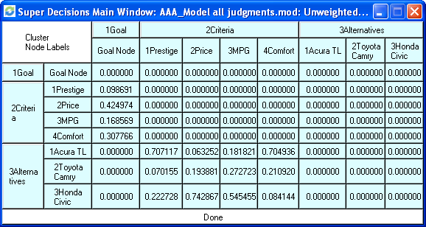
The Unweighted Supermatrix after all Judgments Completed

Slide 33
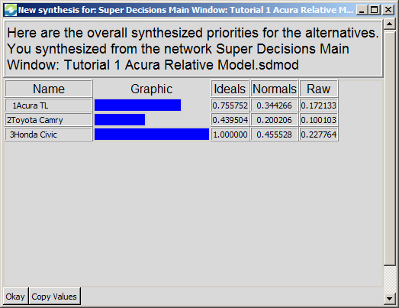
Synthesize to get Overall Results
Select Computations>Synthesize or click to get the final results: the priorities of the alternatives. You MUST name the Alternatives cluster with some variation of the word alternatives to get an answer.
Acura TL 0.344
Toyota Camry 0.200
Honda Civic 0.456
The Raw values come from the Limit Supermatrix. The Normalized values are obtained from them by summing and dividing each by the sum. The Ideals are obtained by dividing the Raw values by the largest Raw value

Slide 34
Sanity Check
The Computations>Sanity Check will reveal incomplete comparisons and duplicate goals, among other things. Each time you finish a set of comparisons you must mark it complete before proceeding to the next set. Unintentionally skipped comparisons will also be caught by the Sanity Check.

Slide 35
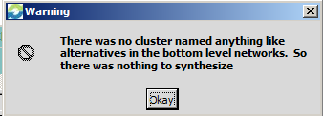
WARNING! No Alternatives Found
This error message will appear if there is no cluster named some version of the word alternatives, IN ENGLISH, but for example, 3alternatives is an acceptable name. The SuperDecisions software uses this word to find for which nodes it should deliver synthesized priorities extracted from the raw values in the limit supermatrix. To obtain synthesized priorities for any other nodes go to the limit supermatrix, get the raw values, and normalize them yourself. The Normals are the raw values divided by their sum. The Ideals are the raw values divided by the largest raw value.

Slide 36
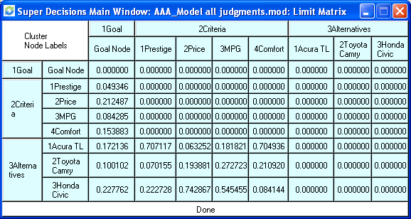
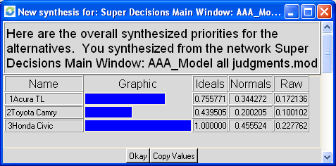
Results obtained from Limit Supermatrix

Slide 37
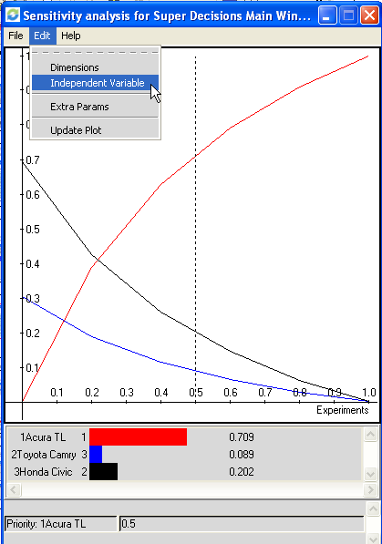
Graphical Sensitivity
To do graphical sensitivity select the Computations>Sensitivity command
Select Edit>Independent Variable to get to the Sensitivity input selector box and change the Independent Variable to the Goal.
The first graph that appears has the first node, alphabetically, selected as the “with respect to” node. It is generally not the one you want. Here you need to select the Goal, not the Acura TL, as the independent variable

Slide 38
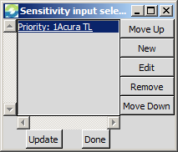
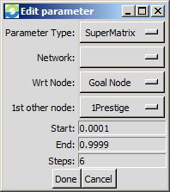
Graphical Sensitivity (cont’d)
Step one. Select the Edit>Independent Variable command
Step two. In the Selected Node box highlight the current node (Acura) then lick Edit.
Step three. In the Input Parameter Box select Parameter Type: Supermatrix, the Goal as Wrt Node (“with respect to”) and select one of the criteria as the 1st other node, for example, choose Prestige. Click on the button to the right to get the drop down box with the other choices.

Slide 39
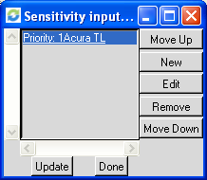
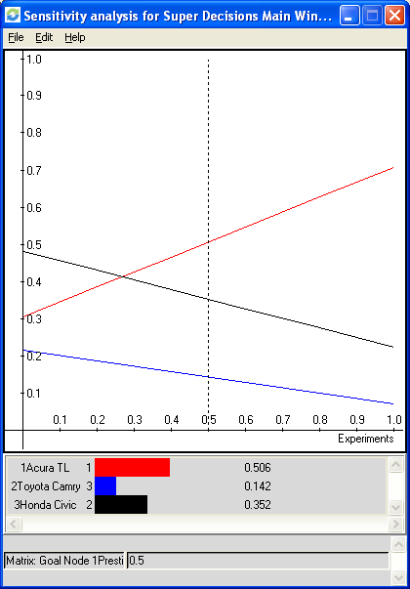
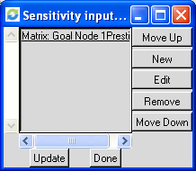
Getting Sensitivity Graph for Prestige
Show Selected Node Box
Set Parameters Box
1
2
Sensitivity Graph for Selected node(s)
Updated Parameters – click Update for results
Priority of Prestige is given on x-axis; vertical line starts at Prestige priority of 50%; car priorities for Prestige=50% priority are shown by intersections with vertical line.
3
4

Slide 40

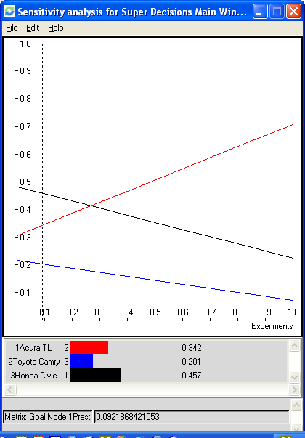
Interpreting Sensitivity of Prestige
At Prestige = 50%, Acura is best
At Prestige = 9.2% (actual priority in model), Civic is best
Click and drag vertical line to change priority of Prestige on horizontal axis from 0.5 to 0.1.
The analysis: If your priority is less than about 25% for Prestige, the Honda is the car to buy. For any priority greater than that, the Acura is your best car.

Slide 41
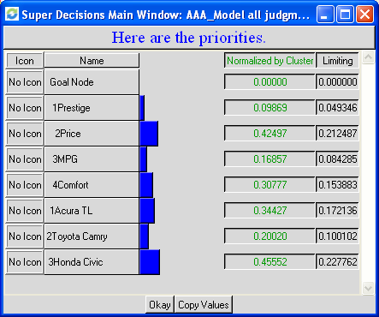
Priorities of all Nodes in Model
Select Computations>Priorities command to see the priorities of all nodes in model
“Limiting priority” column shows priority of Prestige compared to all the other nodes in the entire model.
“Normalized by Cluster” column shows the priority of Prestige (.096) compared to the other criteria in its cluster.
Drag the vertical line from .5 to .096 on the x-axis in Sensitivity to show the priorities of the cars at the model priority of .096 for Prestige.

Slide 42
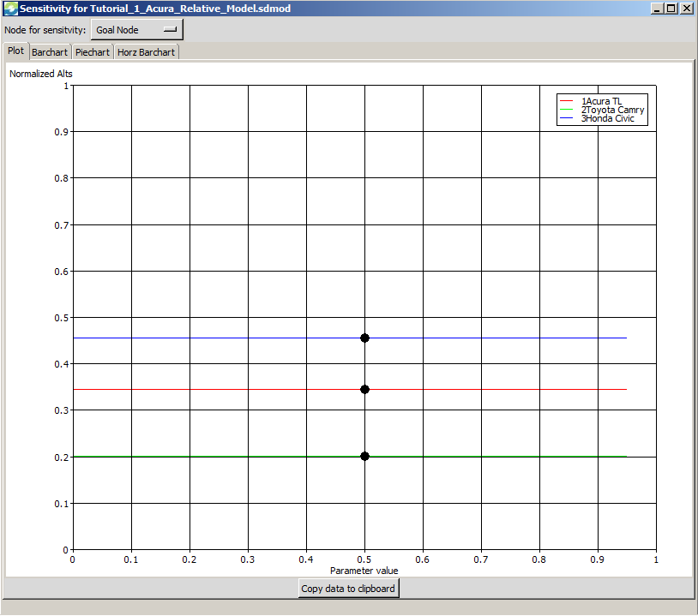
Dynamic Sensitivity
Select Computations>New Sensitivity to get into Dynamic Sensitivity Mode
Click on “Node for Sensitivity” selector button at right and change from Goal Node, shown here, to 1Prestige.

Slide 43

Dynamic Sensitivity - Prestige
The Prestige parameter can be dragged from 0.00 to 1.00. At 0.50, the priorities of the cars are the same as the overall synthesized result priorities of 0.344, 0.200 and 0.456.

Slide 44

Dynamic Sensitivity
At a parameter value of 1.00 for Prestige the most prestigious car, the Acura is clearly the best choice.

Slide 45

Putting Subcriteria into a Hierarchical Model
Create separate clusters for the subcriteria of the criteria that will have subcriteria.
Price has subcriteria of initial cost and maintenance, which then connect to the cars.
Comfort has subcriteria of Ride and Driving Performance which then connect to the cars.
Prestige and MPG have no subcriteria and connect directly to the cars.

Slide 46
Exporting Supermatrices
The following files may be exported as .txt files using the File>Export command:
Unweighted Supermatrix
Weighted Supermatrix
Limit Supermatrix
Cluster Matrix
Import into Excel using the File>Open command. Launch Excel. File>Open and be sure to select All Files for type of file so the .txt file you exported will appear. Click yes throughout the wizard to open the exported supermatrix in an Excel spreadsheet.

Slide 47
Reports
The Computations>Full Report command and the File>Print command both generate the same HTML file of reports about the model. You may use the Print Preview version, or save as a .html file. The report gives the names and descriptions of the nodes and clusters and important priorities.

