Slide 1

Installing VS Code and Python

Slide 2
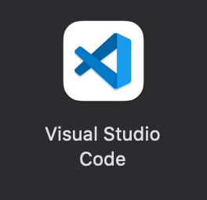

VS Code
VS code is a code editor developed and released by Microsoft, it is free and open-source. The most up-to-date version for downloading is available on the official website of visual studio
https://code.visualstudio.com
MAC:
Download and save the VS code installer for macOS (VSCode-XXX-Universal.zip) to your computer.
Copy the downloaded "Visual Studio Code" from the Downloads folder to the Applications folder.
Open the application by double clicking the VS Code icon
Open the application by double clicking the VS Code icon
MAC
Windows
Notes:
Ask to download before coming to the setup session

Slide 3



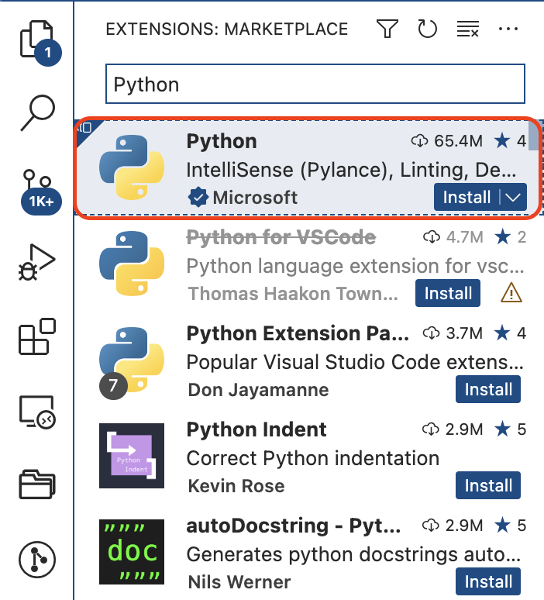
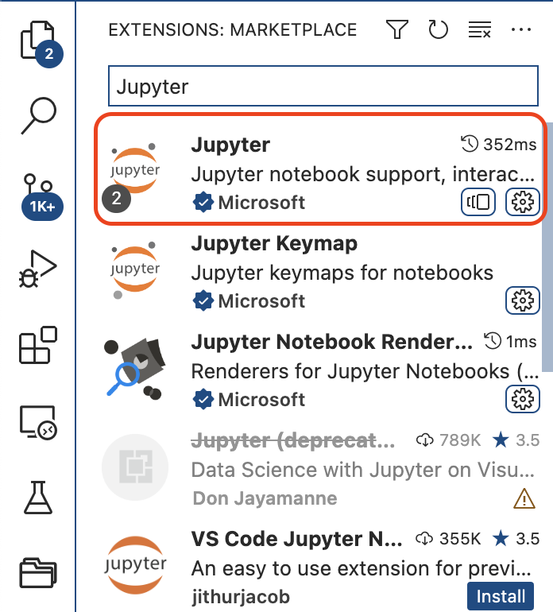



Python and Jupyter
Click the Extensions icon on the left side of VS Code to go to the Extensions Marketplace.
Next, search for Python in the marketplace, find Python published by Microsoft. Then click the install button next to Python. Once the installation is finished, the install button will change to a Manage icon.
Next, search in the same location, the marketplace, for Jupyter and install the package that is published by Microsoft by clicking install.
MAC
&
Windows

Slide 4
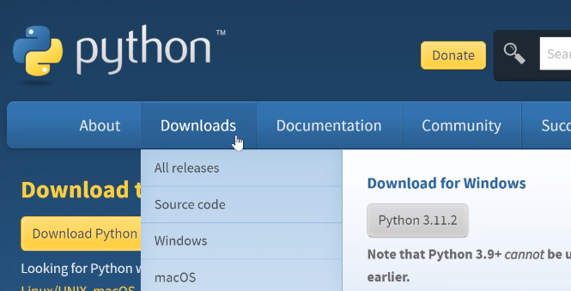
Python interpreter
Next, we will install the python interpreter from the Python official website
https://www.python.org
MAC:
In the Download section, select your system macOS to download the latest version of Python.
Double click the downloaded installer to complete installation. You will need admin access for the installation.
In the Download section, select your system macOS to download the latest version of Python.
Double click the downloaded installer to complete installation.
Make sure to check the “Add .exe to PATH” option
MAC
&
Windows
MAC
Windows

Slide 5
On Mac

Slide 6
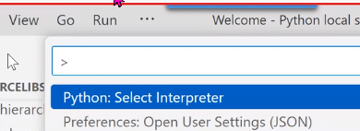

Validate installation
Activate Python by using the Select Interpreter command from the
View – Command Palette
And choosing the python version you just installed
To validate whether Python has been successfully installed in your computer, inside VS code, open a terminal through "Terminal->New Terminal" menu and then run the following command.
python3 --version
Press Enter key to run the command
Create a new .ipynb file and type
print(“hello world”)
Execute the command and see the results in the terminal
If you get a “Python not found error” look at the bottom corner of your screen, you probably will see a “Select Interpreter” message. To fix it, you will need to follow the 1st step on this page

Slide 7
On Windows

Slide 8
Validate installation
Activate Python by using the Select Interpreter command from the
View – Command Palette
And choosing the python version you just installed
To validate whether Python has been successfully installed in your computer, inside VS code, open a terminal through "Terminal->New Terminal" menu and then run the following command.
python --version
Press Enter key to run the command
Create a new .ipynb file and type
print(“hello world”)
Execute the command and see the results in the terminal
If you get a “Python not found error” look at the bottom corner of your screen, you probably will see a “Select Interpreter” message. To fix it, you will need to follow the 1st step on this page

