Slide 1
Cereal Industry Market share
Goal: Forecast Cereal industry marketshare
Alternatives:
Kellogg
General Mills
Post
Quaker

Slide 2
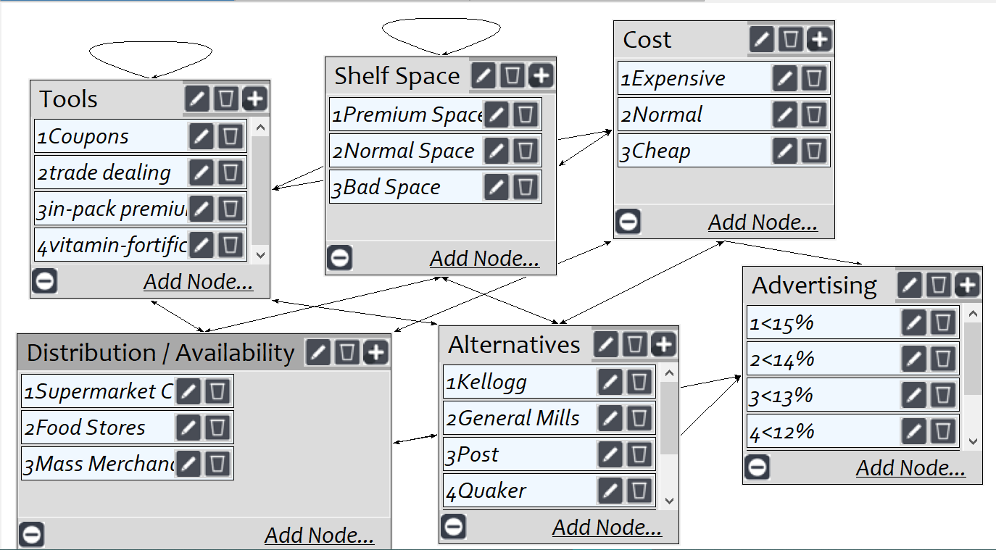
Model
Screenshot of SuperDecisions software Version 3.x

Slide 3
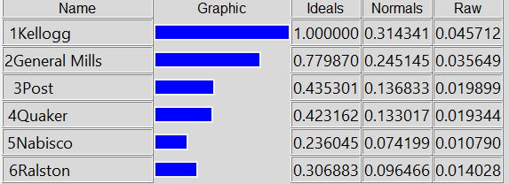
Results

