Slide 1
Big Burger Market share
Goal: Forecast big burger’s market share
Alternatives:
MacDonals
Burger King
Wendy’s

Slide 2
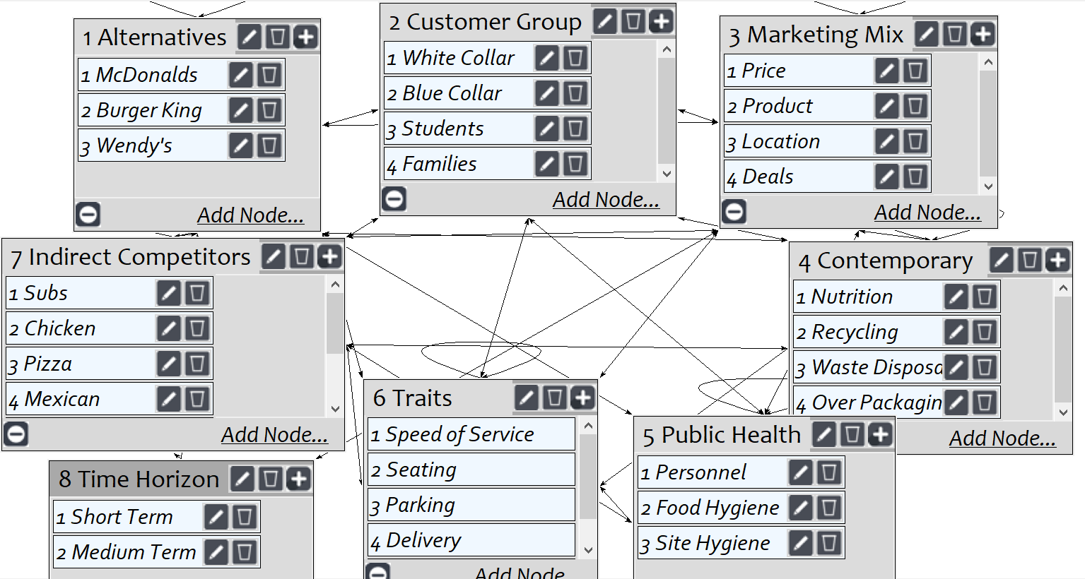
Model
Screenshot of SuperDecisions software Version 3.x

Slide 3
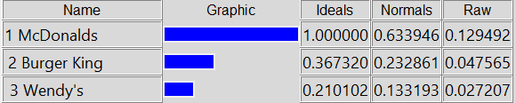
Results

