Slide 1
Determining Market Share of different categories of beer
Goal: Beer Market share
Alternatives:
Cheap Brew
Microbrew & Imports
Premium

Slide 2
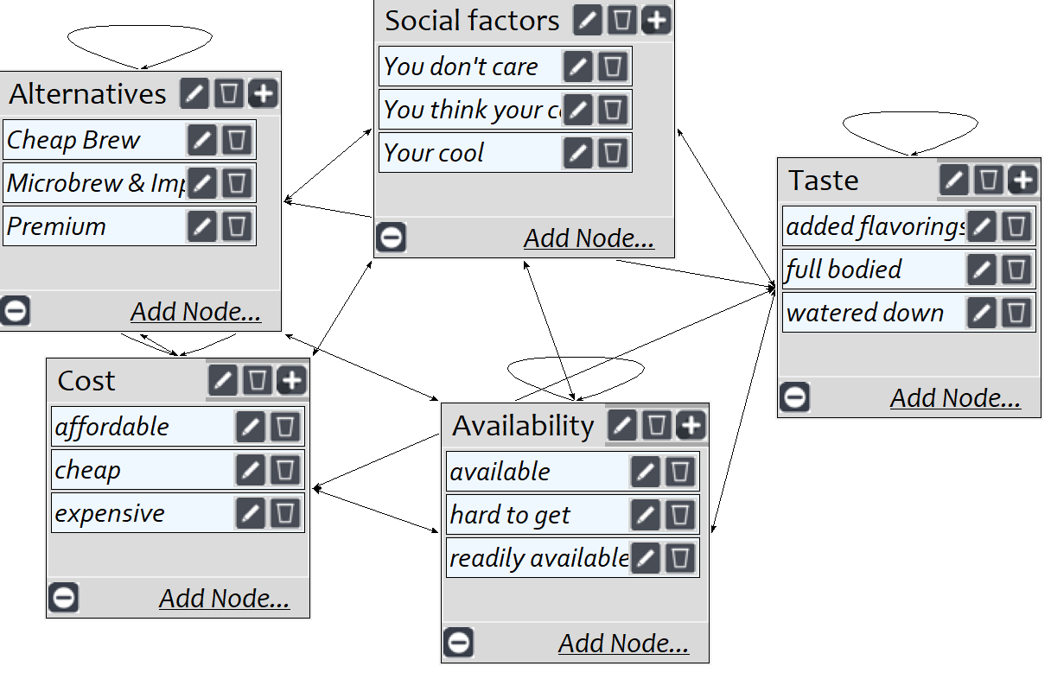
Model
Screenshot of SuperDecisions software Version 3.x

Slide 3
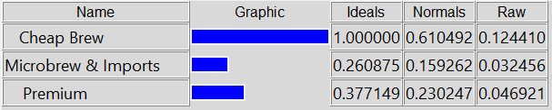
Results

