Slide 1
Determining Market Share of Walmart, Kmart and Target
Goal: estimate the current relative market share of Walmart, Kmart and Target.
Alternatives:
  Walmart
  Kmart
  Target

Slide 2
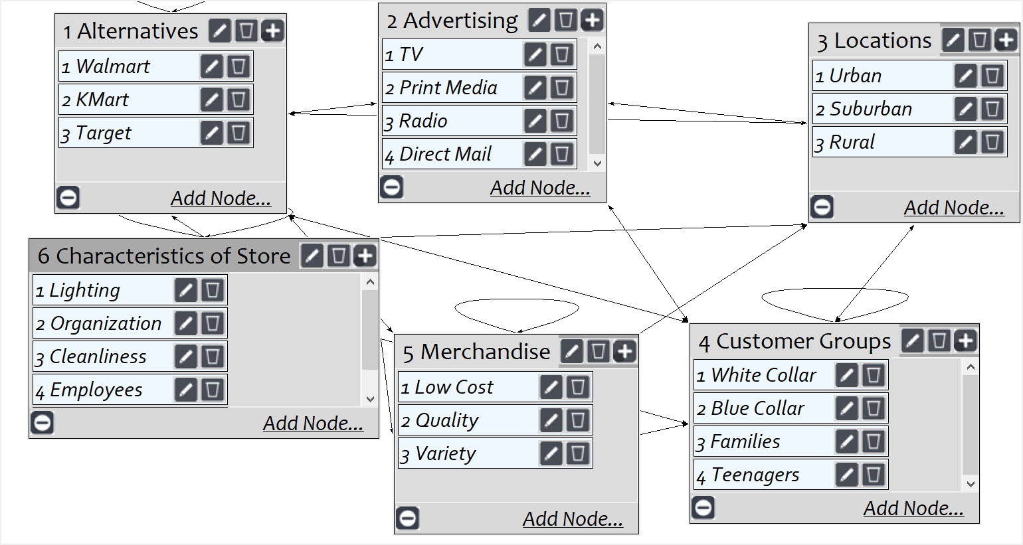
Model
Screenshot of SuperDecisions software Version 3.x

Slide 3
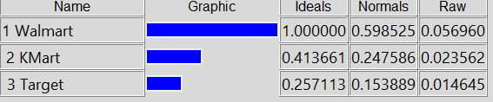
Results

