Slide 1



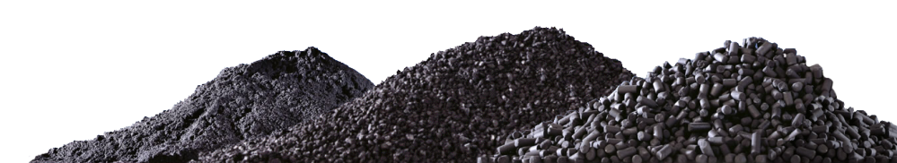
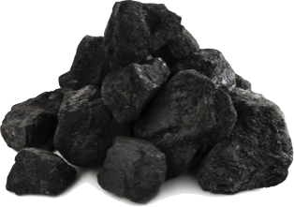
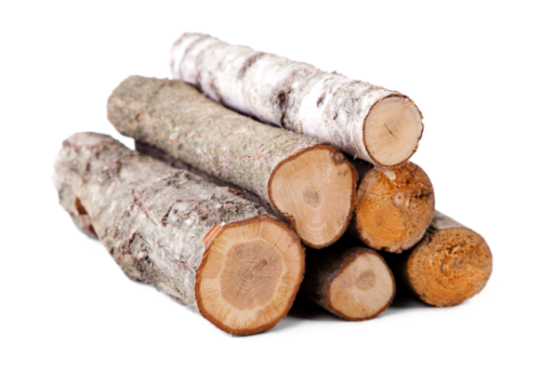
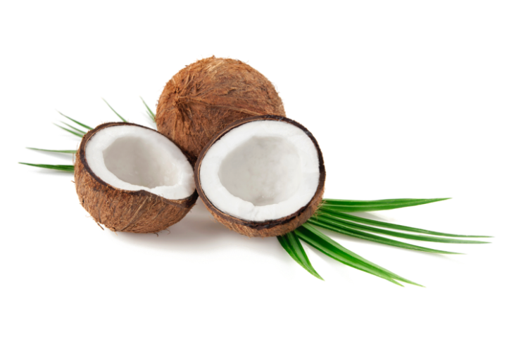

US Activated Carbon Manufacturers
EXTRUDED
GRANULAR
POWDER
Automotive
Drinking Water
Food & Beverage
Industrial
Pharmaceutical
Car manufacturers use AC to limit emissions, improve air quality and provide advanced battery technology to industry
Provide clean, safe drinking water
Purify products
AC is used to remove and recover contaminants from air emissions
AC is used to reduce environmental impact and allow wastewater reuse or disposal
AC is used in desiccant packs to control moisture. Poison control uses AC to remove ingested toxins.
By: Nicole Passarella

Slide 2
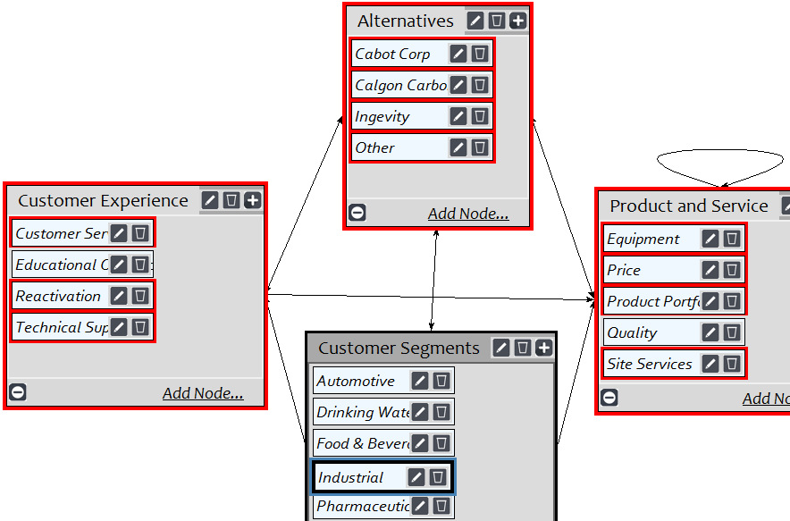
Market share is driven by a company’s whole product and service offering
Central cluster is customer segments
Main markets
How well an alternative supports segment in relation to clusters drives market share
Industry connection displayed
Criteria priorities by segment
Alternatives Priority | Normalized By Cluster | Limiting
Cabot Corp | 0.33187 | 0.131414
Calgon Carbon Corp | 0.46606 | 0.184553
Ingevity | 0.09832 | 0.038935
Other | 0.10375 | 0.041083
Customer Segments Priority | Normalized By Cluster | Limiting
Automotive | 0.09597 | 0.012668
Drinking Water | 0.26559 | 0.035057
Food & Beverage | 0.2253 | 0.029739
Industrial | 0.26893 | 0.035498
Pharmaceutical | 0.14419 | 0.019033
Product and Service Priority | Normalized By Cluster | Limiting
Equipment | 0.09853 | 0.029168
Price | 0.5218 | 0.154467
Product Portfolio | 0.11641 | 0.034462
Quality | 0.1545 | 0.045736
Site Services | 0.10876 | 0.032195
Customer Experience Priority | Normalized By Cluster | Limiting
Customer Service | 0.28935 | 0.050923
Educational Outreach | 0.11112 | 0.019557
Reactivation | 0.34172 | 0.06014
Technical Support | 0.25781 | 0.045373

Slide 3
The compatibility index shows that the ANP results are close to the actual market share
US Activated Carbon Manufacturers
 | Actual Mkt Share | Model Mkt Share
Calgon Carbon | 47.4% | 46.6%
Cabot | 33.9% | 33.2%
Ingevity | 8.3% | 9.8%
Other | 10.4% | 10.4%
Strong model as a result of working in the industry over the past 7 years
RESULTS
Number of Alternatives | 4
Sum of Matrix | 16.101492
Compatibility Index | 1.0063432

