Slide 1

Market Share of Infant Formula Companies in the United States
Katy Gallmeyer

Slide 2
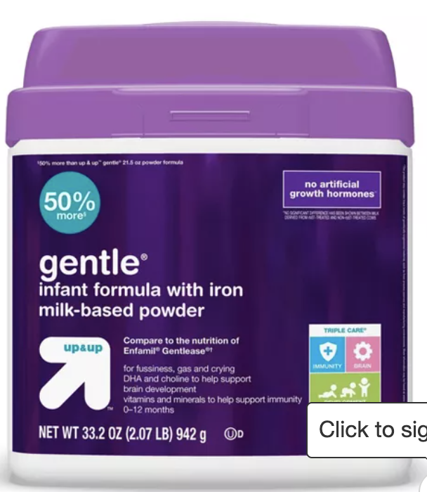
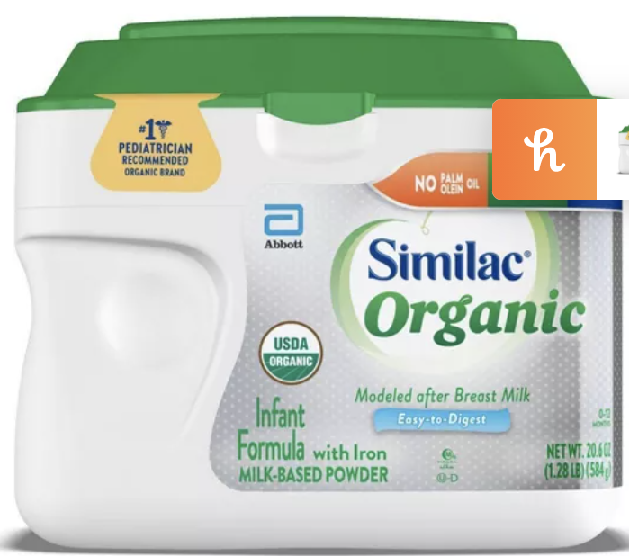
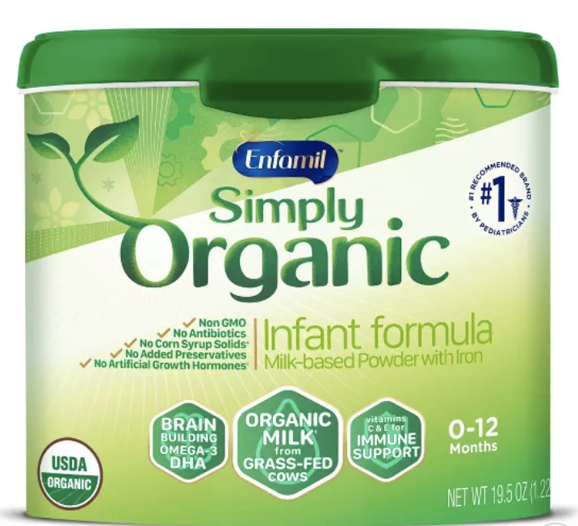
Who are the major players?
1. Similac (Abbott Laboratories)
60.3%
2. Enfamil (Mead Johnson)
25.1%
3. Perrigo LLC
14.6%

Slide 3
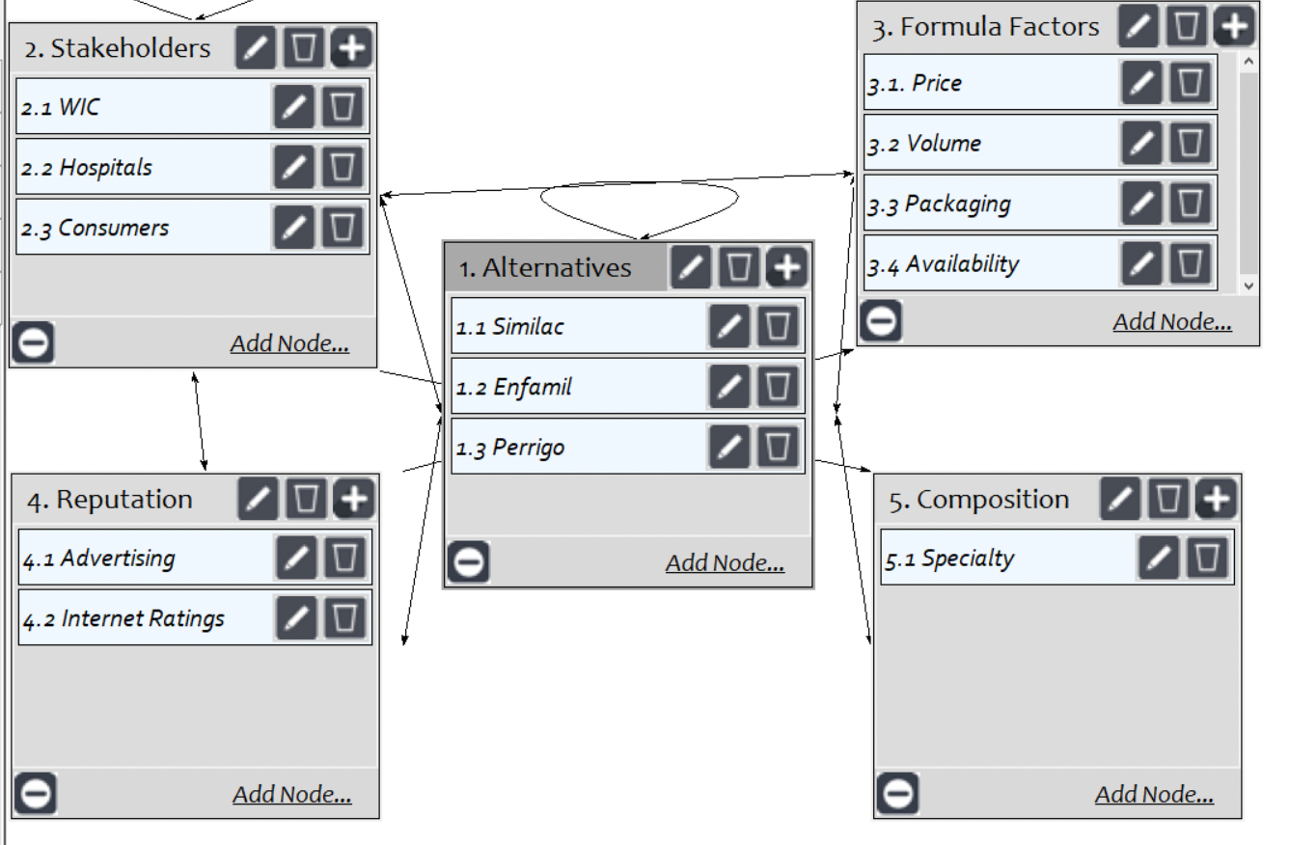
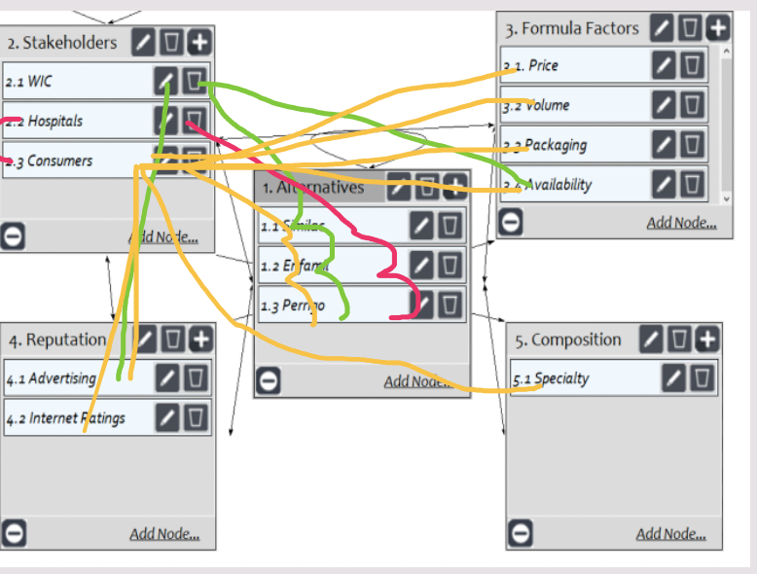
With respect to Similac, which stakeholder is most important when considering gaining marketing share? With respect to WIC, which alternative is the most preferred? By how much? With respect to consumers, price is [how much more important] than volume.

Slide 4
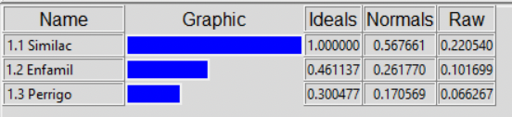
Market Share Actual | Superdecision Normalized Values | Compatability Index
.60351 | .567
.25094 | .261 | 1. 008
.14555 | .171

