Slide 1
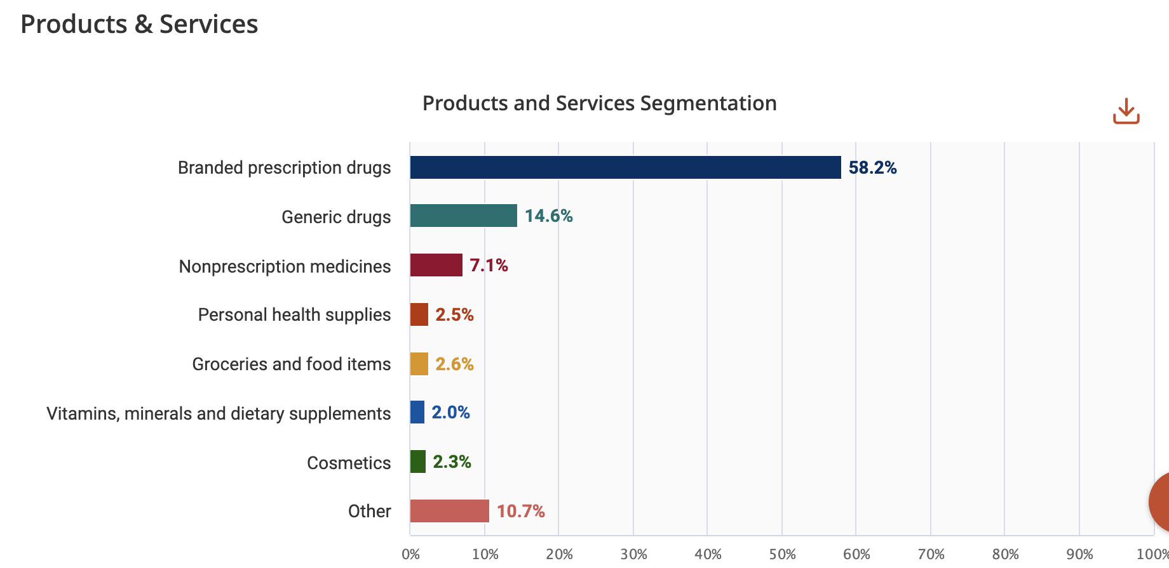

U.S. Retail Pharmacy Market Share Brian Donahoe
Three major competitors
Multiple inflows of revenue
Prescription drug- major activity of industry
High barriers to entry
Region specific dominance

Slide 2
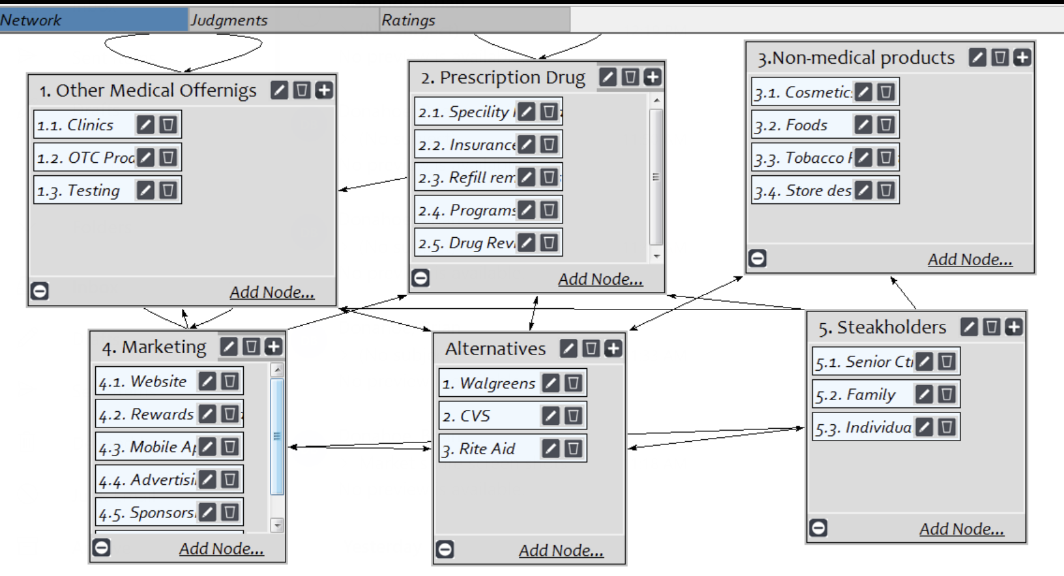



SuperDecisions Model
Alternatives
Walgreens
CVS
Rite Aid
Stakeholders
Senior Citizens
Family
Individual
Other Clusters
Other Medical Offerings
Prescription Drug
Non-medical Products
Marketing
Connections Discussion

Slide 3
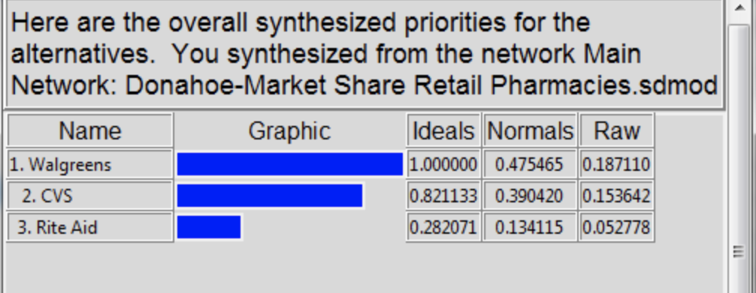
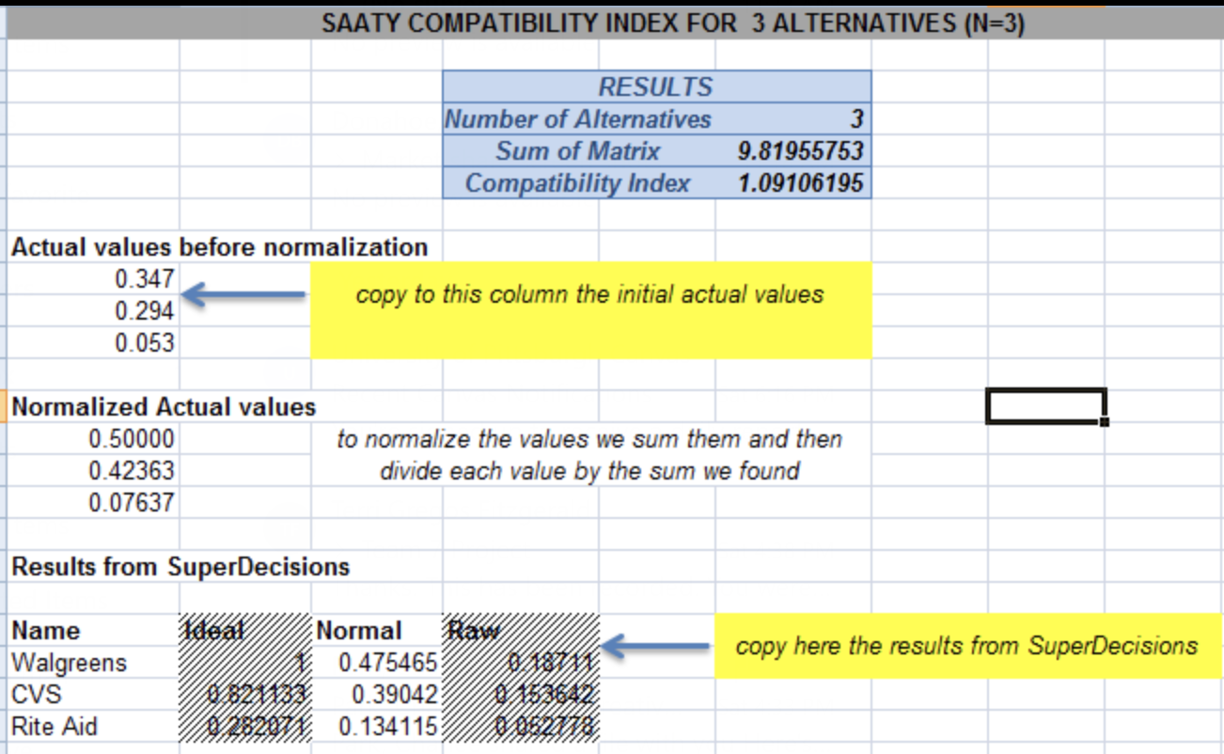
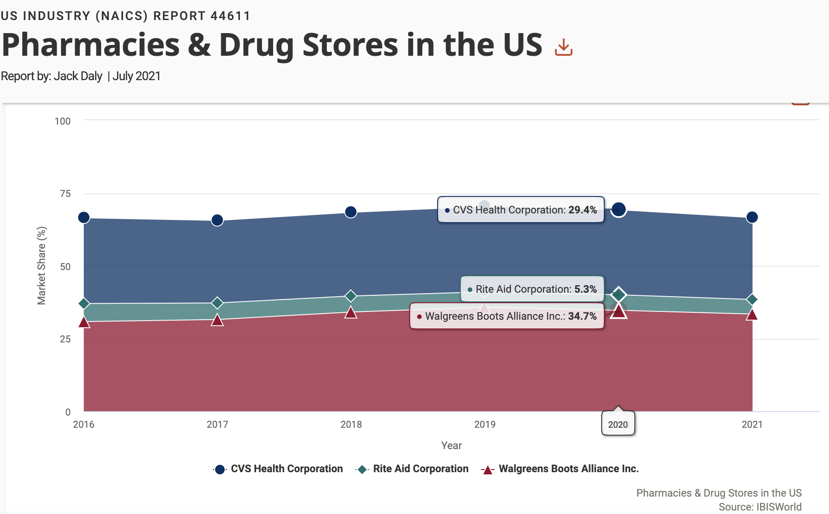
Comparison of Market Share Model
Number of Alternatives:
n=3
Compatibility Index:
1.091
Results:
Walgreens
CVS
Rite Aid

