Slide 1
ANP - MARKET SHARE OF WALMART,KMARTAND TARGET
ALTERNATIVES:
Walmart
Kmart
Target.

Slide 2
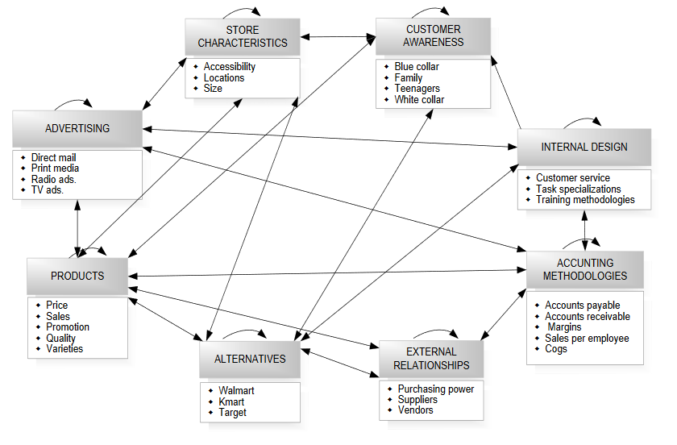
Model

Slide 3
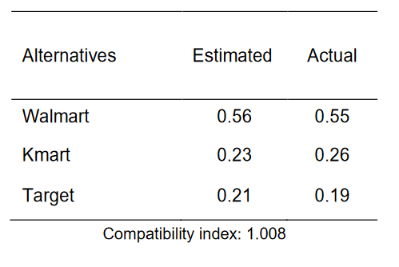
Results

