Slide 1
ANP - MARKET SHARE OF SPECIALTY RETAILERS
ALTERNATIVES:
Abercrombie& Fitch
American Eagle
Pacific Sunwear

Slide 2
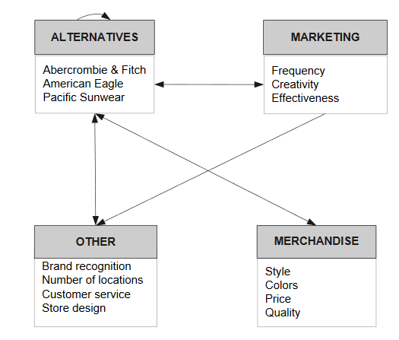
Model

Slide 3
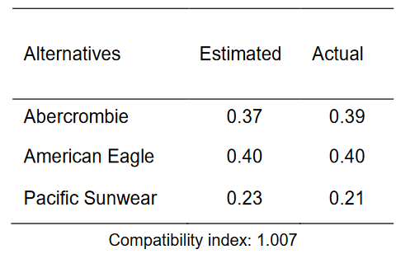
Results

