Slide 1
ANP - MARKET SHARE OF SOUP POWDERS
ALTERNATIVES:
  OMO
  Ariel

Slide 2
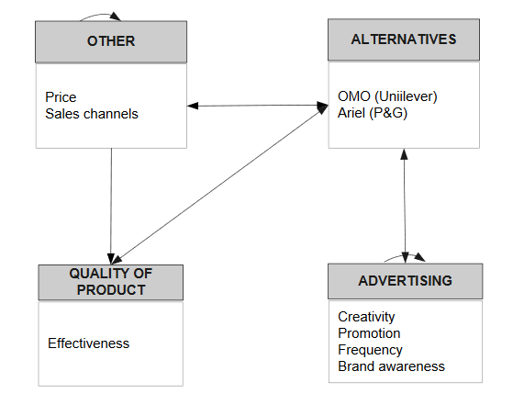
Model

Slide 3
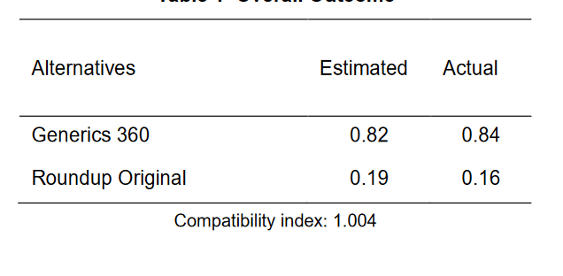
Results

