Slide 1
ANP - MARKET SHARE OF PC SELLING COMPANIES
ALTERNATIVES:
Dell
IBM
Toshib

Slide 2
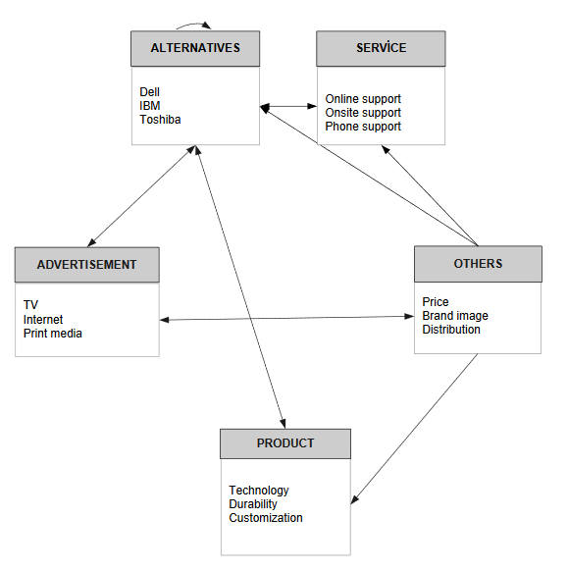
Model

Slide 3
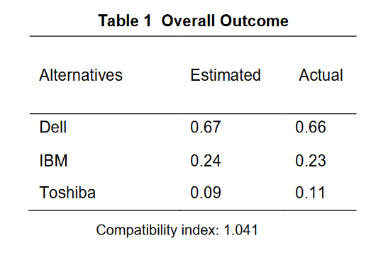
Results

