Slide 1
ANP - MARKET SHARE OF INTERNET CONNECTION METHODS
ALTERNATIVES:
  Internet Access through digital subscriber line (DSL),
  Internet access through cable
  Internet access through dial-up

Slide 2
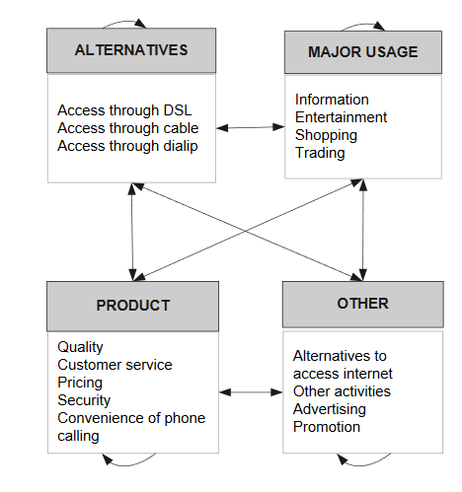
Model

Slide 3
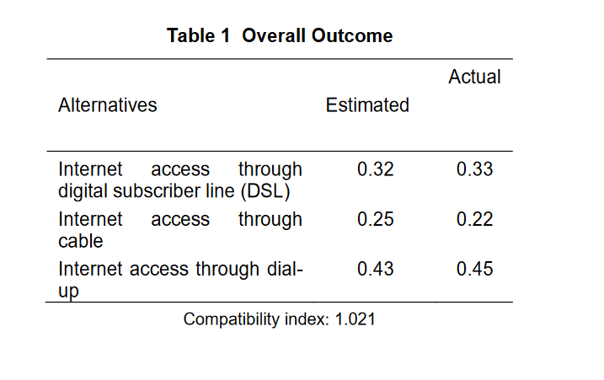
Results

