Slide 1
ANP - MARKET SHARE OF GLYPHOSATE
ALTERNATIVES:
  Generics 360
  Roundup Original
  Roundup Transorb
  Roundup WG
  Zapp Q

Slide 2
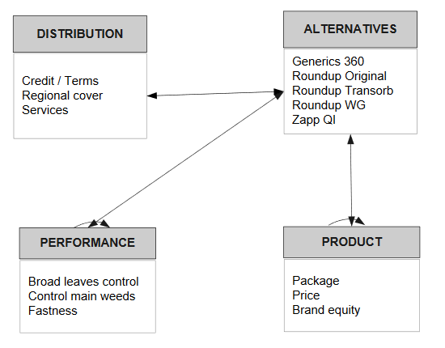
Model

Slide 3
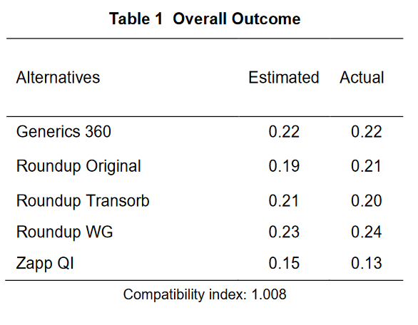
Results

