Slide 1
ANP - MARKET SHARE OF DVDPLAYERS
ALTERNATIVES:
Gradiente
Philips
L&G
Sony
Outros.

Slide 2
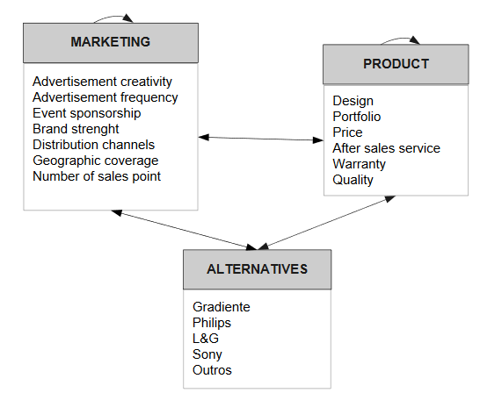
Model

Slide 3
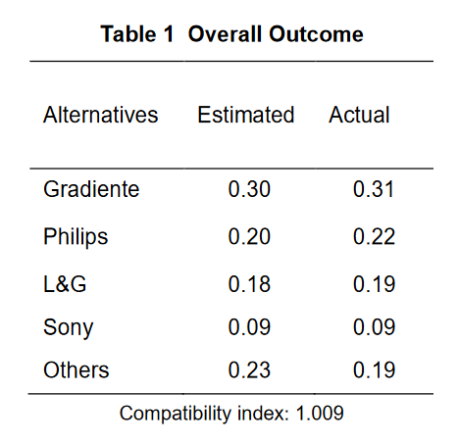
Results

