Slide 1
ANP - MARKET SHARE OF DOG TREATS
ALTERNATIVES:
Pupperoni
Beggin Strips
and Milk Bone Soft & Chew

Slide 2
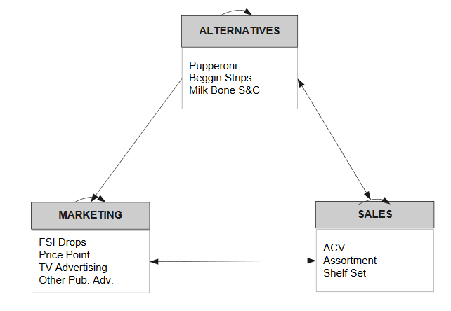
Model

Slide 3
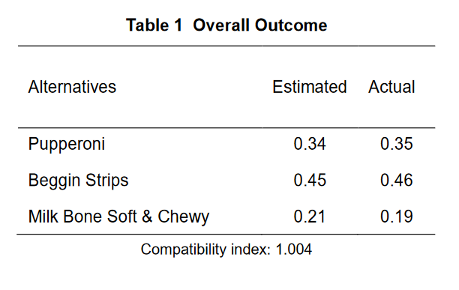
Results

