Slide 1
ANP - MARKET SHARE OF CEREAL INDUSTRY
ALTERNATIVES:
Kellogg
General Miles
Post
Quaker
Nabisco
Ralsto

Slide 2
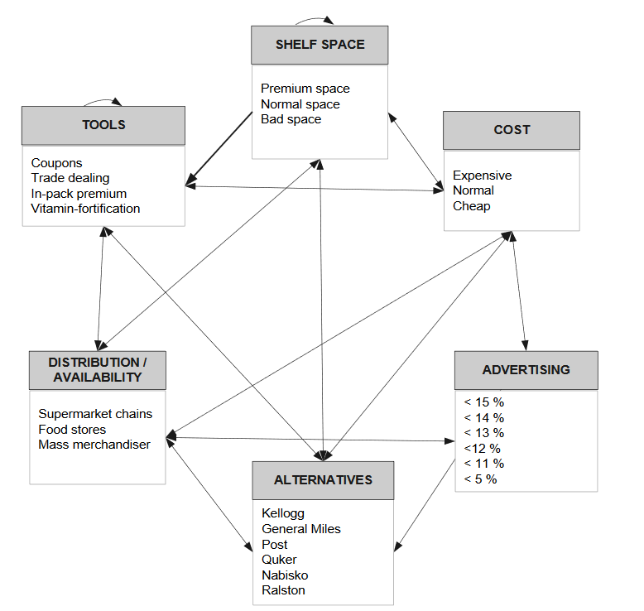
Model

Slide 3
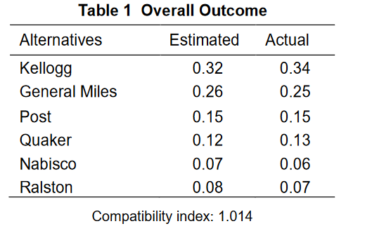
Results

