Slide 1
ANP - MARKET SHARE OF BEER MARKET
ALTERNATIVES:
  Skol
  Nova Schin
  Brahma
  Antarctica

Slide 2
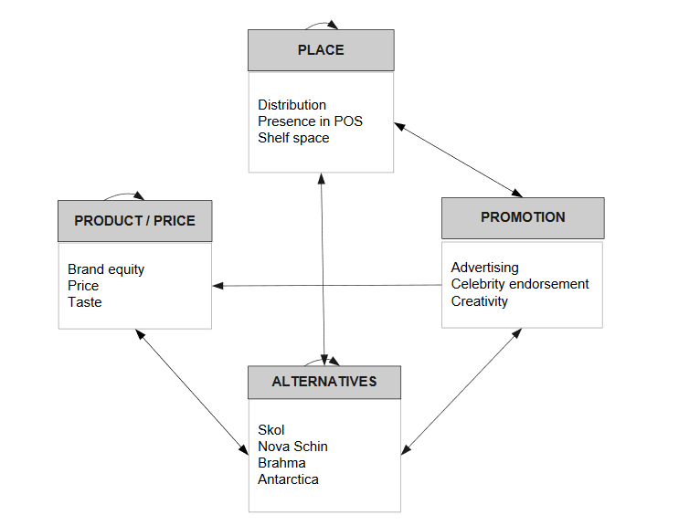
Model

Slide 3
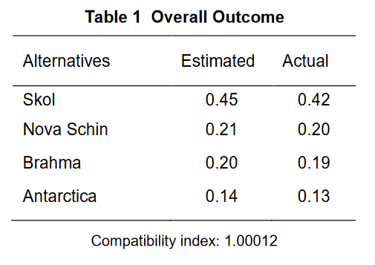
Results

