Slide 1
ANP - MARKET SHARE OF AUTOMOBILE PRODUCERS
ALTERNATIVES:
  Ford
  Fiat
  GM
  VW

Slide 2
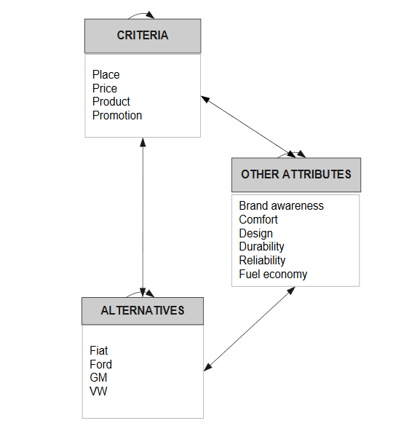
Model

Slide 3
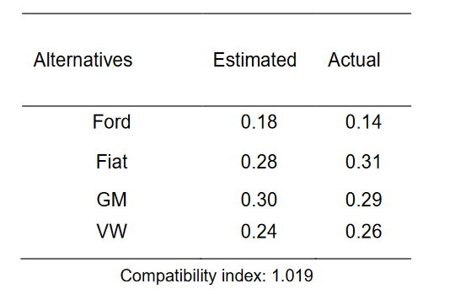
Results

