Slide 1
ANP - MARKET SHARE OF AUDIO SYSTEMS
ALTERNATIVES:
CCE
Philips
Gradiente
Panasonic
LG
Other

Slide 2
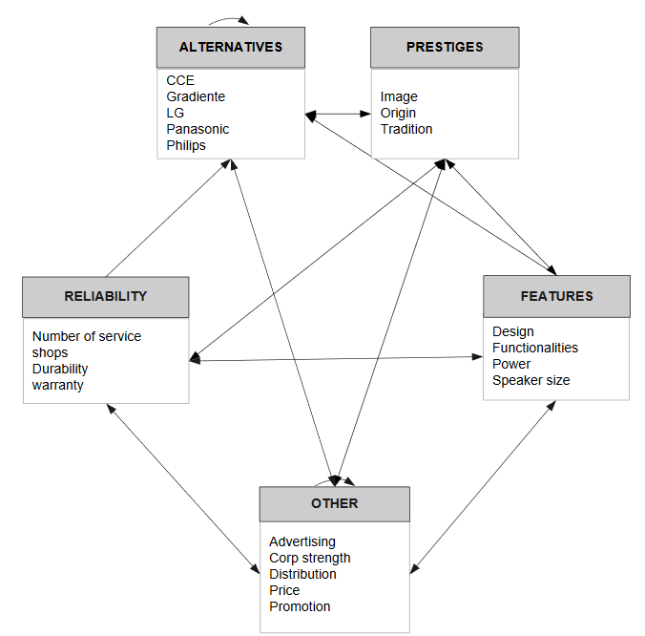
Model

Slide 3
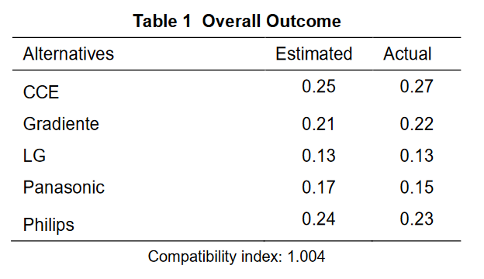
Results

