Slide 1
ANP - MARKET SHARE OF ATHLETIC SPORTS SHOES
ALTERNATIVES:
Nike,
Adidas,
Reebok

Slide 2
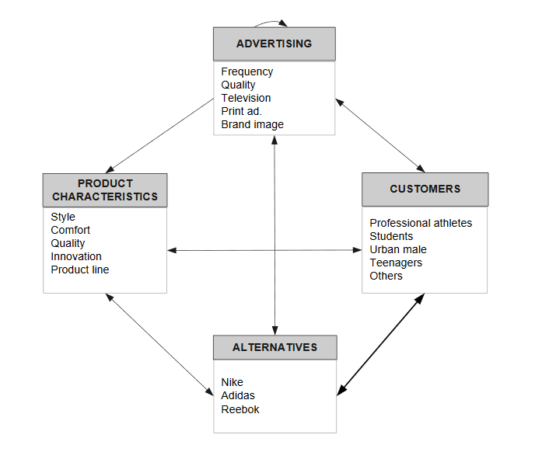
Model

Slide 3
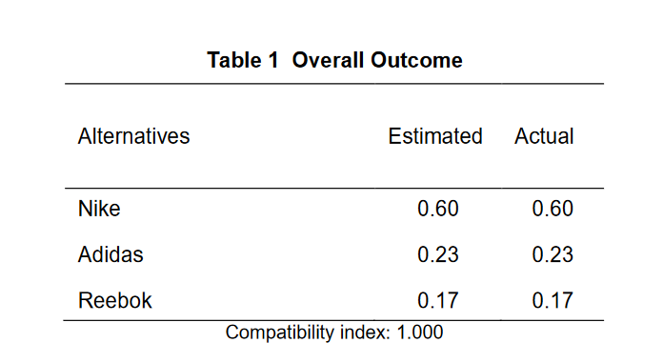
Results

