Slide 1
Deregulated Energy Market Entry Model
Rob Byrnes
October 15, 2012

Slide 2
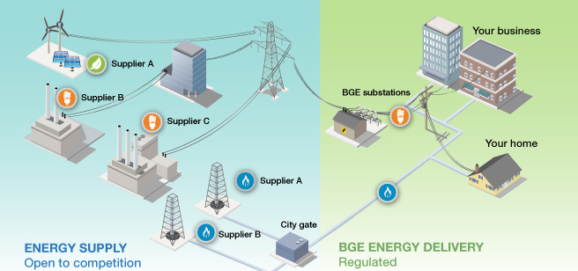
Introduction / Background
Deregulated Energy Markets

Slide 3
Alternatives
American Electric Power (AEP)
  South East Ohio
  1.5 million customers
  Overlap with Columbia Gas of Ohio
Philadelphia Electric Company (PECO gas)
  Eastern Pennsylvania
  500,000 customers
  Overlap with PECO electric
Potomac Edison Power Company (PEPCO)
  Central Maryland
  500,000 customers
  No overlap with existing markets

Slide 4
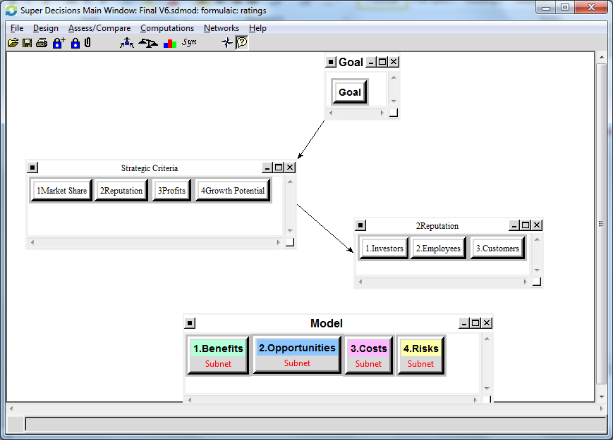
Strategic Criteria

Slide 5
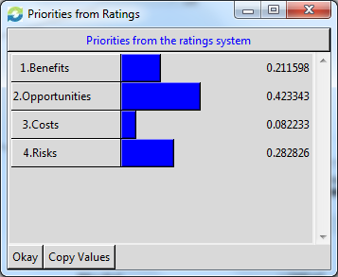
Ratings Priority
Opportunity And Risks are the most important Priorities

Slide 6
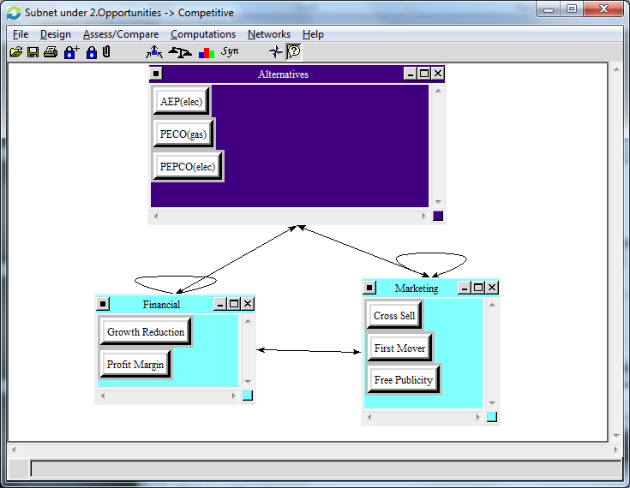
Opportunity Subnet - Competitive

Slide 7
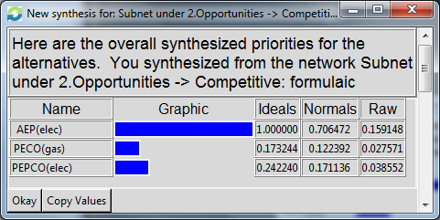
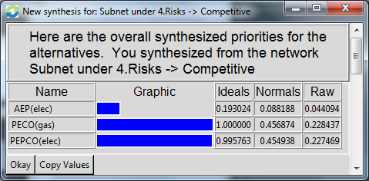
Subnet Analysis
Opportunity
Risks

Slide 8
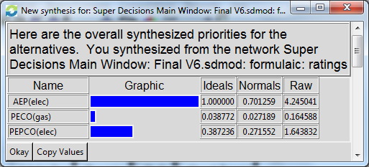
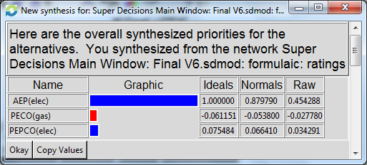
Synthesized Results
Additive (negative)
(Long Term)
Multiplicative
(Short Term)

Slide 9
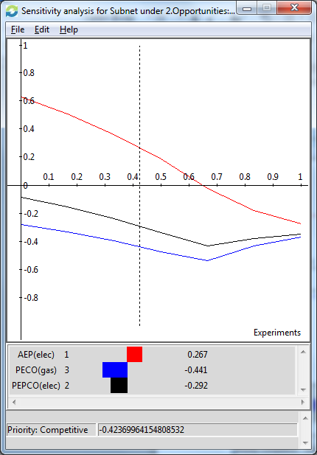
Sensitivity Analysis
Opportunity Sensitivity Analysis
Decrease from AEP
PECO and PEPCO
  Close the gap around 65%.
  Never able to overtake AEP

Slide 10

Conclusion
Go into AEP market as soon as possible
Prepare to enter to PEPCO market next. Keep watch on the market for any changes which would impact the ranking
Monitor the PECO gas market as it may become more attractive

