Slide 1
ANP - Sporting apparel
This model estimate the market share of distilled spirits in the United States.
Nike: 69.2% Adidas: 15.4% Under Armour: 13.8%

Slide 2
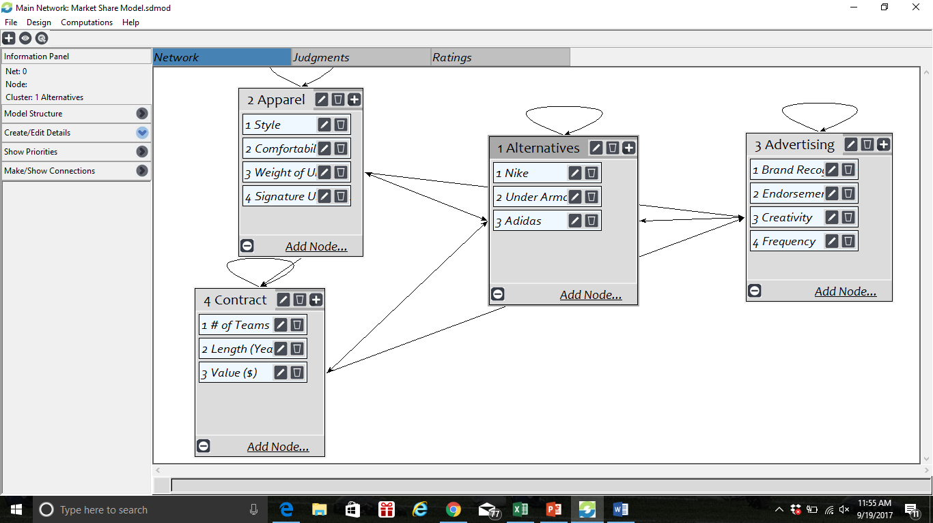
Model

Slide 3
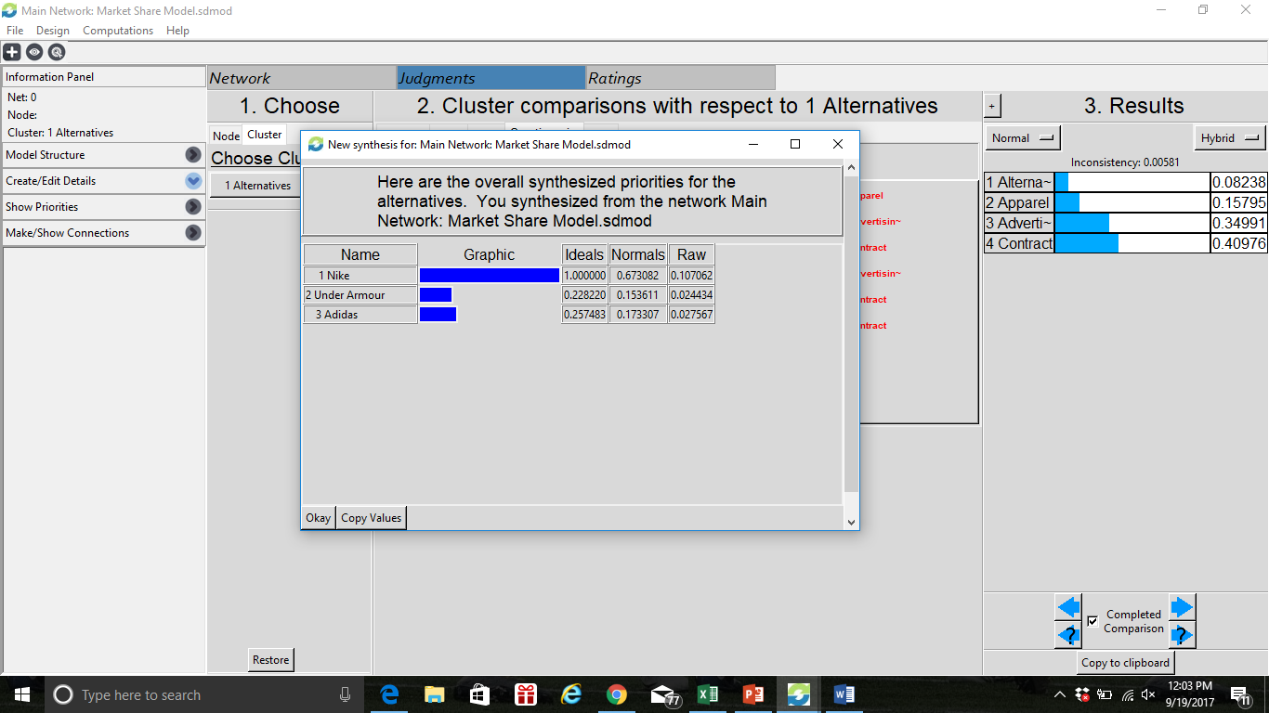
Results

