Slide 1
ANP - Market share of gaming systems
The market share of gaming systems is investigated.
The alternatives for this model include:
  Nintendo Switch
  PlayStation 4
  Xbox One

Slide 2
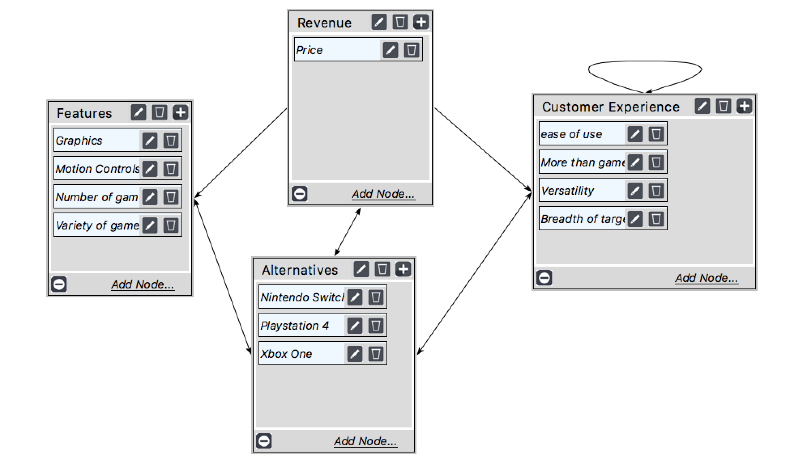
Model

Slide 3
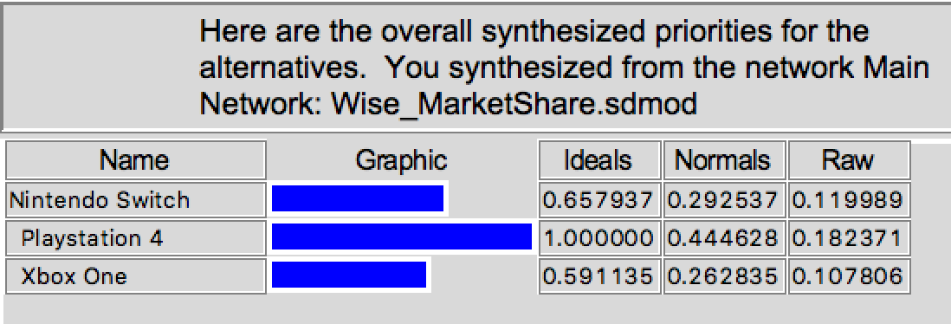
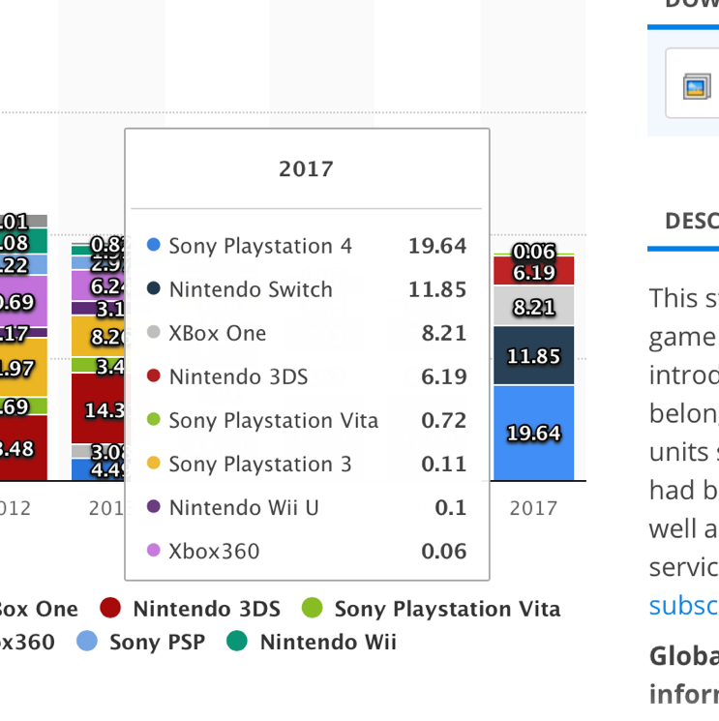
Results

