Slide 1
ANP - Market share for US mobile telephone carriers
Alternatives:
AT&T, T-Mobile and Verizon
Criteria:
Price of 4G plan;
Maximum number of phones allowed;
Price of tablet plan;
Overall Coverage;
Rural Coverage;
Advertising budget;
Early termination fee;
Help and Support:

Slide 2
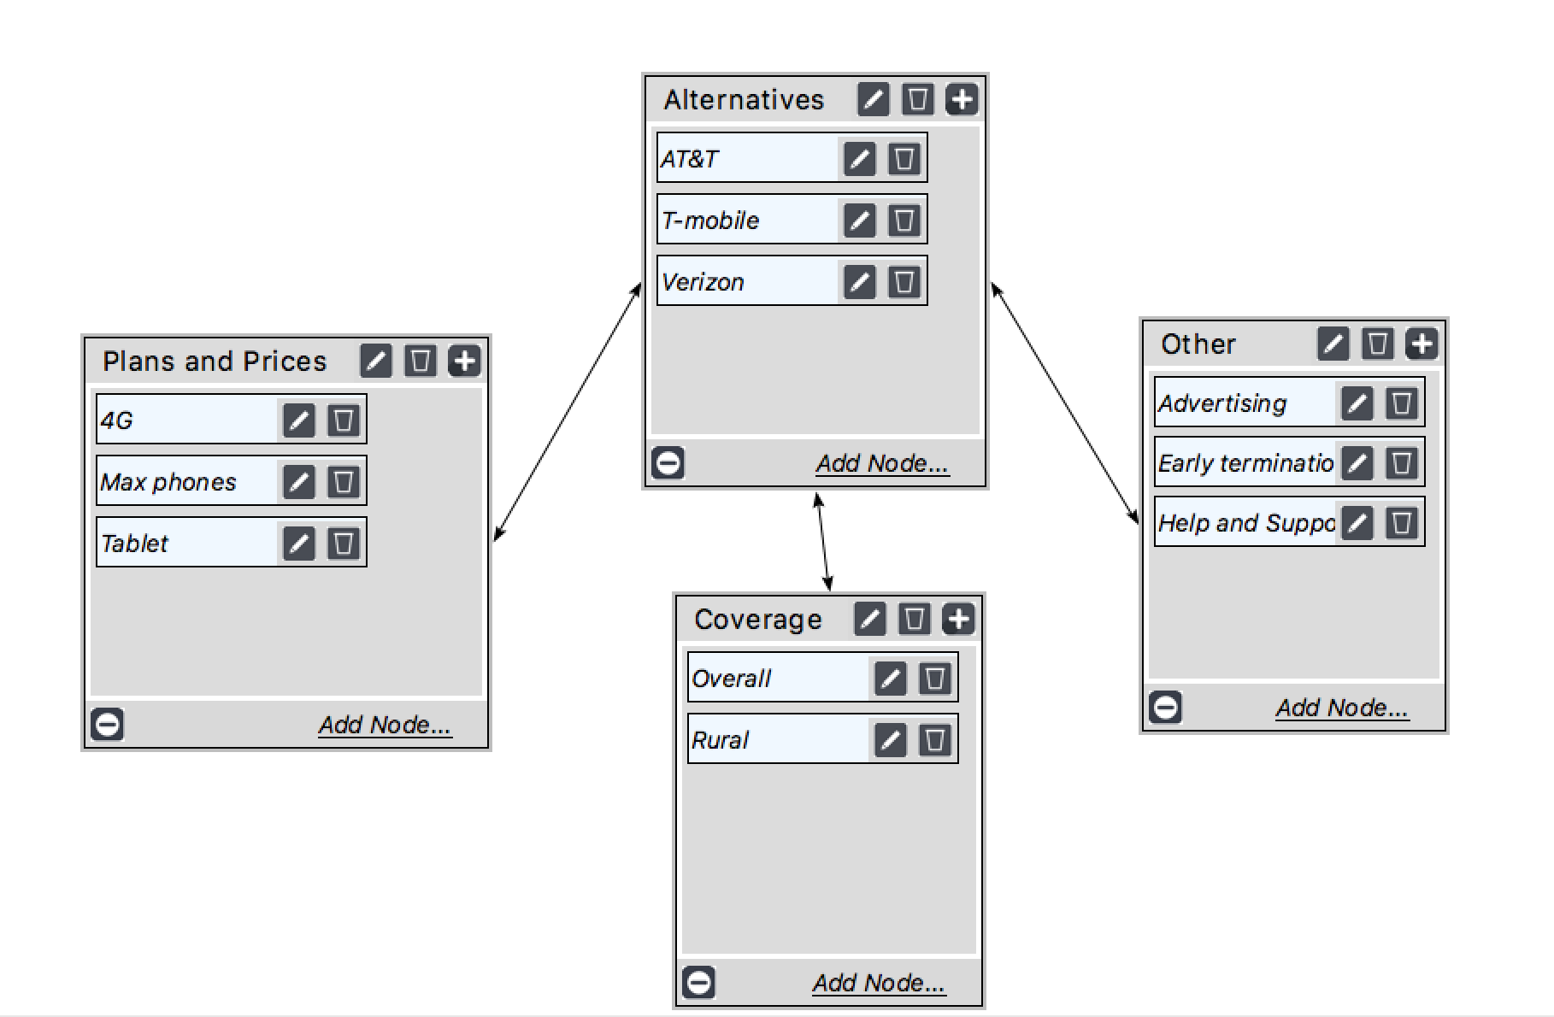
Model

Slide 3
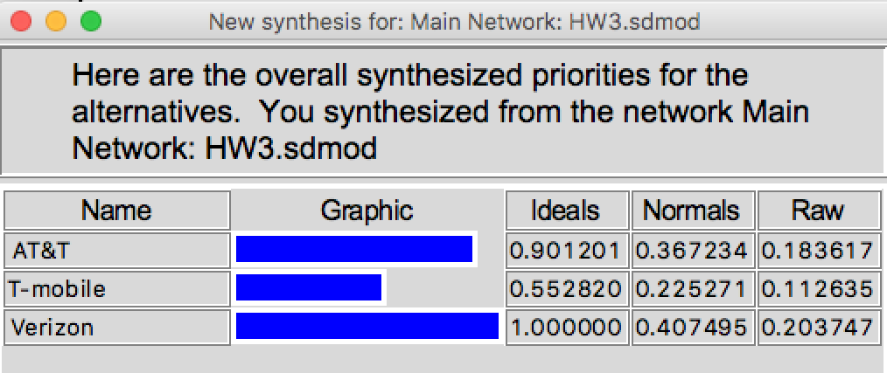
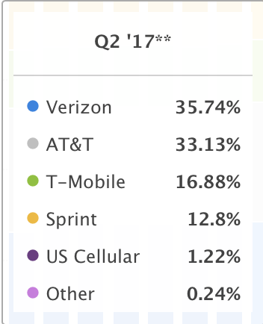
Results

