Slide 1
ANP - desktop browsing market shares
Alternatives:
  Google Chrome, Mozilla Firefox, Microsoft Internet Explorer/Edge, and Other (including Safari, Opera, etc.)
Criteria:
  Characteristics, advertising, and service

Slide 2
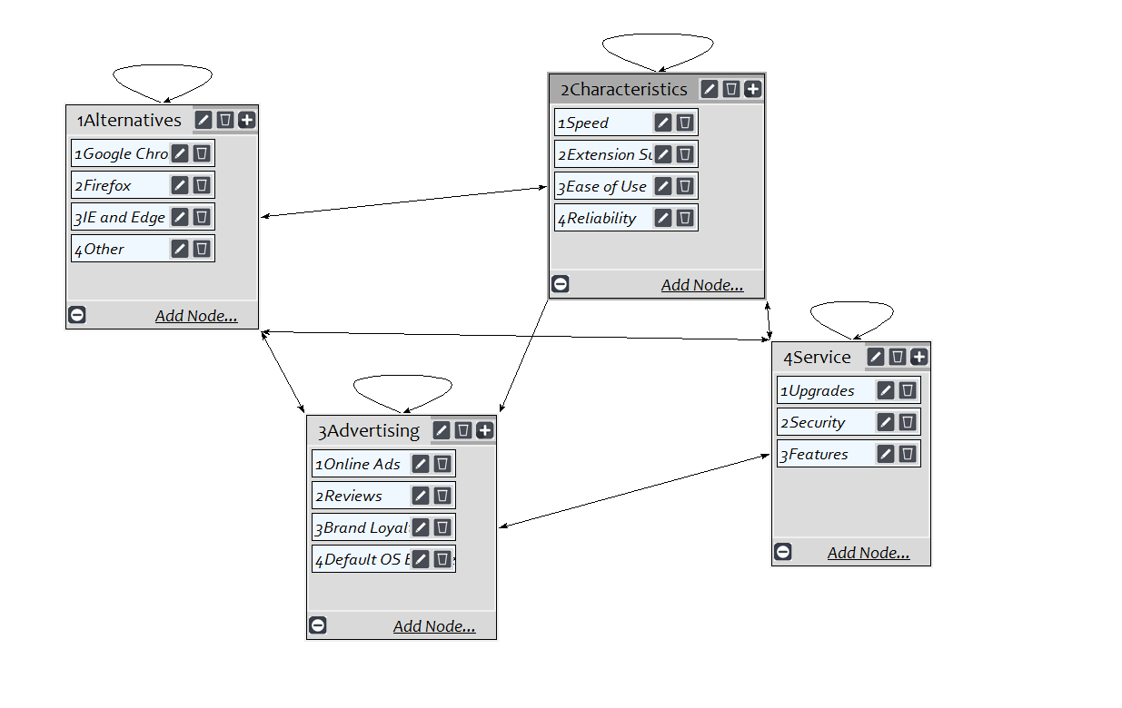
Model

Slide 3
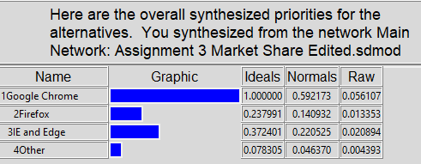
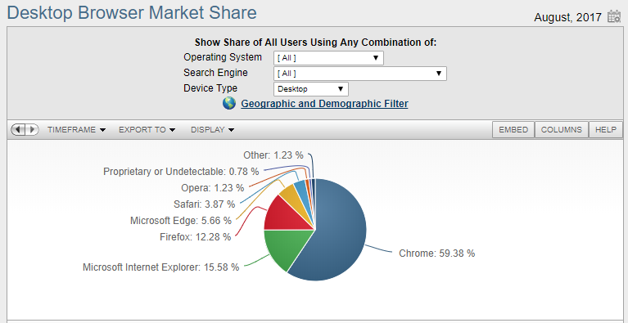
Results

