Slide 1
Passenger Car Market
Goal: rationalize the current market share of the passenger car market in the US
Alternatives:
American
Asia
European

Slide 2
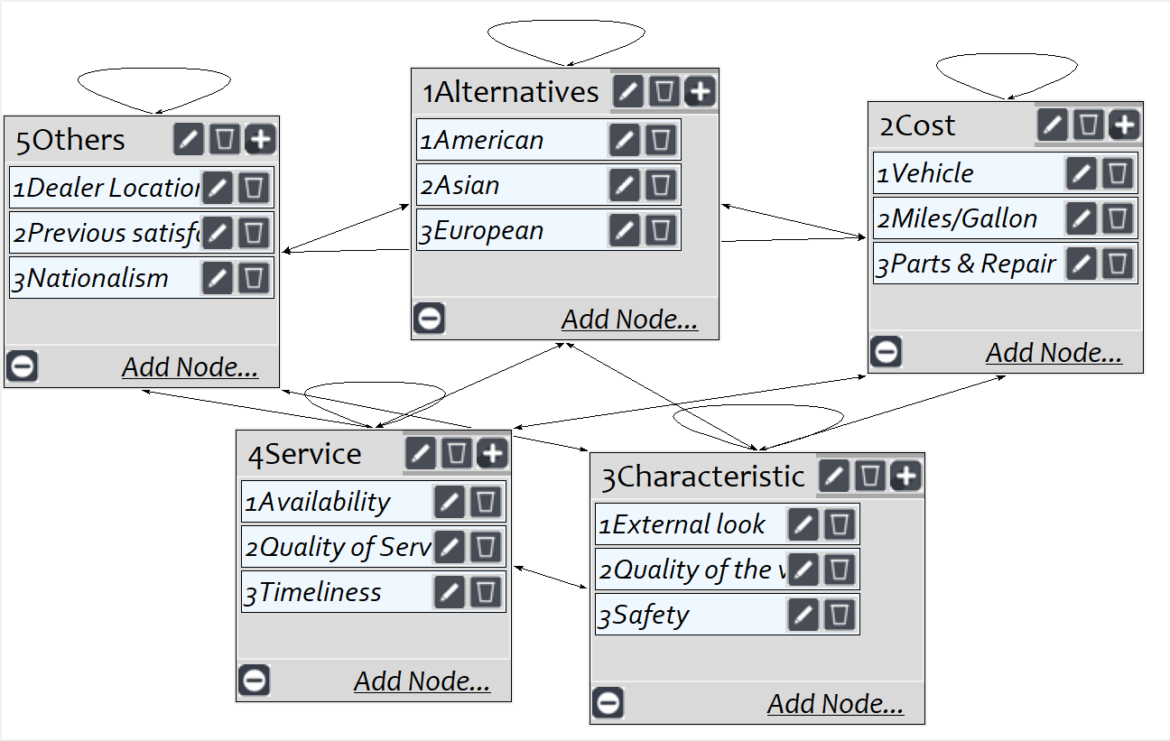
Model
Screenshot of SuperDecisions software Version 3.x

Slide 3
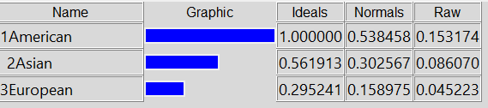
Results

