Slide 1
Toyota Market share
Goal: Determining Market Share of Ford, Toyota and Saturn

Slide 2
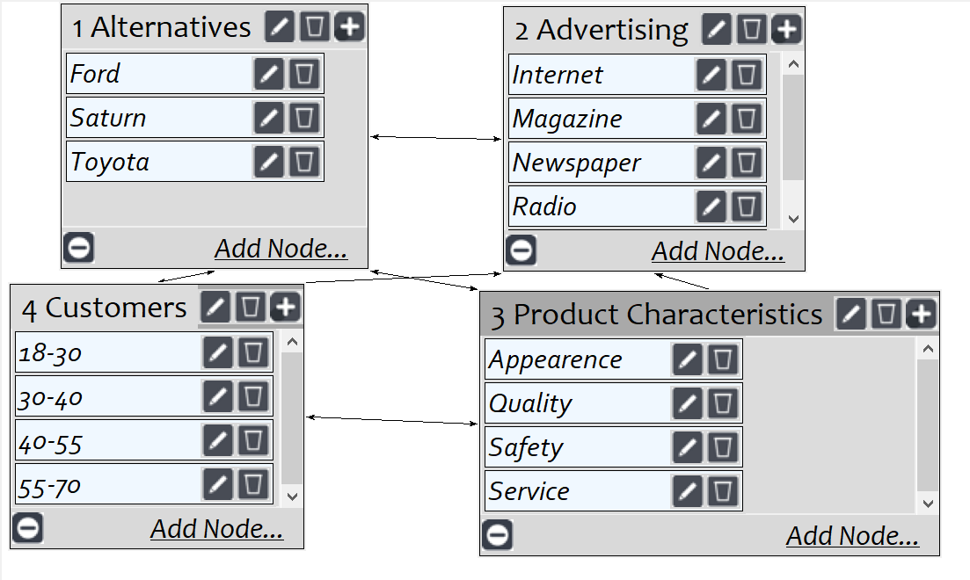
Model
Screenshot of SuperDecisions software Version 3.x

Slide 3
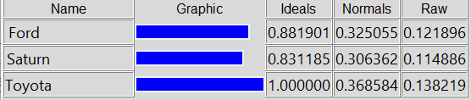
Results

