Slide 1
Hamburger market share
Goal: Hamburger market share forecasting
Alternatives:
  1 McDonald's
  2 Burger King
  3 Wendy's

Slide 2
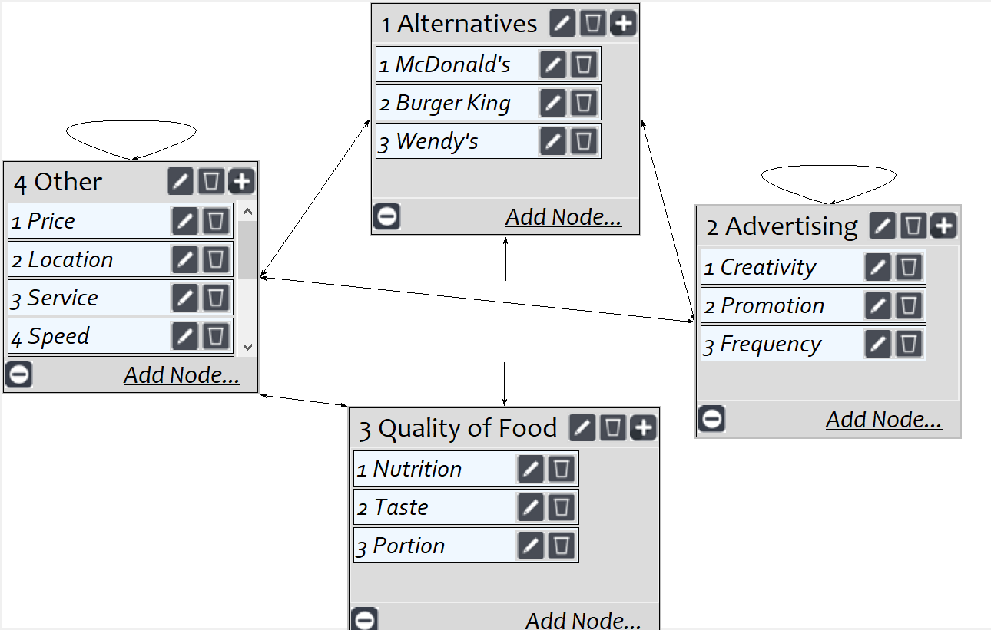
Model
Screenshot of SuperDecisions software Version 3.x

Slide 3
Hamburger Model
Synthesized Local:
Other Menu Item 0.132
Cleanliness 0.115
Speed 0.104
Service 0.040
Location 0.224
Price 0.138
Reputation 0.167
Take-Out 0.086
Quality Portion 0.494
Taste 0.214
Nutrition 0.316
Synthesized Local Cont’d:
Advertising Frequency 0.485
Promotion 0.246
Creativity 0.267
Competition Wendy’s 0.156
Burger King 0.281
McDonald’s 0.566
Simple Hierarchy Complex Hierarchy Feedback Actual
(Three Level) (Several Levels) Network Market
Share
Wendy’s 0.3055 0.1884 0.156 0.1320
Burger King 0.2305 0.2689 0.281 0.2857
McDonald’s 0.4640 0.5427 0.566 0.5823

Slide 4
