Slide 1
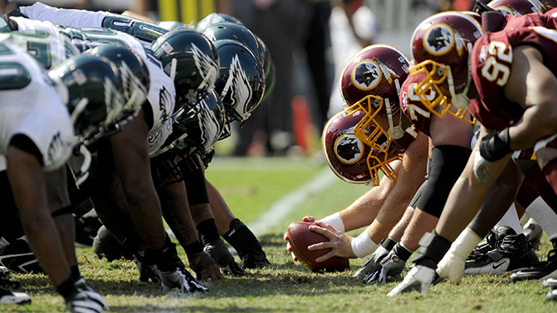
Determining Whether the NFL Should Modify Its Regular Season to 18 Games
Shannon Harris and Paul Matthews
10/17/2011

Slide 2
AGENDA
Introduction
Model
Strategic Objectives
Criteria
Results
Criteria Results
Ratings Model
Top-Level Results
Sensitivity Analysis
Conclusion

Slide 3
Introduction
Current Schedule
16 regular season games
4 preseason games
1 bye week
Preseason Games
Do not count towards team’s final record
Coaches use games to evaluate players and decide final roster
Starters play a fraction of the game
Season ticket holders required to pay face value for tickets
Proposed Schedule
18 regular season games
2 preseason games
2 bye weeks

Slide 4
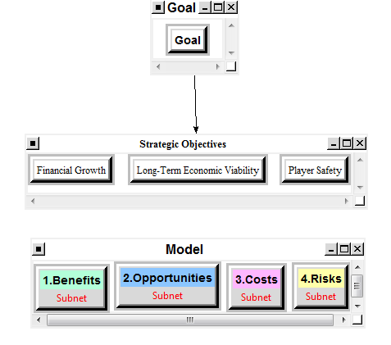
Model

Slide 5
Strategic Objectives
Financial Growth
Expand current revenue streams
Develop new sources of revenue
Long Term Economic Viability
Protect integrity of the sport
Increase football’s popularity
Player Safety
Reduce risk of serious injury for players

Slide 6
Criteria
BENEFITS
OPPORTUNITIES
Economic
Merchandise Sold at Games
Tickets
TV Rights
Bar and Restaurant Sales
Social
Fan Satisfaction
League Popularity
Institutional
Additional Bye Week
Decreased OTA and Training
Increased Competitiveness
Minor League
Modify IR Terms
Social
International Games
Increased Benefits for Retired Players

Slide 7
Criteria
COSTS
RISKS
Economic
Increased Roster
Pay Players for Additional Games
Social
Competitive Attrition
Complexion of Season
Variance Between Statistics
Economic
Decreased Profit Margin per Game
Negative Returns for Bad Seasons
Social
Evaluation of New Players
Longer Disappointing Seasons
Player Injury

Slide 8
Results
Criteria Results
For each of the BOCR subnets, the decision networks were built and pair-wise comparisons made for each connection
After each subnet was synthesized, the New Schedule alternative was found to be the preferred alternative for each subnet
 | Keep Current Schedule (4-Pre; 16-Regular) | New Schedule (2-Pre; 18-Regular)
BENEFITS | .208407 | .791593
OPPORTUNITIES | .381265 | .618735
COSTS | .266606 | .733394
RISKS | .172573 | .827427

Slide 9
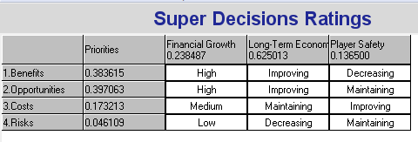
Results
Ratings Results
A ratings model was then developed based upon the New Schedule alternative
Rankings for Financial growth – High, Medium, Low
Rankings for Long-Term Economic Viability and Player Safety – Improving, Maintaining, Decreasing

Slide 10
Results
Top-Level Results
Strategic Objective Weights
Long-Term Economic Viability - .62501
Financial Growth - .23849
Player Safety - .13650
The New Schedule is most preferable when using the additive formula (long-term result)
The Current Schedule is the most preferable using the multiplicative formula
 | Keep Current Schedule (4-Pre; 16-Regular) | New Schedule (2-Pre; 18-Regular)
ADDITIVE | .326966 | .673034
MULTIPLICATIVE | .681499 | .318501

Slide 11
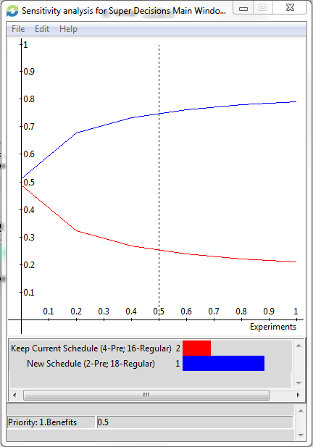
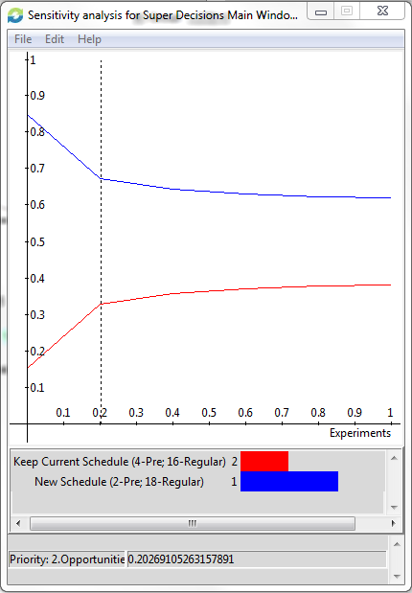
Sensitivity Analysis
BENEFITS
OPPORTUNITIES

Slide 12
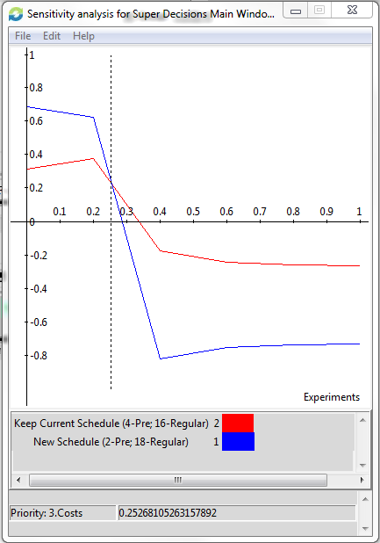
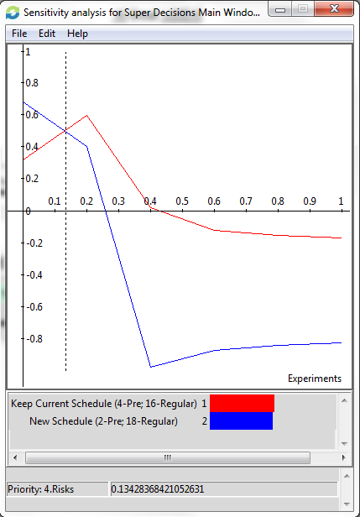
Sensitivity Analysis
COSTS
RISKS

Slide 13
Conclusion
Our model concludes that the NFL will fulfill its strategic objectives in the long-term by updating the current schedule to include 2 pre-season games followed by 18 regular season games
In the final collective bargaining agreement it was agreed to maintain the current 16 game format for the next ten years. This conclusion agrees with the short-term results based upon the multiplicative formula

