Slide 1
How Should Student Athletes Be Paid?
Decision Making in a Complex Environment: Final Project
Corey Filburn and Alexander Rascoe

Slide 2
Introduction
College Athletes in the United States generate tremendous revenue
Money is distributed within the university
Entice donations from booster clubs and alumni attending games
New facilities are built that attract students and faculty
Contributes to the prestige of the university
Athlete Benefits
Scholarship? Maybe
“Talent” scholarships in the form of leadership scholarships

Slide 3
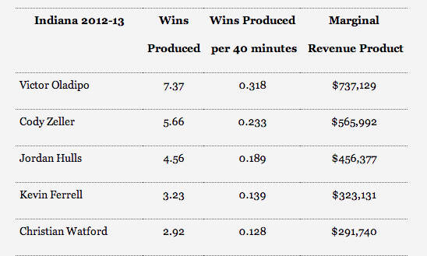
Scope of the Problem
Marc Emmert President of NCAA ➔ $1.6 M/yr
Basketball Coach John Calipari of Kentucky➔ $5.2 M/yr
Football Coach Nick Saban of Alabama ➔ $5.62 M/yr
TV Contract between ESPN and the ACC ➔ $3.6 billion/15 years

Slide 4
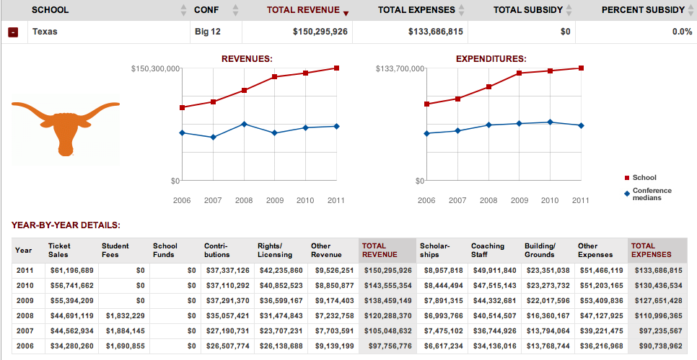

Slide 5
Student Athlete Compensation Models
How do they work?
Percentage of Revenue
Full-Time Salary
Part-Time Salary
Stipend

Slide 6
Building the Model
Strategic Criterion
Economic
Practical
Conclusive
BOCR Subnets

Slide 7
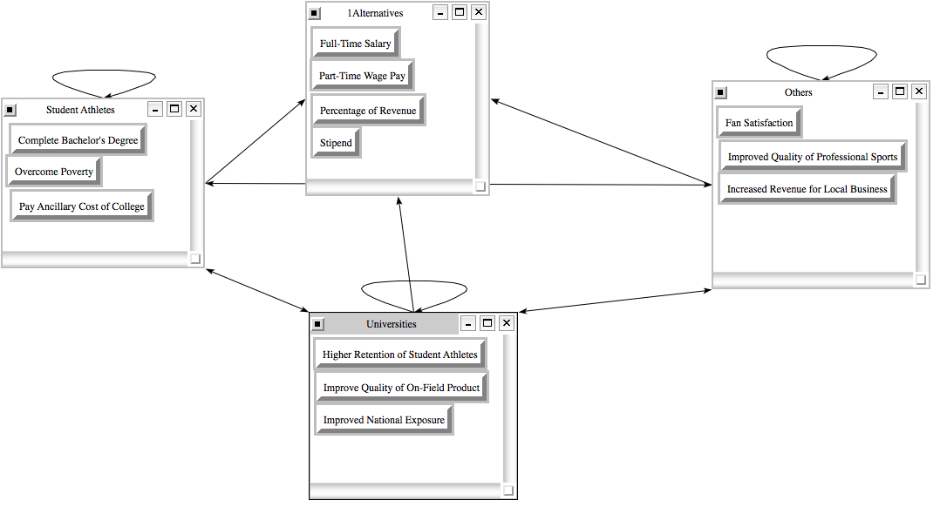
Building the Model: Benefits

Slide 8
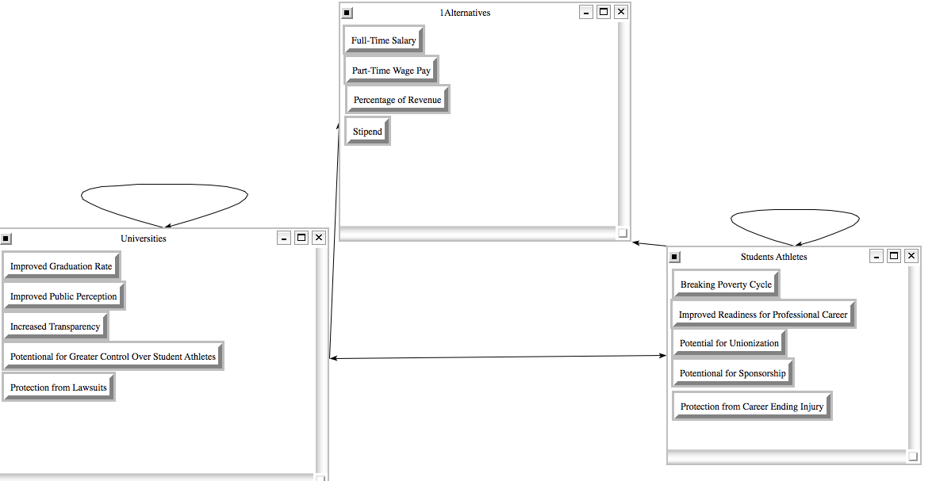
Building the Model: Opportunities

Slide 9
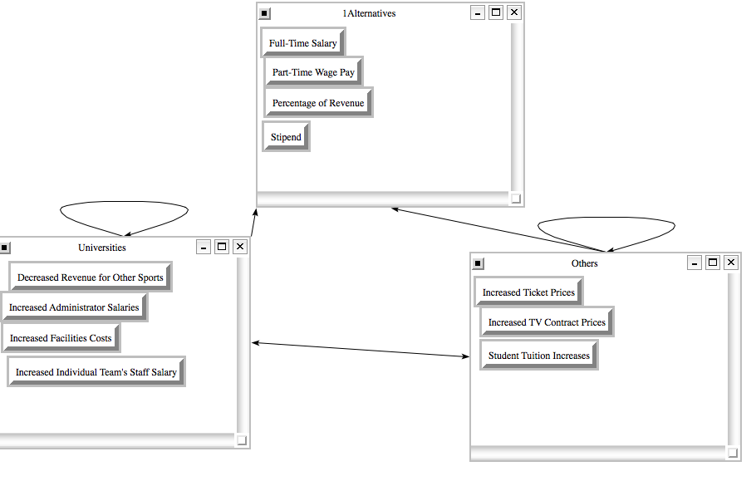
Building the Model: Costs

Slide 10
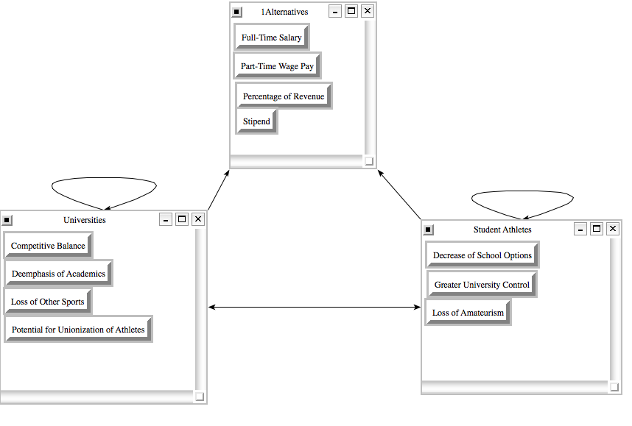
Building the Model: Risks

Slide 11
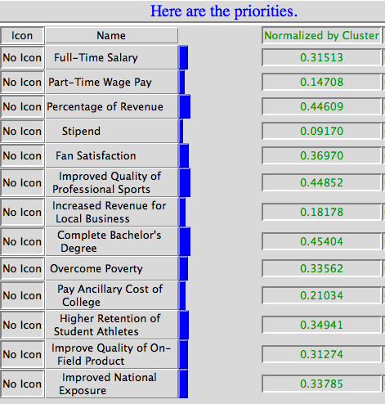
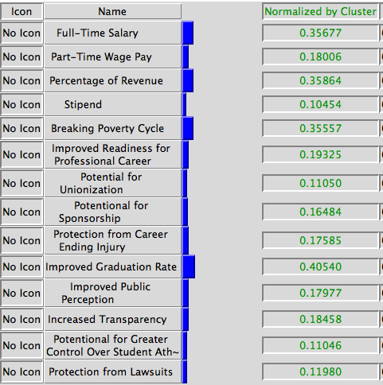
Benefits and Opportunities

Slide 12
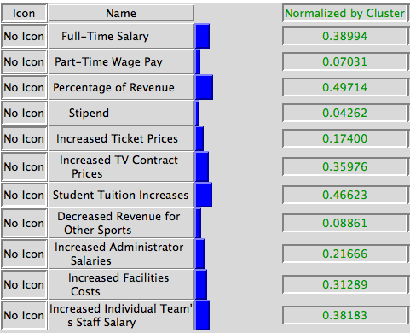
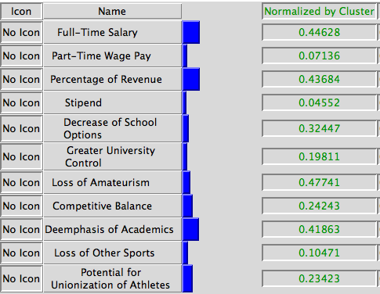
Costs and Risks

Slide 13
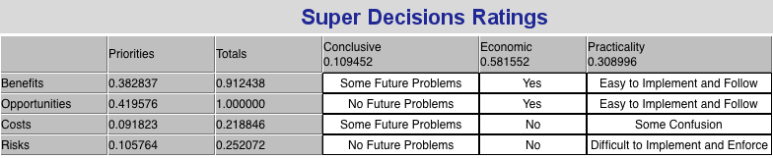
Computation

Slide 14
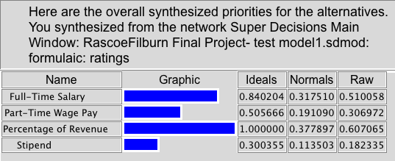
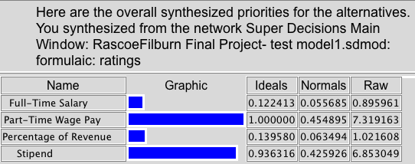
Synthesis
Additive (Long Run)
Multiplicative (Short Run)

Slide 15
Conclusion:
Costs and Risks in the short term make the smaller overall payment models more appealing
Outweighed by tremendous Benefits and Opportunities in the long term
The payment strategies are scaled essentially by earning potential
%Revenue > Full-Time and Part-Time > Stipend
%Revenue model is preferred in the long run

