Slide 1
National Hockey League Roster Decision
Mike Colligan

Slide 2
Description of the Decision
National Hockey League teams use AHP for drafting players
ANP can be used for more complex roster decisions
Not always the best players, but the right fits
Notes:
AHP allows scouts to contribute pairwise comparison from all over the world

Slide 3
Description of the Decision
Pittsburgh Penguins Defense
6 roster openings – 4 already taken
1. Kris Letang Options:
2. Brooks Orpik *Simon Despres
3. Paul Martin *Deryk Engelland
4. Matt Niskanen *Ben Lovejoy
5. ? *Joe Morrow
6. ? *Brian Strait

Slide 4
The Options
Simon Despres
2009 1st round pick (18 NHL games)
Joe Morrow
2011 1st round pick (0 NHL games)
Deryk Engelland
30 year old veteran (145 NHL games)
Ben Lovejoy
28 year old veteran (95 NHL games)
Brian Strait
Fits team needs on defense (12 NHL games)

Slide 5
Structure
Strategic Criteria:
Win Right Now
Win in Playoffs This Year
Build for Future Years
Based on Individual and Team aspects
Benefits (37%)
+Opportunities (25%)
-Costs (13%)
-Risks (24%)

Slide 6
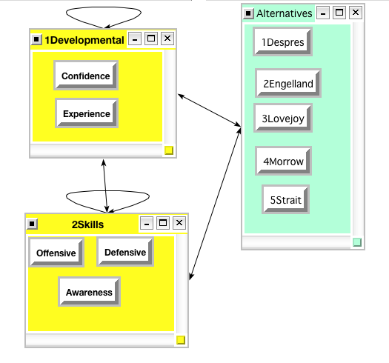
Benefits: Individual

Slide 7
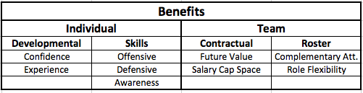
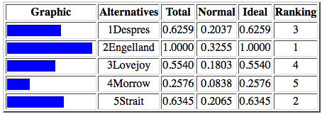
Benefits
Notes:
Engelland top because of best defensive skills, complementary attributes (fight, can do things no one else can do)

Slide 8
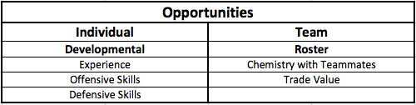
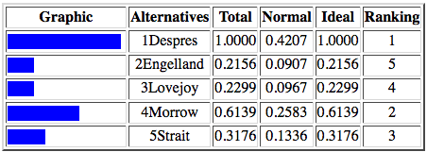
Opportunities
Notes:
Despres great opportunity to develop (already played one year in minor leagues), gain NHL experience, build chemistry with teammates he’ll be playing with in future years
Engelland Lovejoy already developed and have good chemistry

Slide 9
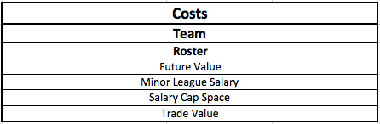
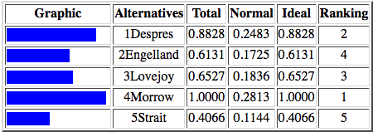
Costs
Notes:
Straightforward
Based on salary
Future Value (also in Benefits)

Slide 10
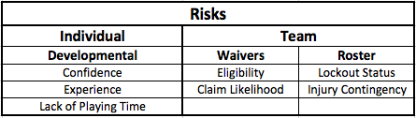
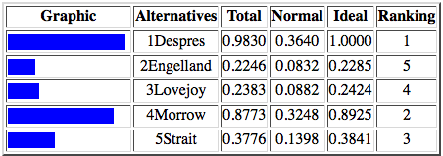
Risks
Notes:
Biggest risks is Despres
Want him to develop but if could hurt him if he hardly plays (better off in minor leagues)
Waivers interesting dynamic
Engelland, Lovejoy, Strait are sent to minor leagues they can be claimed by other teams

Slide 11
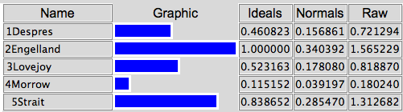
Final Results

