Slide 1
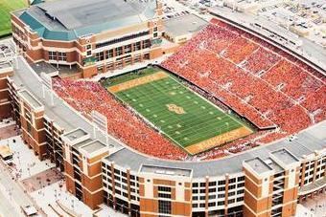

Should Pitt Build an On-Campus Football Stadium?
Logan Baker, Patrick Kahle

Slide 2
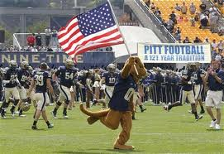
Background
Pitt plays at Heinz Field
Requires student transportation
No sense of ownership
Detrimental to reputation
Difficult to fill
Prepare for what to do when Heinz Field lease is up

Slide 3
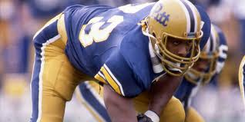
Model Development
Goal: Determine whether or not to build a new on-campus stadium
Alternatives:
Build
Do not build
Control Criteria:
Economic Factors
Fan Satisfaction
University Reputation
Logistics

Slide 4
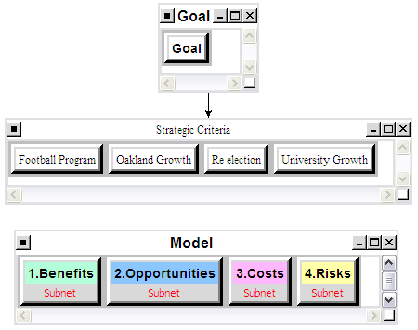
ANP / BOCR

Slide 5
Benefits
Financial Factors | In Stadium | Ticket Sales
 |  | Concessions (stadium)
 |  | Merchandise (stadium)
 | On Campus | Parking (campus)
 |  | Apparel
 |  | Food
 | City | Transportation
 |  | Casino Revenue
 |  | Parking (public)
Fan Satisfaction | Access to Stadium | Prox to campus bldgs, housing
 |  | Casual fan ease of access
 |  | Student ease of access
 | Game Day Environment | Tailgating
 |  | Pregame atmosphere
 |  | In-game atmosphere
 |  | Alumni presence
University Reputation | Fans | Alumni Support
 |  | Fan Support
 |  | National TV attention
 | Prospective Students | Prospective Student interest
 |  | Prospective Recruit Interest
Logistics | Traffic Flow | Oakland Traffic
 |  | Coordinating Shuttle Services
 |  | Increased foot traffic
 | Resident Burden | Reduced Resident Parking
 |  | Increased Noise
 |  | Oakland Crime

Slide 6
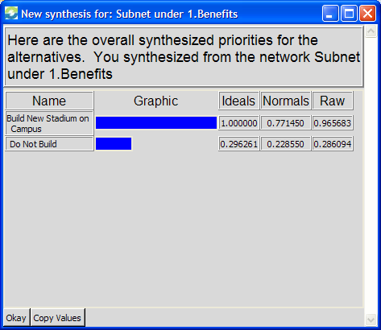
Benefits - Results
Favored construction of stadium

Slide 7
Opportunities
Financial Factors | Stadium | Increase Ticket Sales
 |  | Naming Rights
 |  | Sponsorships
 |  | Park/Concessions/Merch
 | University | Host Concerts
 |  | Increase Enrollment
 |  | Campus Stores
Fan Satisfaction | Alumni/Fans | Alumni Pride
 |  | Visits to Campus
 |  | Donations
 | Students | Student Pride
 |  | Team Support
 |  | Game day Experience
University Reputation | Football | National Reputation
 |  | Bowl Bids
 |  | National TV Games
 |  | Intimidating Environment
 |  | Attract more recruits
 | University | Increase Applications
 |  | National Exposure
 |  | University Pride
Logistics | Transportation | New Exits/Roads in Oakland
 |  | Expand T Route to Oakland
 | Oakland | New Hotels
 |  | New Businesses
 |  | Visual Appeal of Skyline
 |  | Increased Crime in Oakland

Slide 8
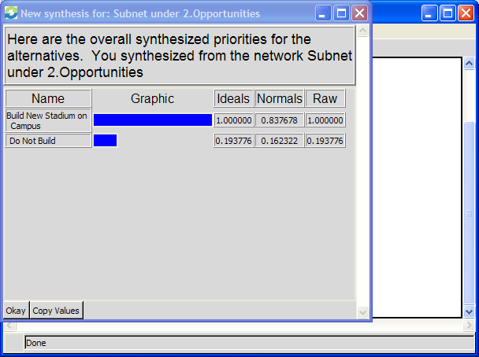
Opportunities - Results
Favored construction of stadium

Slide 9
Costs
Financial Factors | Stadium | Concessions
 |  | Grandstand
 |  | Restrooms
 |  | Training Rooms
 | Other | Promenade
 |  | Statues/Decoration
Fan Satisfaction | North Shore | Proximity to Bars/Casinos
 |  | Tailgating
 |  | Events
 | Heinz Field | Pro Football Facility
 |  | Concessions
University Reputation | National | Share with Steelers
 | Prospective Students | State of the Art Facilities
 |  | Pro Football Facility
Logistics | Traffic | Proximity to Highways
 |  | Alternate Routes
 | Parking | Garage/Lot Quantity
 |  | Proximity to Field

Slide 10
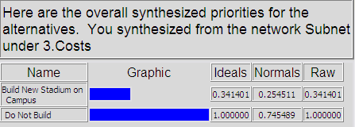
Costs - Results
Favored construction of stadium

Slide 11
Risks
Financial factors | Revenues | Ticket sales
 |  | Concessions
 | Donations | Corporate
 |  | Alumni
Fan satisfaction | Gameday | Atmosphere
 |  | Tailgating
 |  | Fan Engagement
 | Team Success | Bowl Games
 |  | National Ranking
 |  | Recruiting
University reputation | Crime | Violence
 |  | Theft
 |  | Disorderly Conduct
 | Revelry | Rioting
 |  | Fires
 |  | Drunkenness
Logistics | Public transportation | Cleanliness
 |  | Delay
 |  | Overcrowding
 | Traffic | Accidents
 |  | Gridlock
 |  | Alcohol-Related

Slide 12
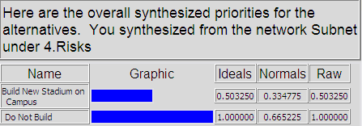
Risks- Results
Favored construction of stadium

Slide 13
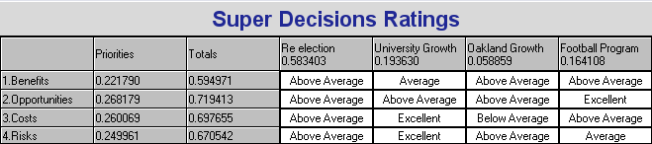
Ratings

Slide 14
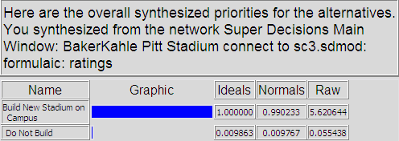
Results - Multiplicative

Slide 15
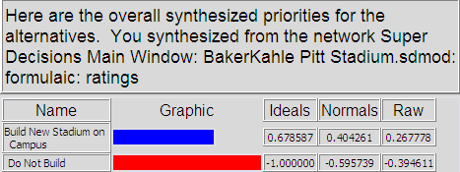
Results - Additive

Slide 16
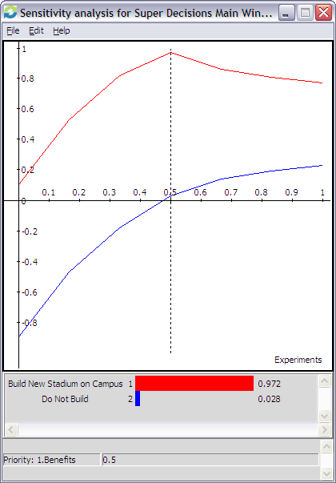
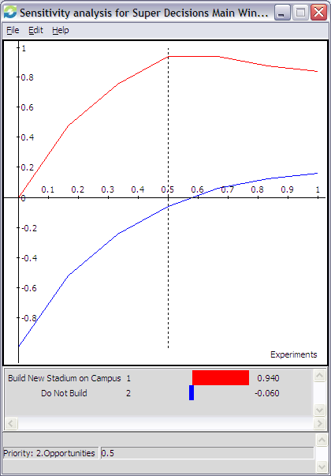
Sensitivity – Benefits & Opportunities

Slide 17
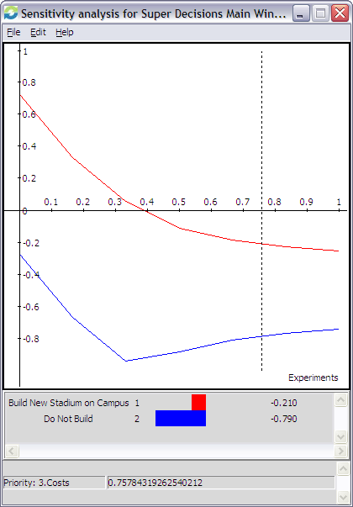
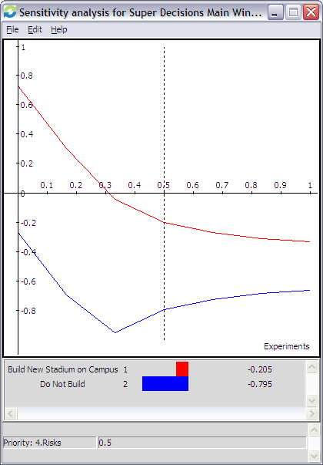
Sensitivity – Costs & Risks

Slide 18
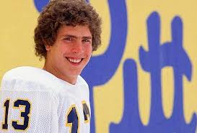
Conclusion
Best short-term: Build
Best long-term: Do not build
Likely decision: Do not build

