Slide 1
NFL National Anthem Protests
Reggie Mitchell

Slide 2
The Issue
In August of 2016, Colin Kaepernick protested during the playing of the National Anthem
Racial Injustice
Police Brutality
"I am not going to stand up to show pride in a flag for a country that oppresses black people and people of color"

Slide 3
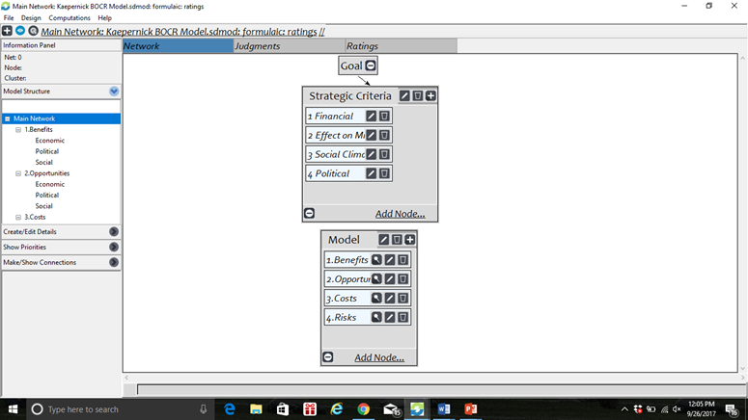
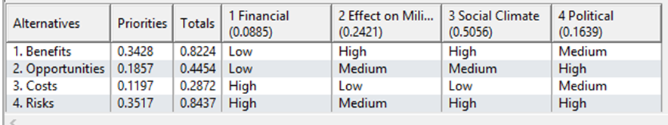
The Model

Slide 4
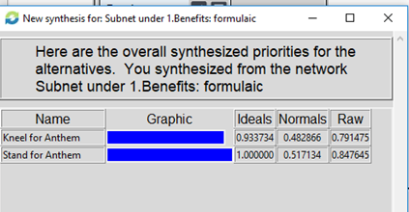
Benefits
Economic
Jersey Sales
Political
Presidential Support
Social
Conversation about Racial Injustice

Slide 5
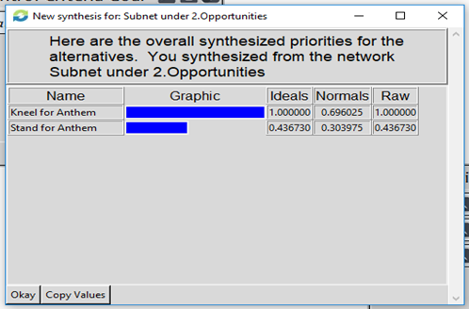
Opportunities
Economic
Fundraising
Political
Police Brutality Reform
Social
More Inclusive Society

Slide 6
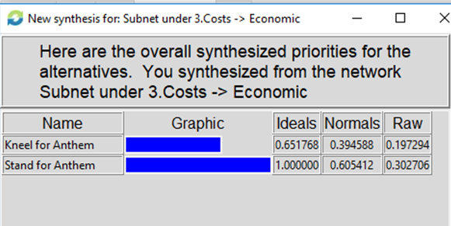
Costs
Economic
Revoked Endorsements
Political
President’s Disapproval
Social
Lack of Fan Support

Slide 7
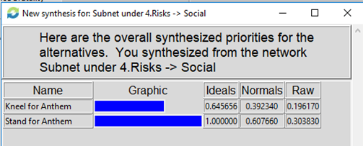
Risks
Economic
Long Term Ticket Sale Losses
Political
No Reform
Social
Increase in Racial Divide

Slide 8
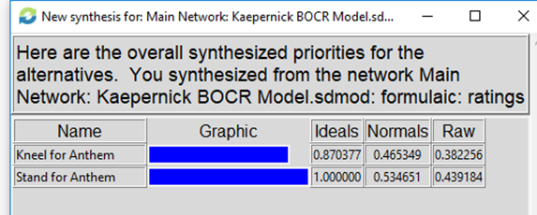
Overall Results

Slide 9
Final Thoughts
It was important to keep my own personal bias out of all of the ratings and priorities
The Economic & Social Risks appear to be the overwhelming reason why most players will decide to Stand for the Anthem
We have to consider the human element in this decision

