Slide 1
Fantasy Football Selection
Goal: Select best fantasy football player
Alternatives:
  Larry Johnson
  Shaun Alexander
  LaDanian Tomlinson

Slide 2
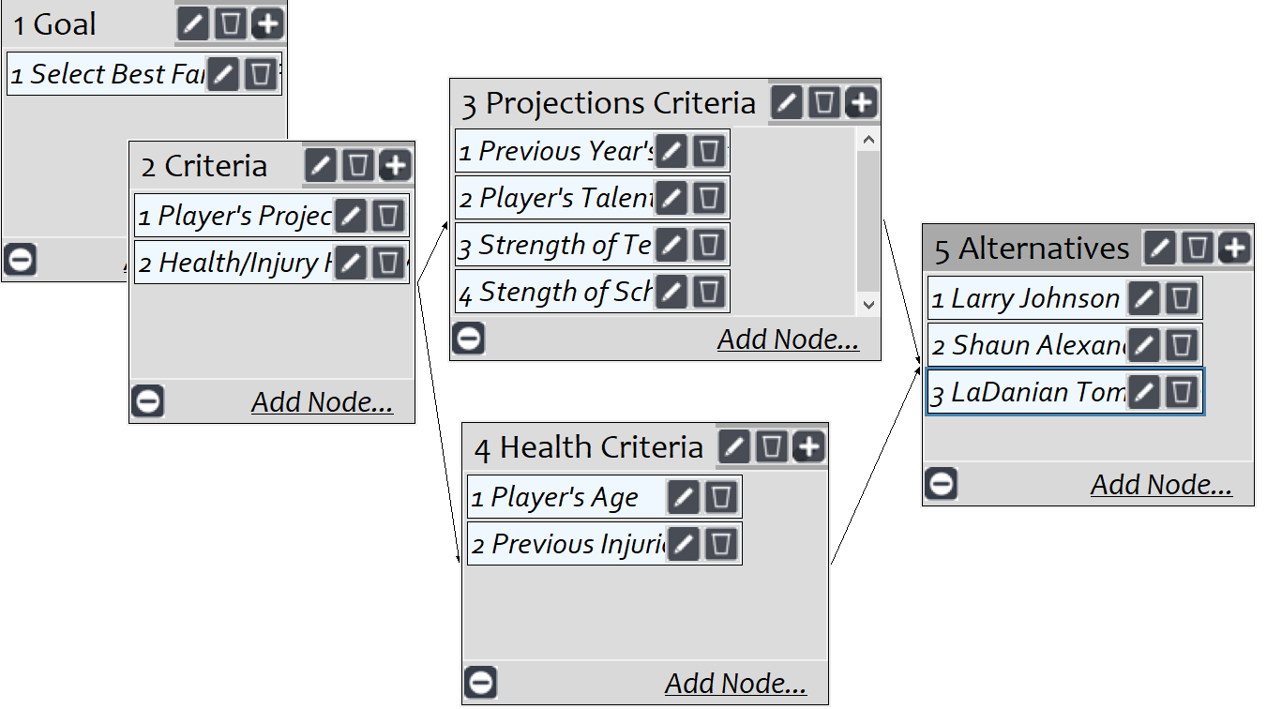
Model
Screenshot of SuperDecisions software Version 3.x

Slide 3
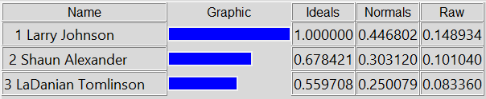
Results

