Slide 1

MLB Game Length
By: Drew Berkhoudt & Brian Petnuch

Slide 2

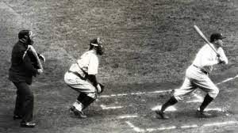
MLB Background
Major league baseball is the oldest of the major professional sport leagues in the United States.
Since its beginning, games have been played for 9 innings.
Over time the total game lengths have increased significantly.
  The average time for a nine inning MLB game has increased by 30 minutes over the past 50 years.
Longer games can lead to higher injury risk for players and loss of interest by fans.
  Only 14% of 18-34 year olds are “avid fans”
A popular idea for a solution to the increased game length is to reduce the innings played to 7
The goal of our project was to determine the best choice for the MLB regarding shortening the length of their games.

Slide 3
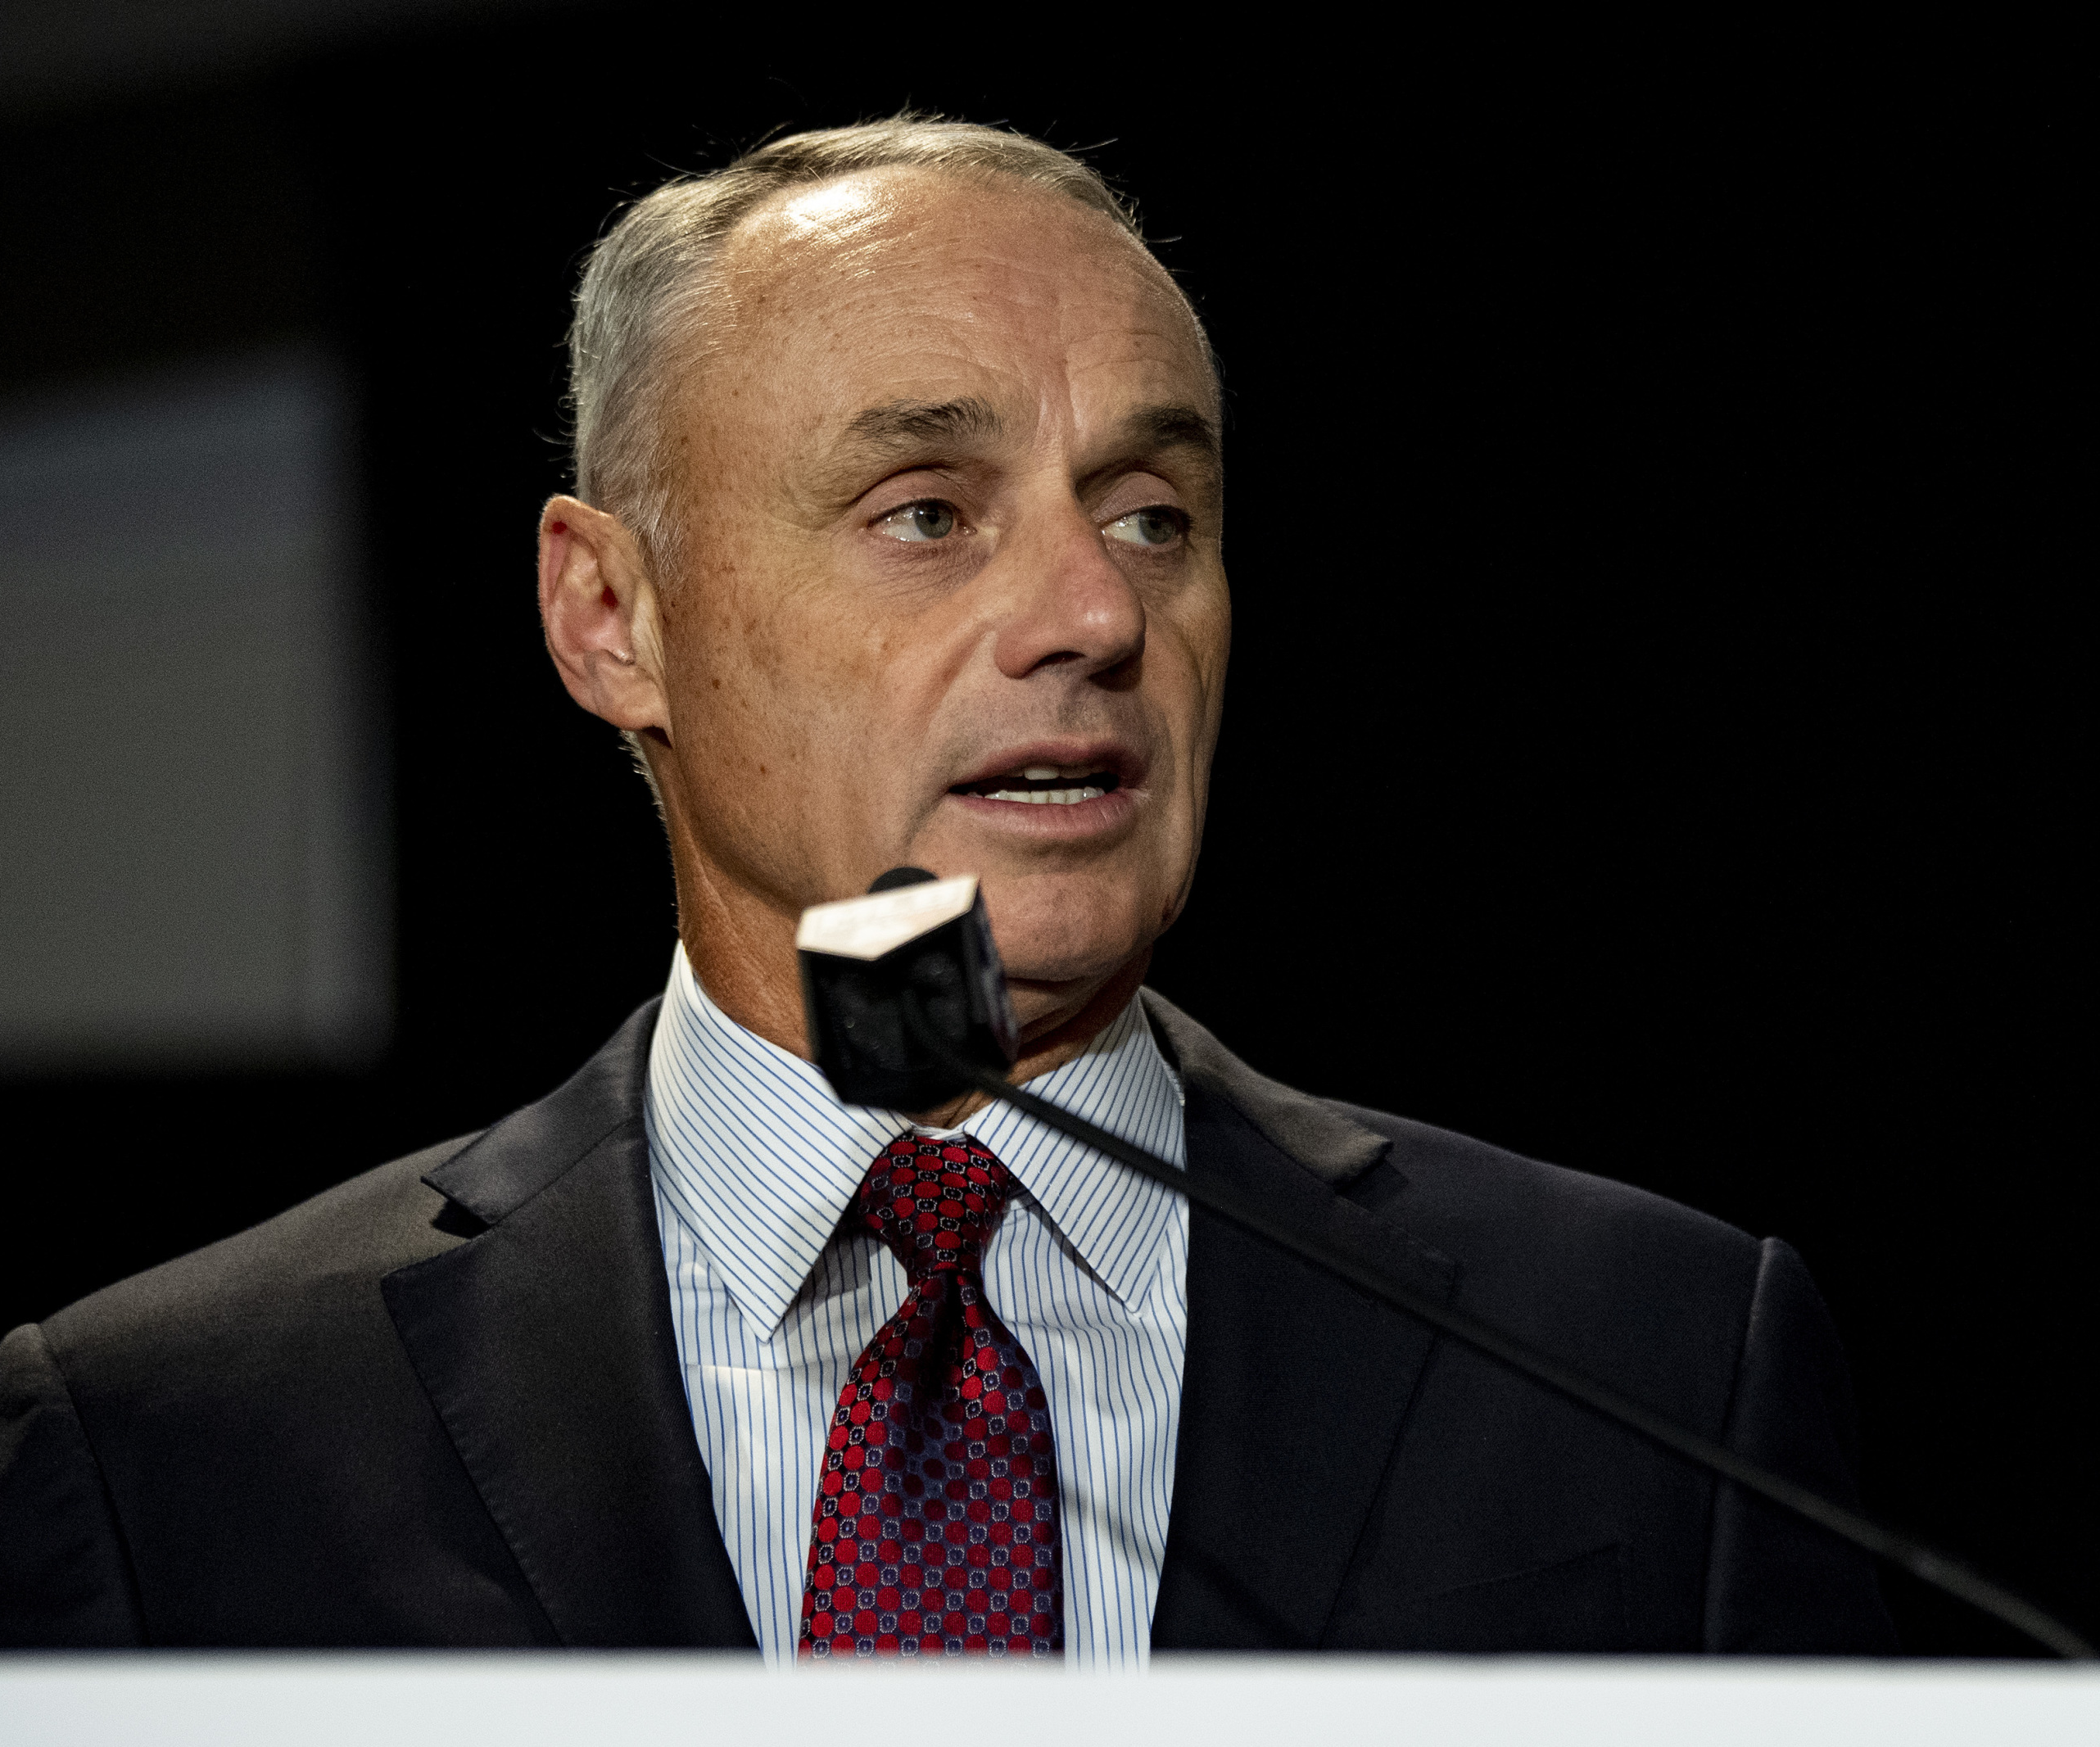
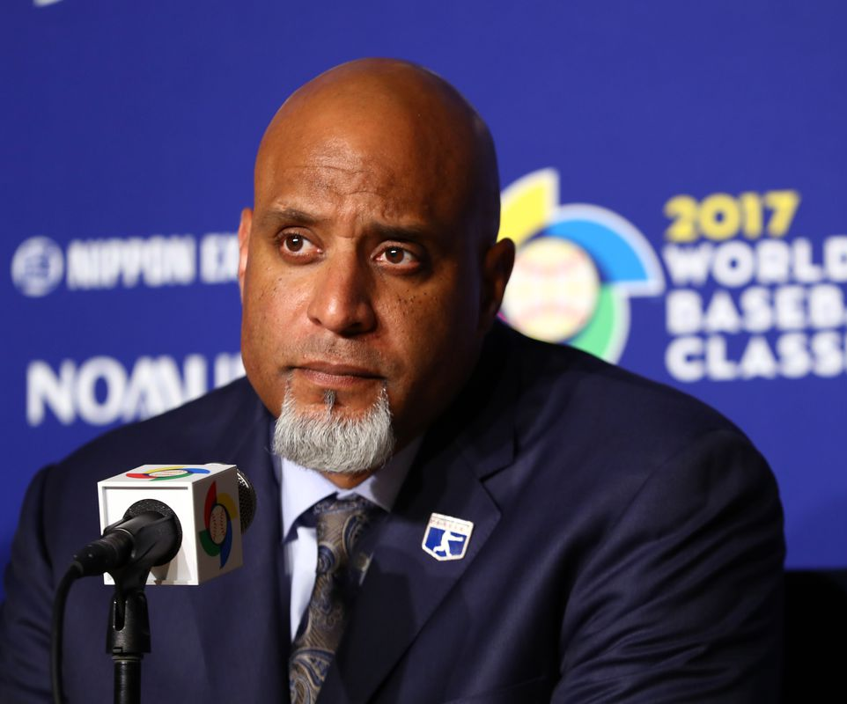
Decision Makers
Rob Manfred
Commissioner of MLB
Tony Clark
Executive Director of MLB Players Union

Slide 4
Alternatives
No Changes
Shorten Games

Slide 5
Goal
Strategic Criteria
Financial Gain
Long-term Growth
Fan Interest
Appeal to Players
Benefit
Financial
  Staff costs
  Operating costs
  Broadcast costs
Fan Engagement
  Time Commitment
  Excitement
  Attractiveness
Opportunity
Financial
  Ticket Revenue
  Merchandise Revenue
  Concession Revenue
  Broadcast Revenue
Player/Team Impact
  Compensation
  Injury Risk
  Game Strategy
Fan Engagement
  Excitement
  Attendance
  Attractiveness
  # of Fans
  Viewership
Cost
Financial
  New signage
  Training Staff
  Marketing
Player/Team Impact
  Rules
  Performance Statistics
  Procedures
  Playing Time
Risk
Financial
  Ticket Revenue
  Merchandise Revenue
  Concession Revenue
  Broadcast Revenue
Player/Team Impact
  Compensation
  In-Game Strategy
  Injury
Fan/Team Impact
  Entertainment Value
  Gambling
  # of Fans
Alternatives
No Changes
Shorten Games

Slide 6
Strategic Criteria Hierarchy
Strategic Criteria
Inconsistency | 0.11969
Name | Normalized | Idealized | Rank
Appeal to Players | 4% | 0.090580415 | 4
Fan Interest | 13% | 0.285526243 | 3
Financial Gain | 36% | 0.771696625 | 2
Long Term Growth | 47% | 1 | 1

Slide 7
BOCR Ratings and Results
Overall
 | Benefits | Opportunities | Costs | Risks
No Changes | 12% | 19% | 43% | 80%
Shorten Games | 88% | 81% | 57% | 20%

Slide 8
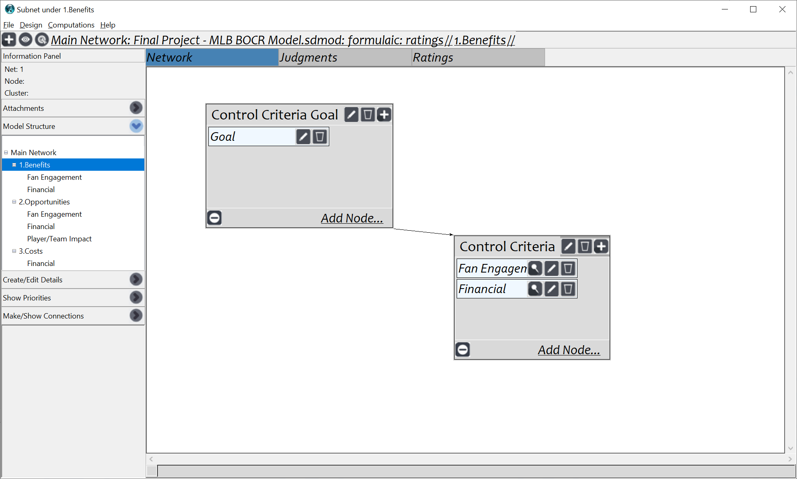
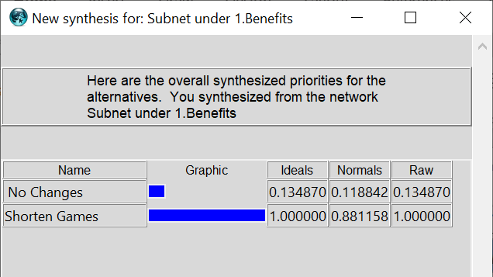
Benefits

Slide 9
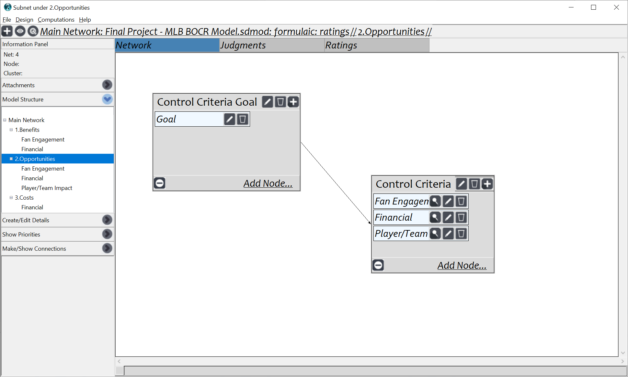
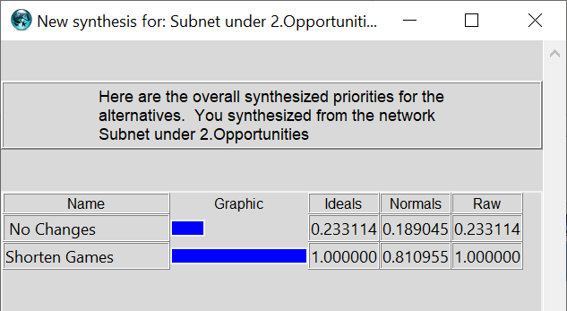
Opportunities

Slide 10
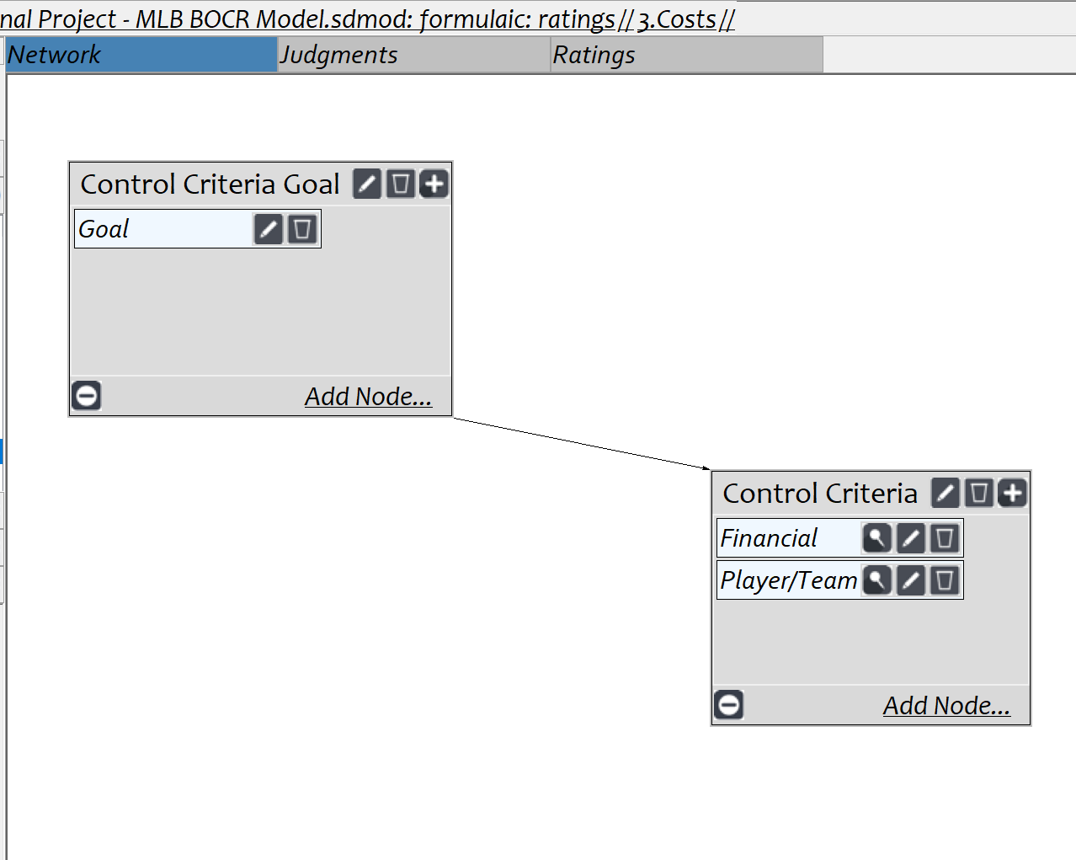
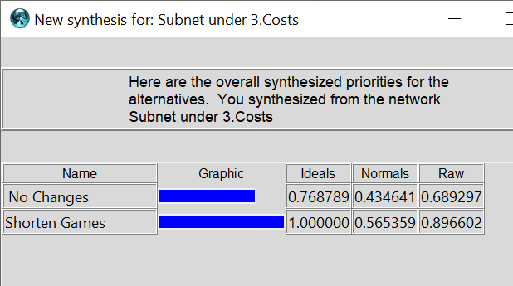
Costs

Slide 11
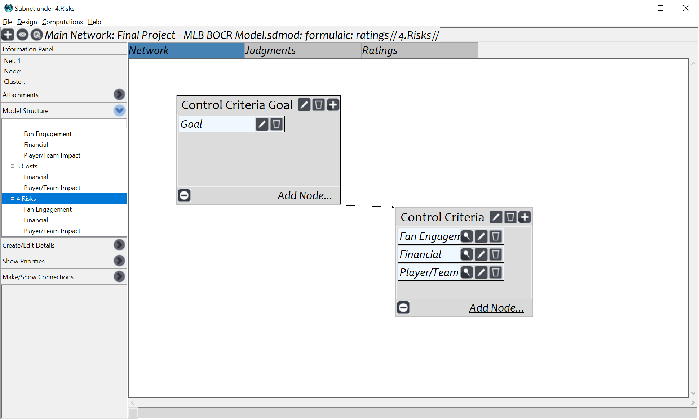
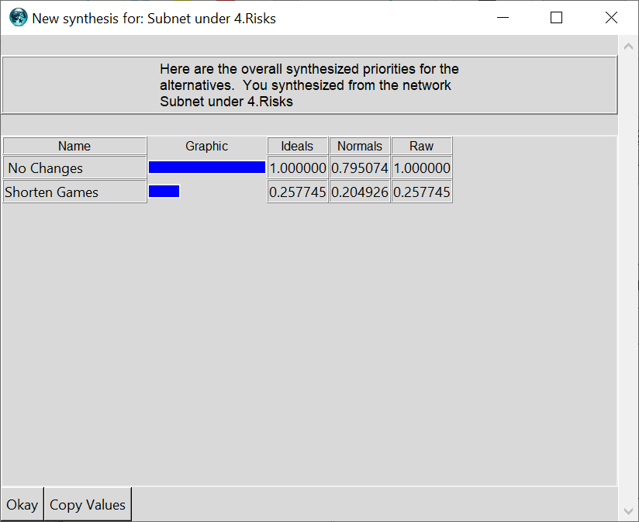
Risks

Slide 12
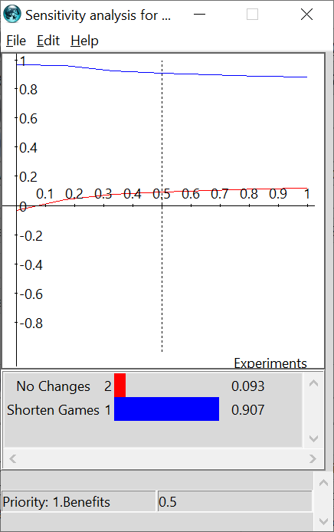
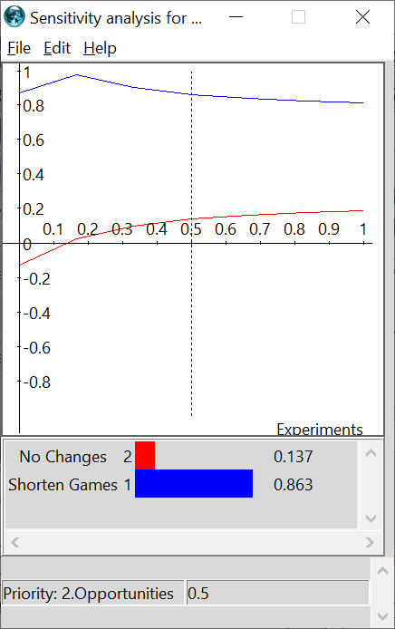
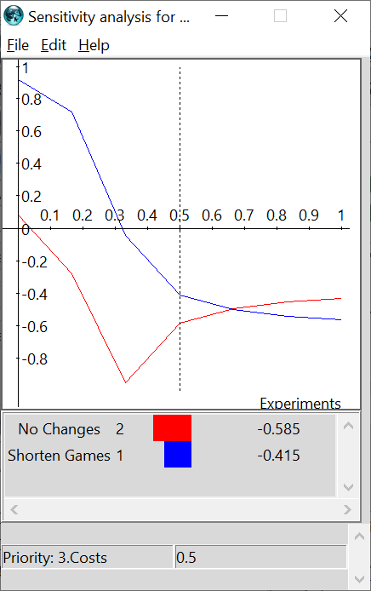
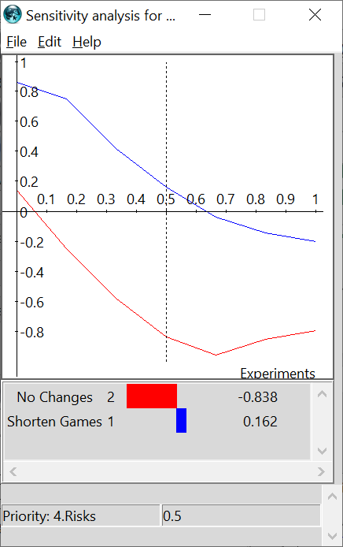
Sensitivity Analysis

Slide 13
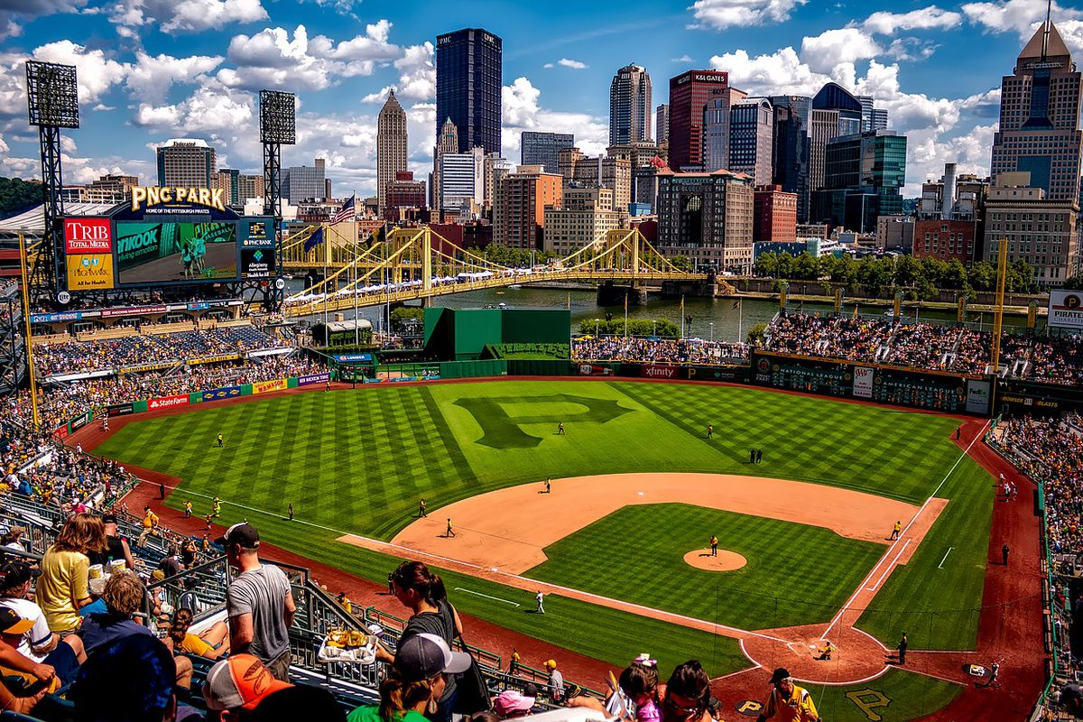
Conclusion
According to our model MLB should reduce the length of their games to 7 innings
7 inning games according to our model would provide greater benefits, increased opportunities, and decrease costs
Possibly some bias as we are fans
Could be a hard sell since the game hasn’t had a major change in some time
Covid provided an opportunity to experiment with 7 inning games

