Slide 1
Should the NCAA Host a National Wrestling Dual Meet Championship?
By Cole Aaron

Slide 2
Background
Competitions types:
Dual Meets
Team vs. Team
Most frequent form of regular season competition
Individual Tournaments
Individually focused
Only form of post season competition

Slide 3
Post Season Alternatives
Host a National Dual Meet Competition
Seven team competition based on conference champions
Do Not Host a National Dual Meet Competition
Current Structure

Slide 4
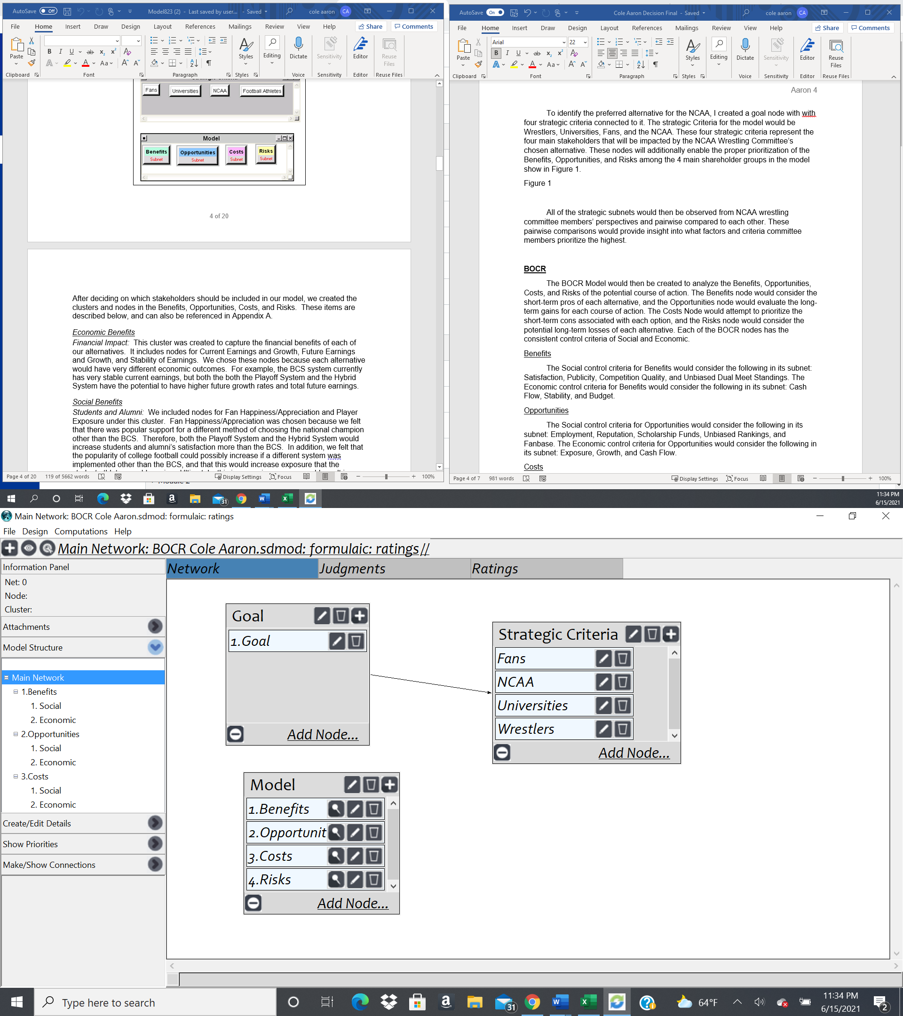
Model Overview
Goal
Strategic Criteria
Fans
NCAA
Universities
Wrestlers
BOCR Model & Control Criteria
Social
Economic
Alternatives

Slide 5
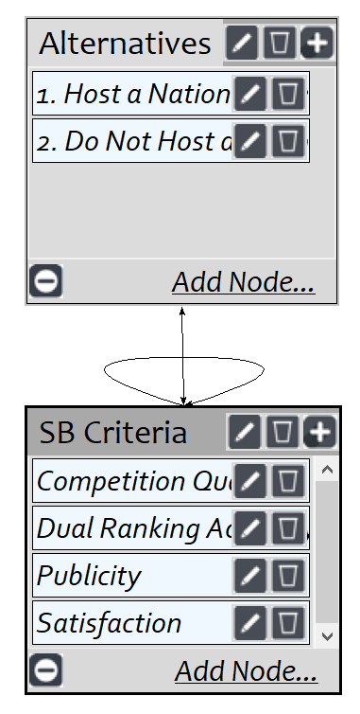
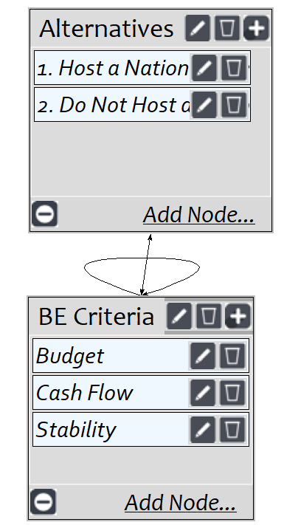
Benefits
Social
Economic

Slide 6
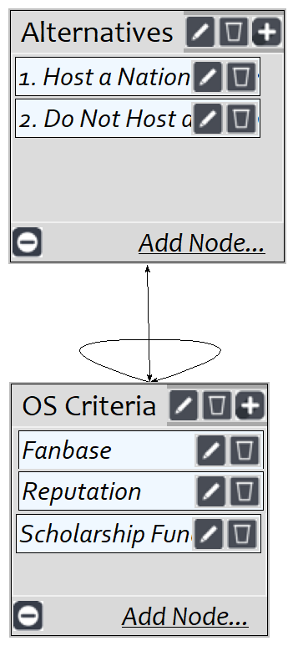
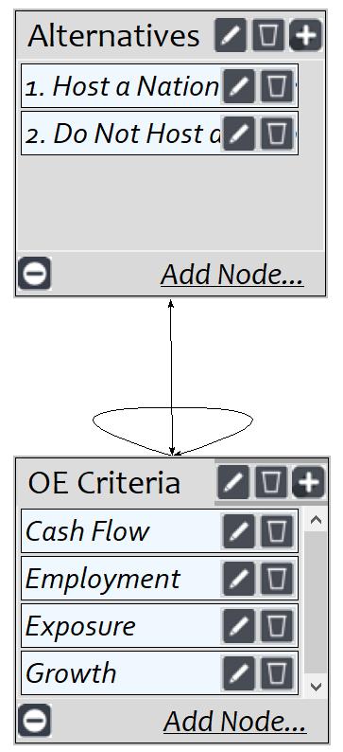
Opportunities
Social
Economic

Slide 7
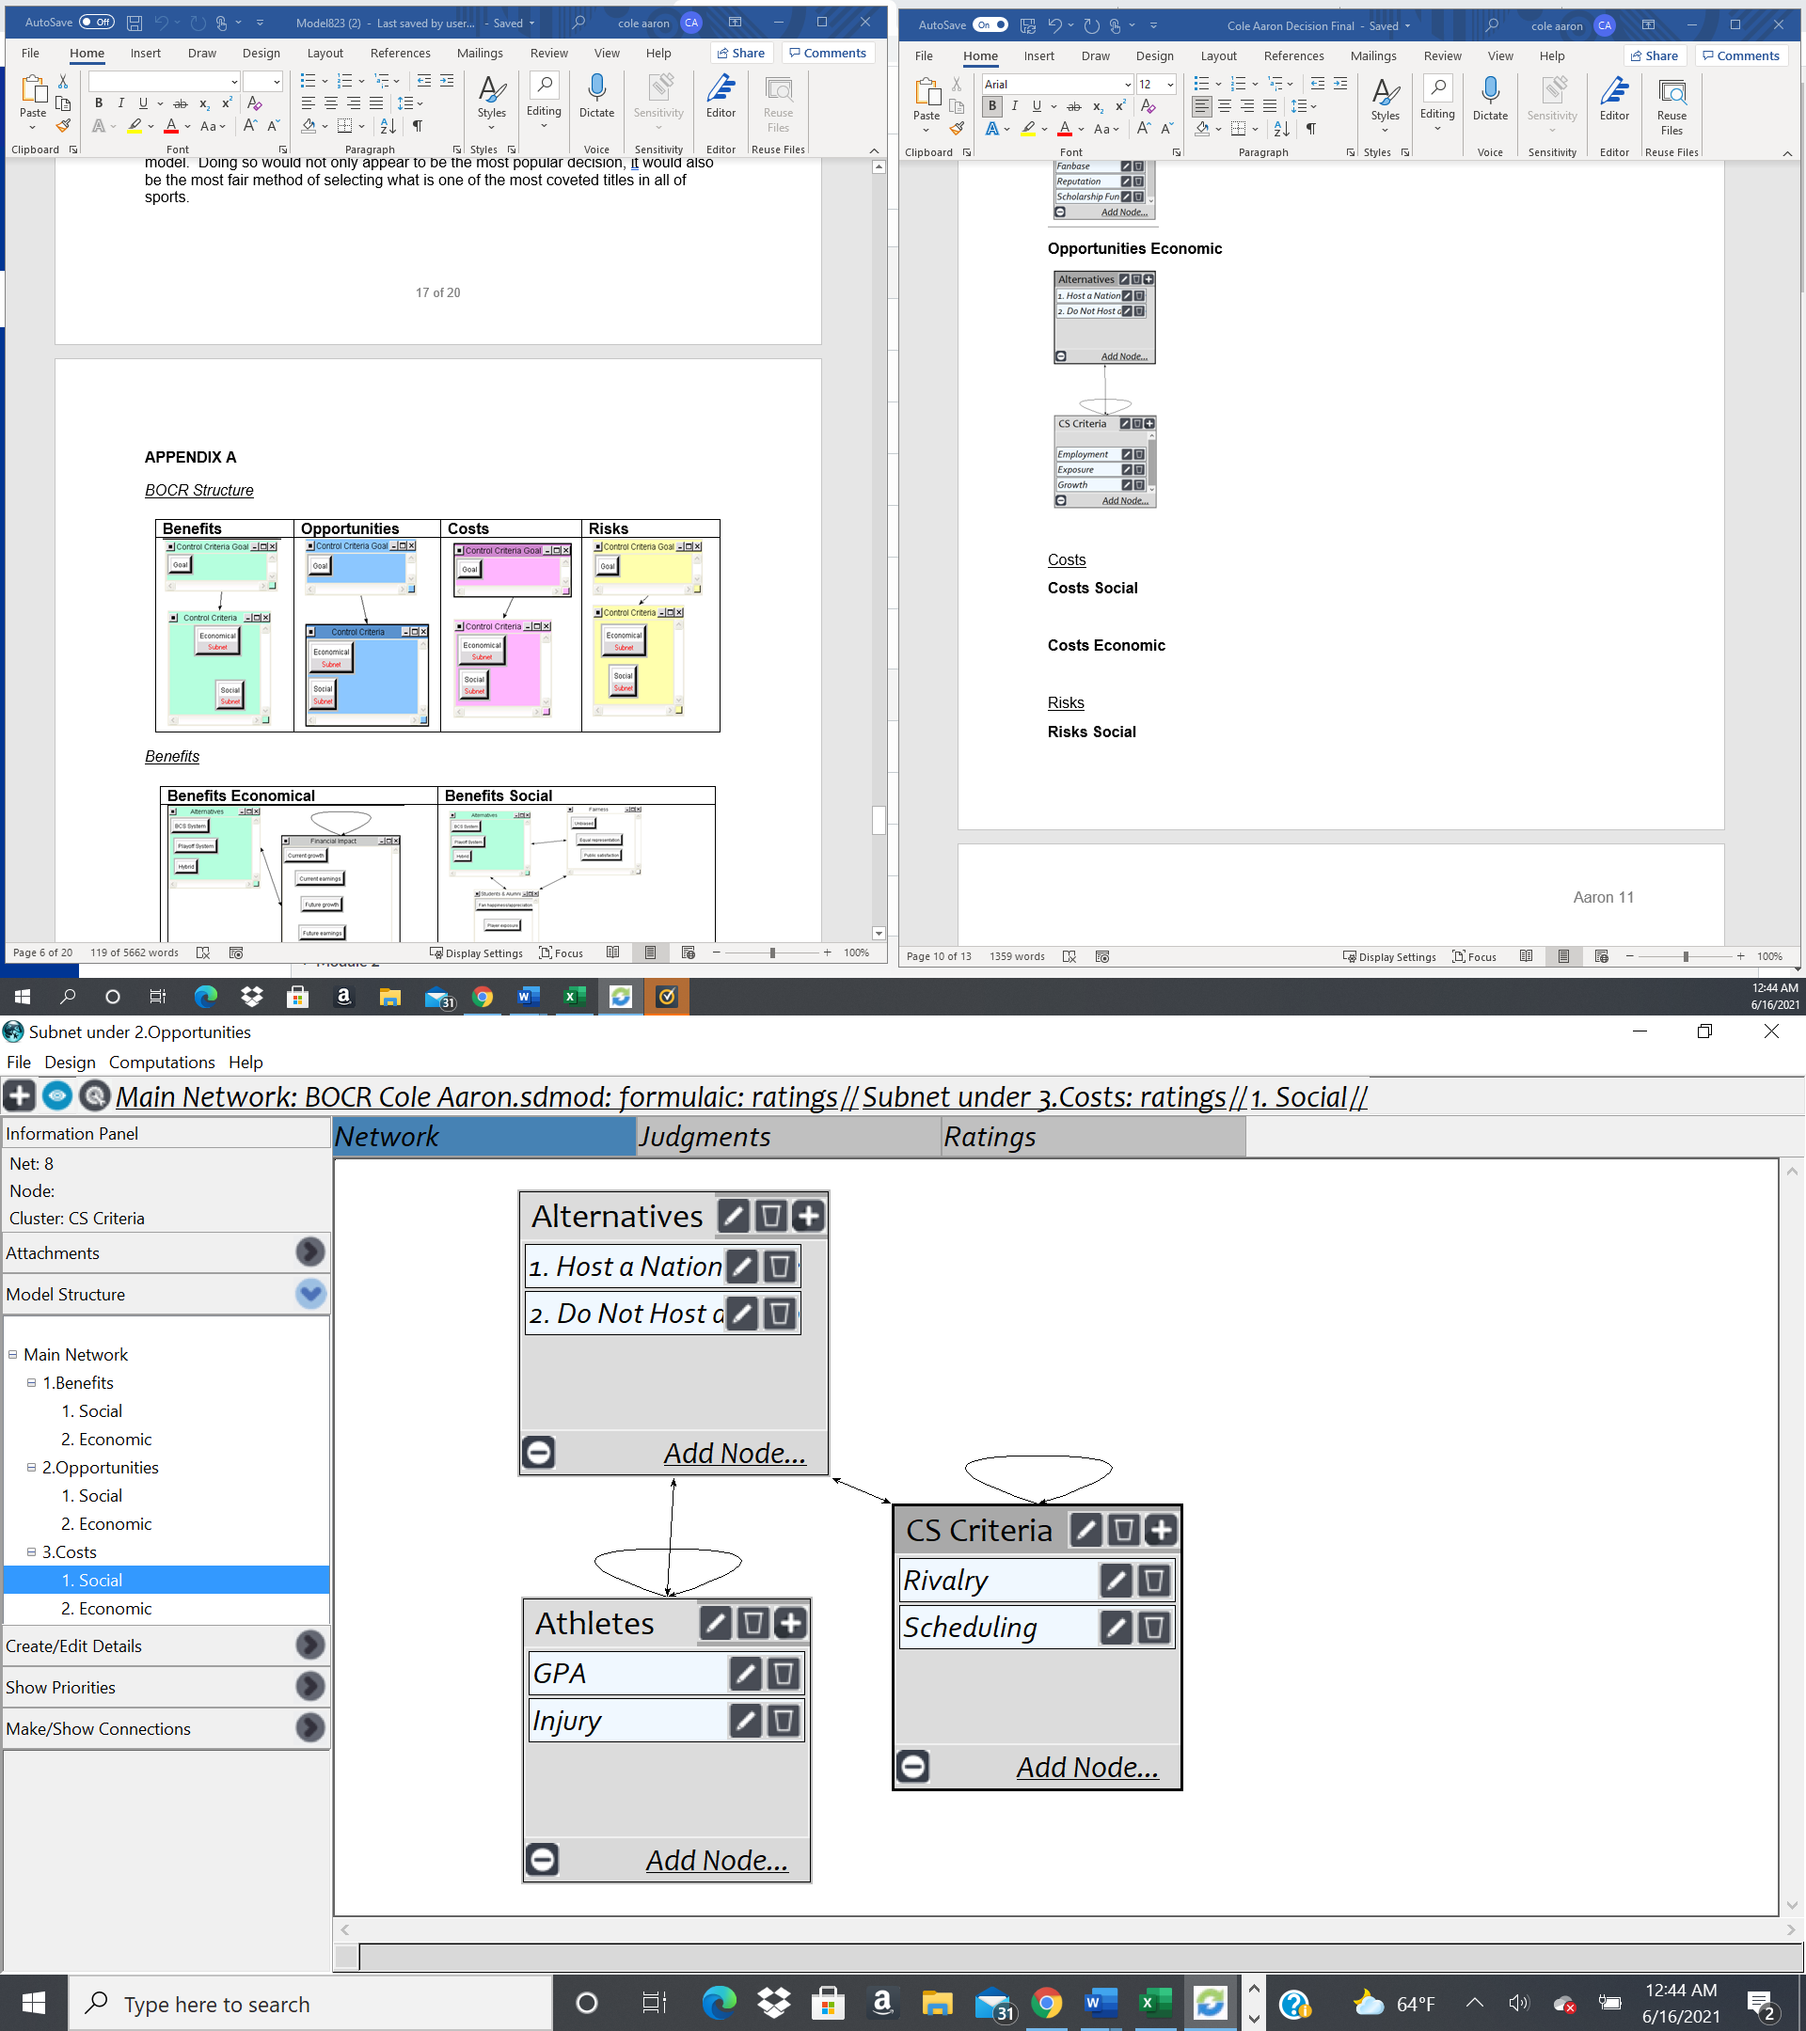
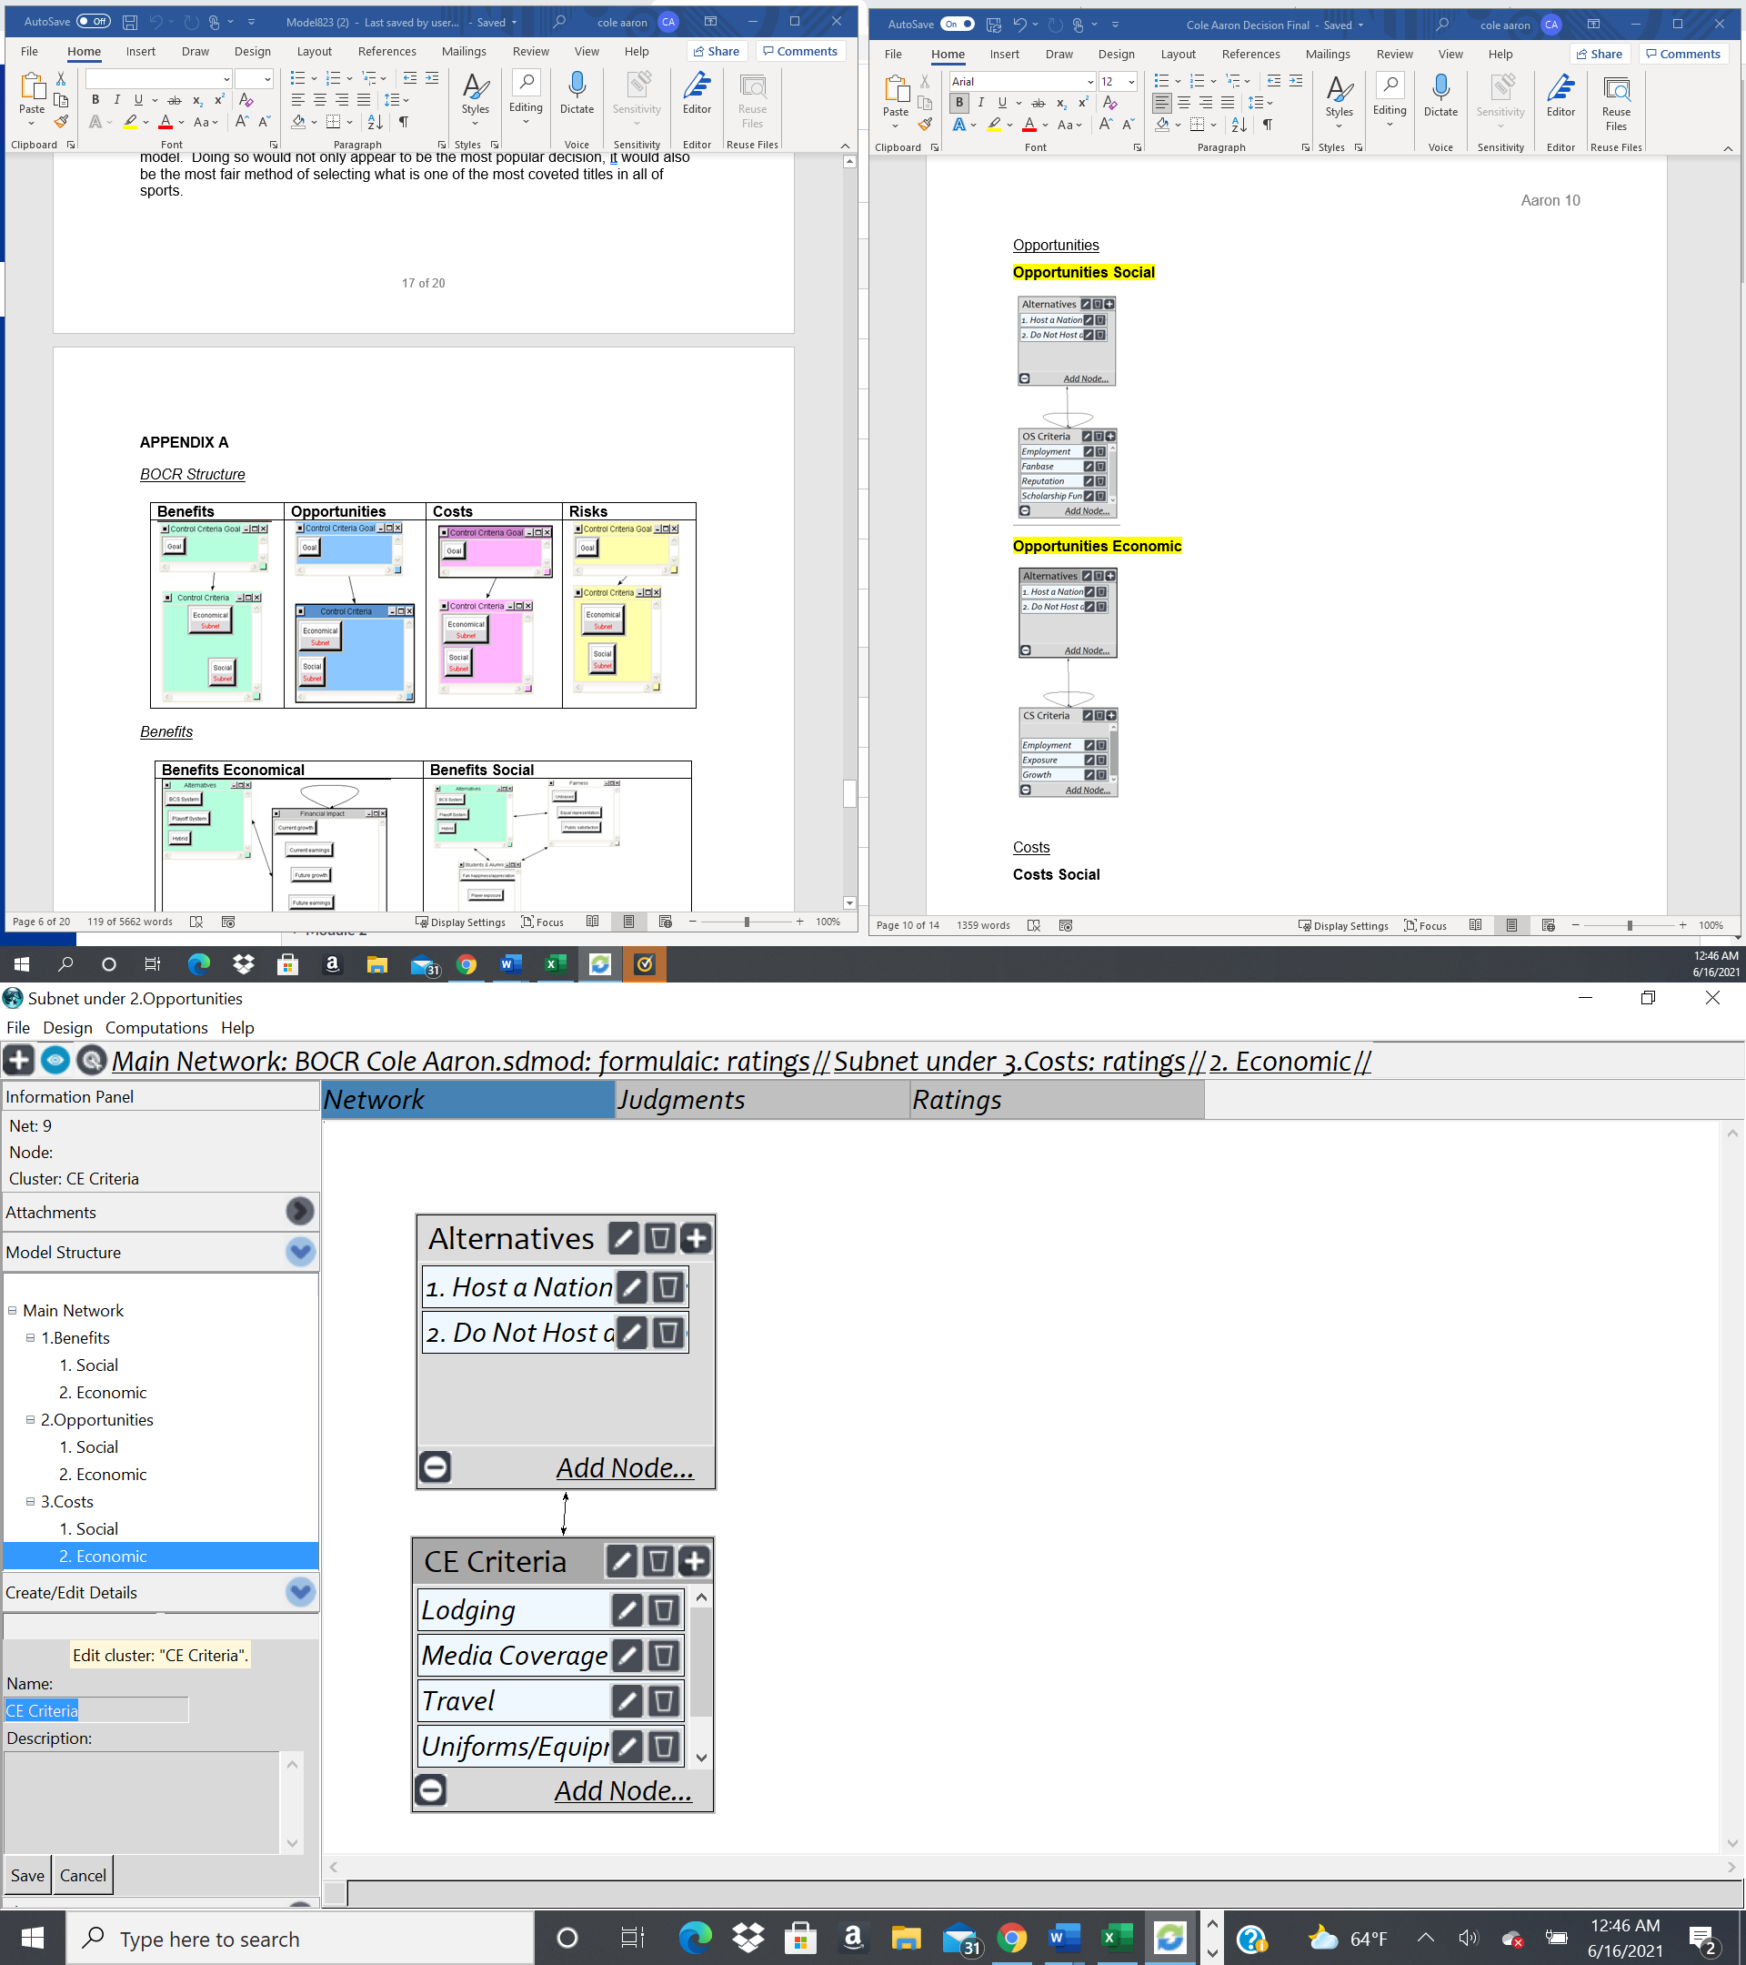
Costs
Social
Economic

Slide 8
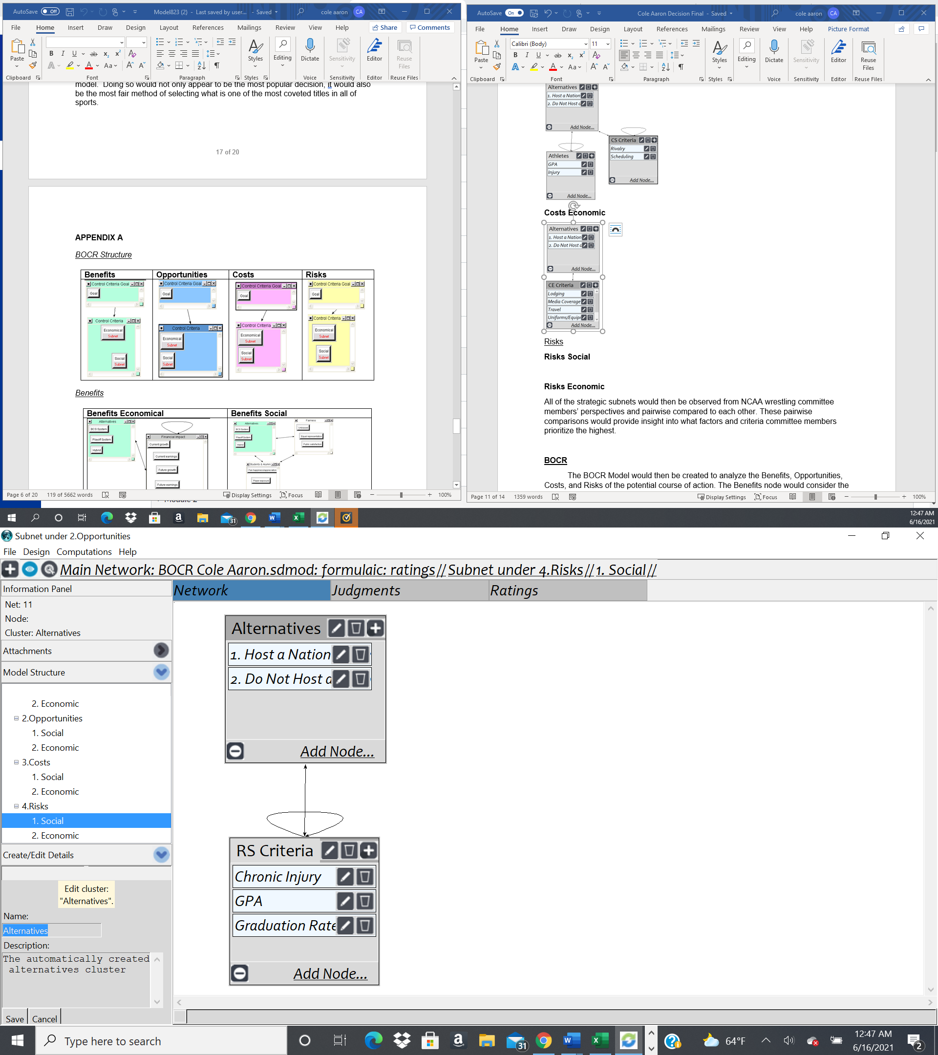
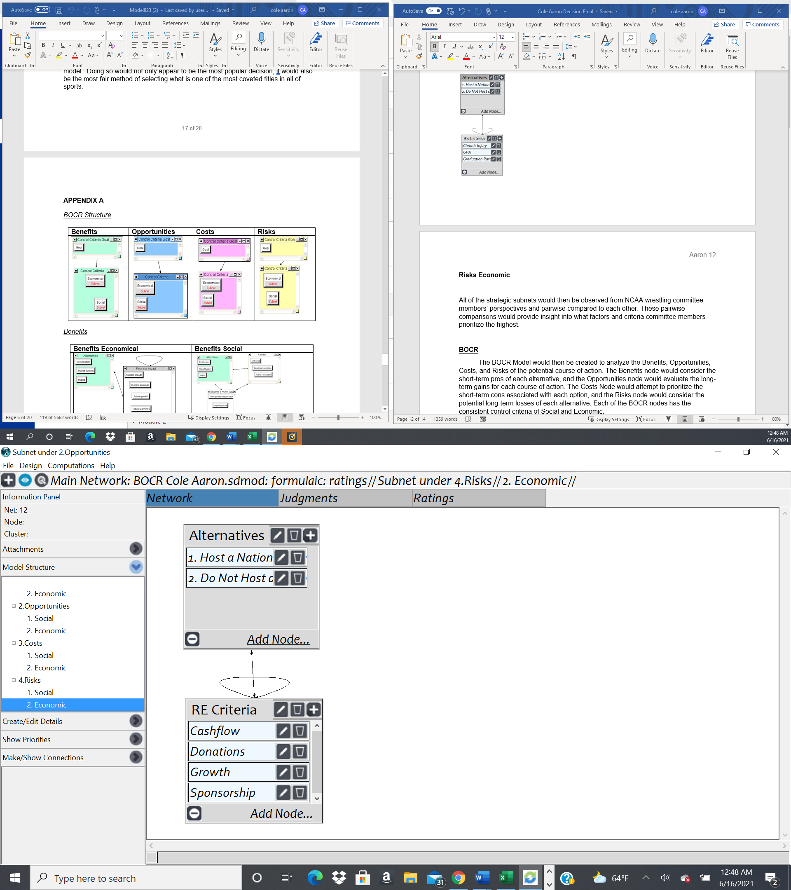
Risks
Social
Economics

Slide 9
BOCR Synthesized Priorities
Benefits
Opportunities
Costs
Risks
Overall Synthesized Priorities for Benefits
Name | Ideals | Normals | Raw
1. Host a National Wrestling Dual Meet Competition | 1 | 77% | 1
2. Do Not Host a National Wrestling Dual Meet Competition | 0.301414 | 23% | 0.301414
Overall Synthesized Priorities for Costs
Name | Ideals | Normals | Raw
1. Host a National Wrestling Dual Meet Competition | 1 | 72% | 1
2. Do Not Host a National Wrestling Dual Meet Competition | 0.391512 | 28% | 0.391512
Overall Synthesized Priorities for Opportunities
Name | Ideals | Normals | Raw
1. Host a National Wrestling Dual Meet Competition | 1 | 65% | 1
2. Do Not Host a National Wrestling Dual Meet Competition | 0.530516 | 35% | 0.530516
Overall Synthesized Priorities for Risks
Name | Ideals | Normals | Raw
1. Host a National Wrestling Dual Meet Competition | 1 | 52% | 0.924609
2. Do Not Host a National Wrestling Dual Meet Competition | 0.92263 | 48% | 0.853071

Slide 10
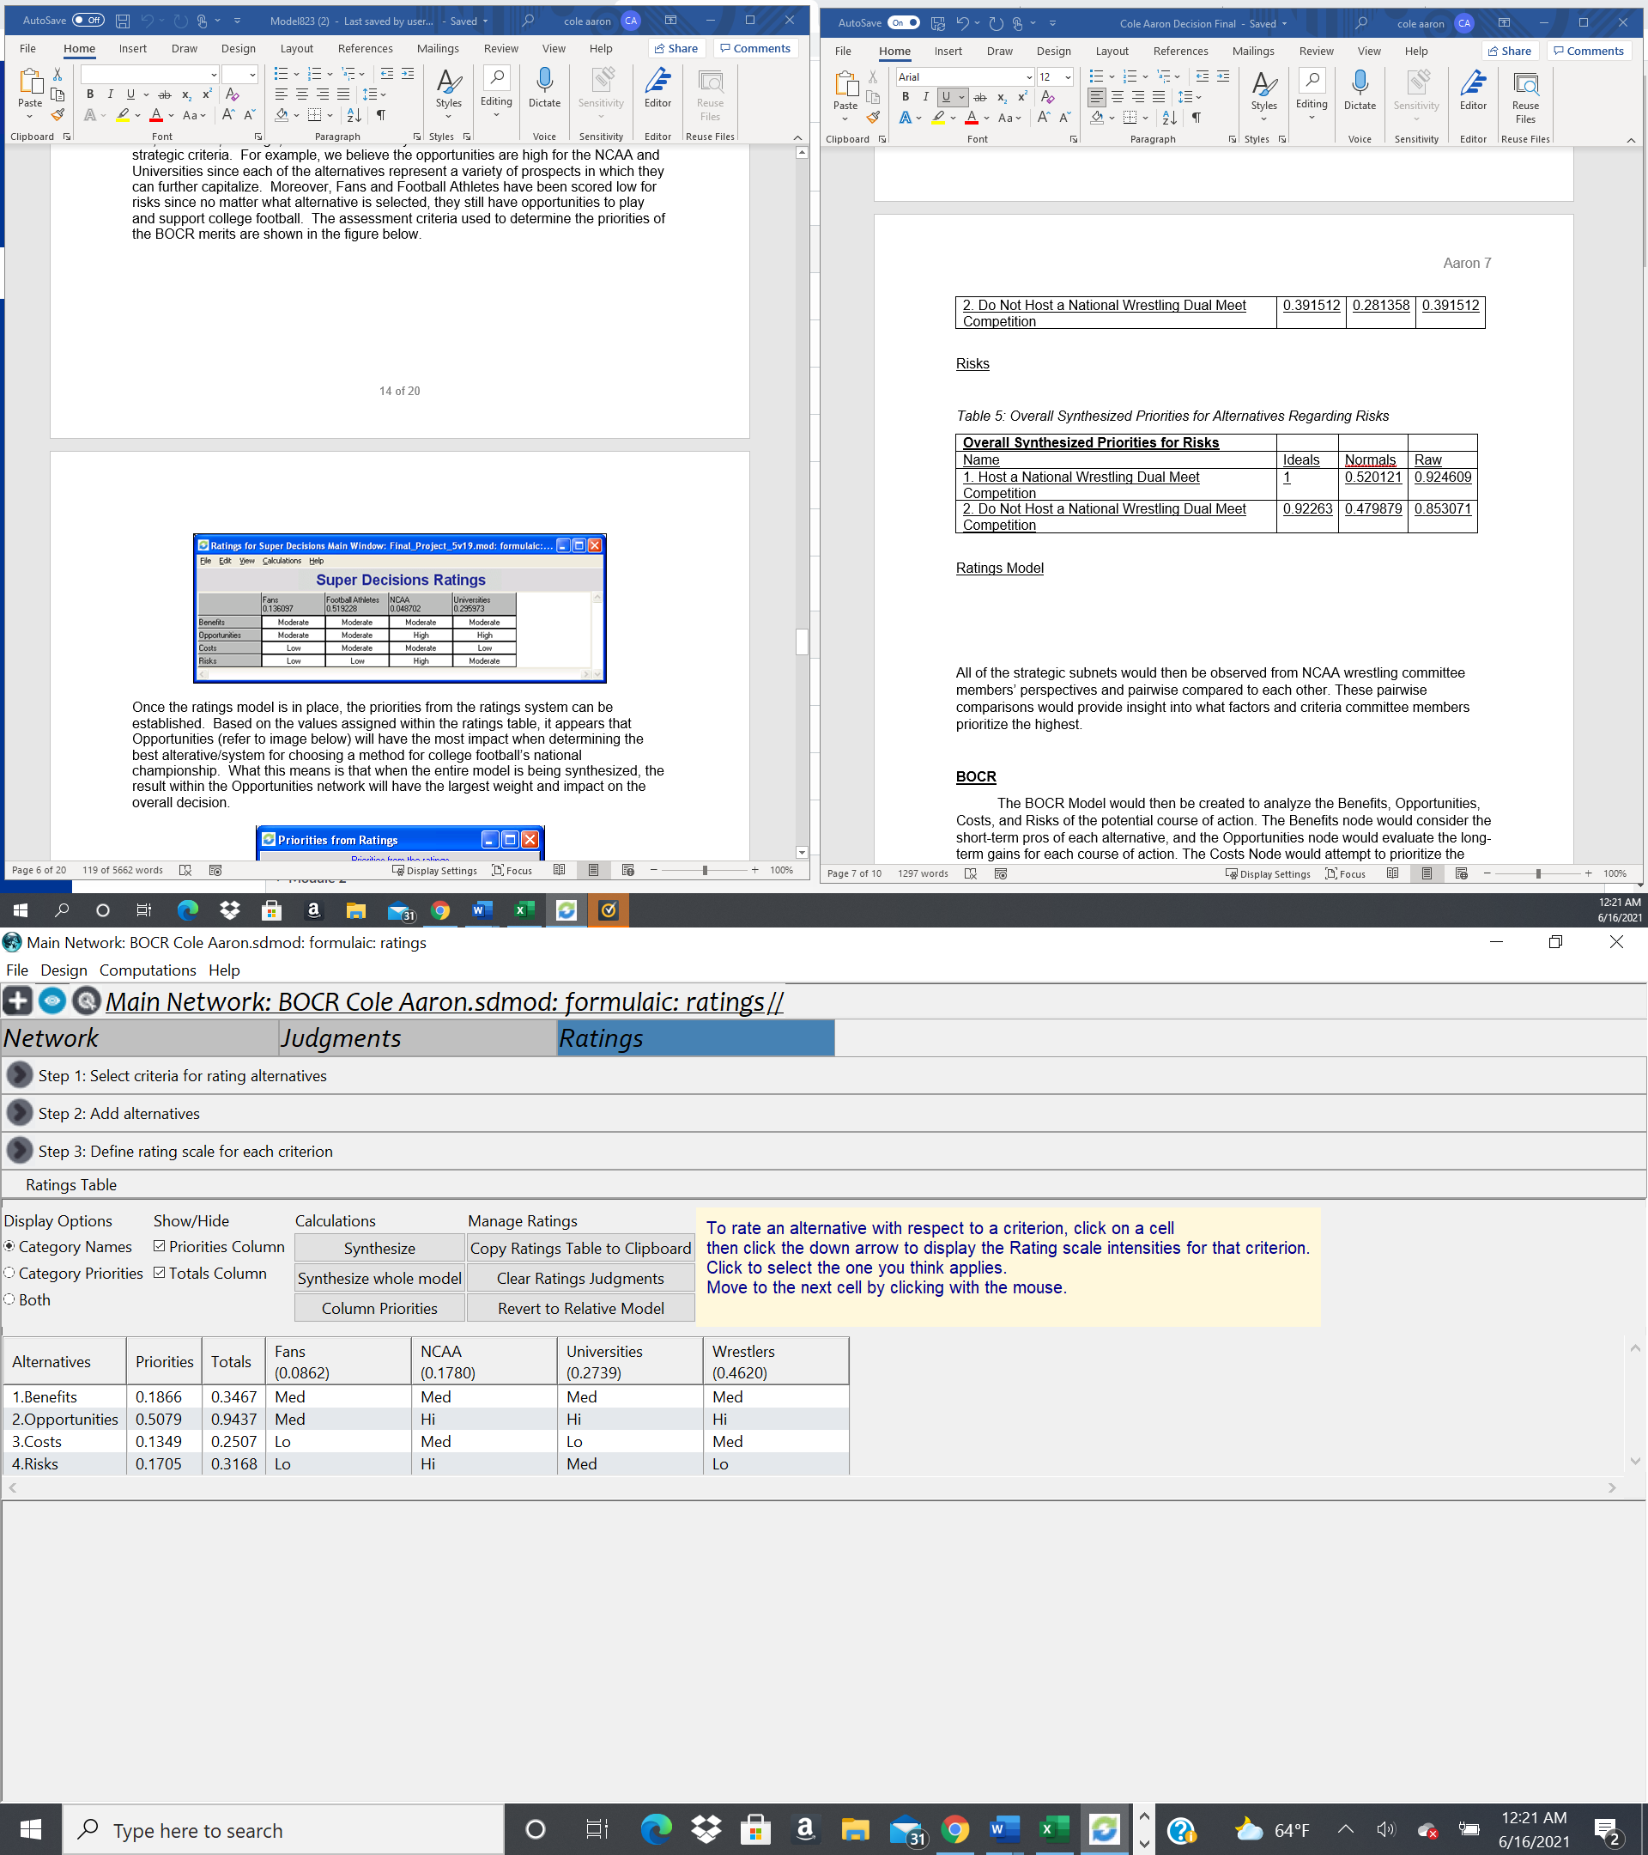
Ratings Model

Slide 11
Full Model Results
Short-Term
Long-Term
Overall Synthesized Priorities for Alternatives [Multiplicative (Short-Term)]
Name | Ideals | Normals | Raw
1. Host a National Wrestling Dual Meet Competition | 1 | 69% | 1.081539
2. Do Not Host a National Wrestling Dual Meet Competition | 0.442678 | 31% | 0.478773
Overall Synthesized Priorities for Alternatives [Additive (Negative)]
Name | Ideals | Normals | Raw
1. Host a National Wrestling Dual Meet Competition | 1 | 76% | 0.401909
2. Do Not Host a National Wrestling Dual Meet Competition | 0.316987 | 24% | 0.1274

Slide 12


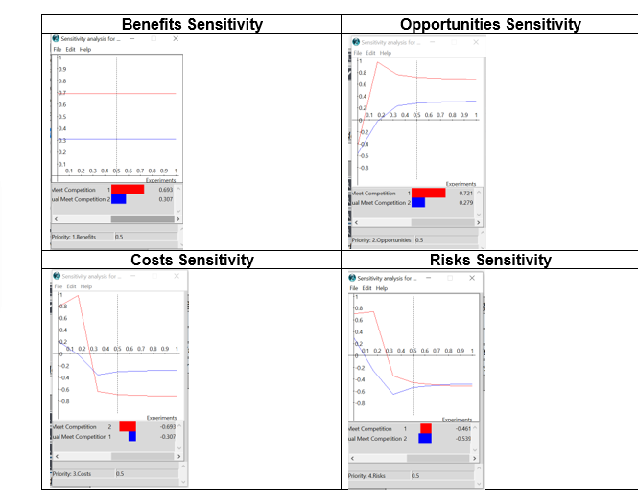



Sensitivity Analysis

Slide 13
Thank You!

