Slide 1

Should the MLB implement a salary cap?
Decision Making
Norman Mahfood Jr.

Slide 2
The Decision…
Current Rules
No Salary Cap
Other possibilities
High-level Salary Cap
Mid-level Salary Cap
Low-level Salary Cap
Rationale
Teams with higher payroll win majority of time.
Ratings dipping and fans in smaller markets not as interested.
MLB wants to grow and expand its fan base.

Slide 3
Criteria
MLB Revenue– Would more teams having a chance of winning the World Series lead to higher revenues? Would the lower salary costs outweigh the risks?
Fan Support – Would the fans be more interested in the sport if more teams had potential chances to win? Would the enhanced competitive balance lead to higher ratings and growth in smaller and new markets?
MLB Media Coverage- Will the MLB receive more media coverage and better ratings given the increased competitive balance of the league.
Players’ Union- What is the response of the MLB Players’ Union to any proposed salary cap? Will there be a strike if cap is imposed?

Slide 4
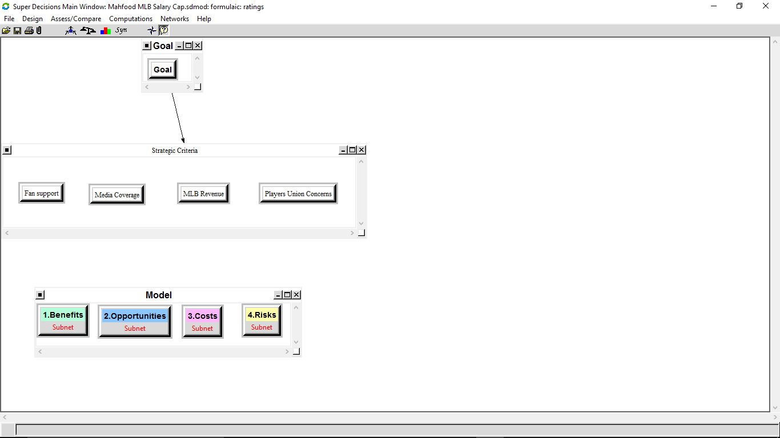
The Hierarchy

Slide 5
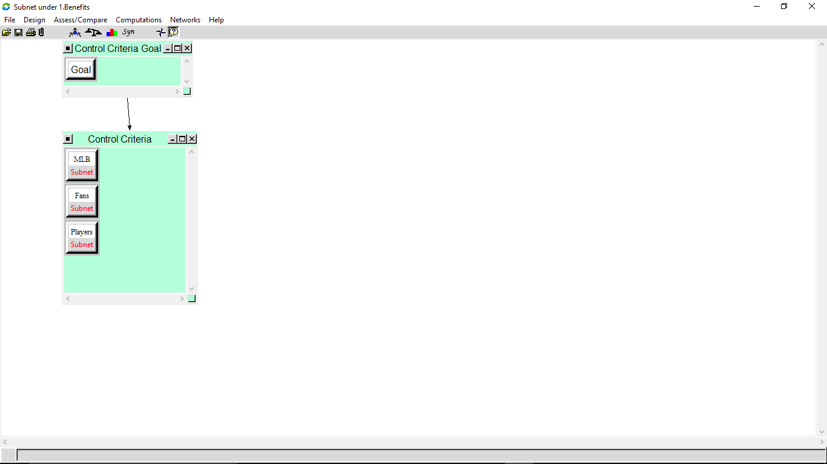
Subnets
The standard benefits, opportunities, costs, and risks criteria were used.
These criteria were judged accordingly with regards to the players, the MLB and fans of the MLB

Slide 6
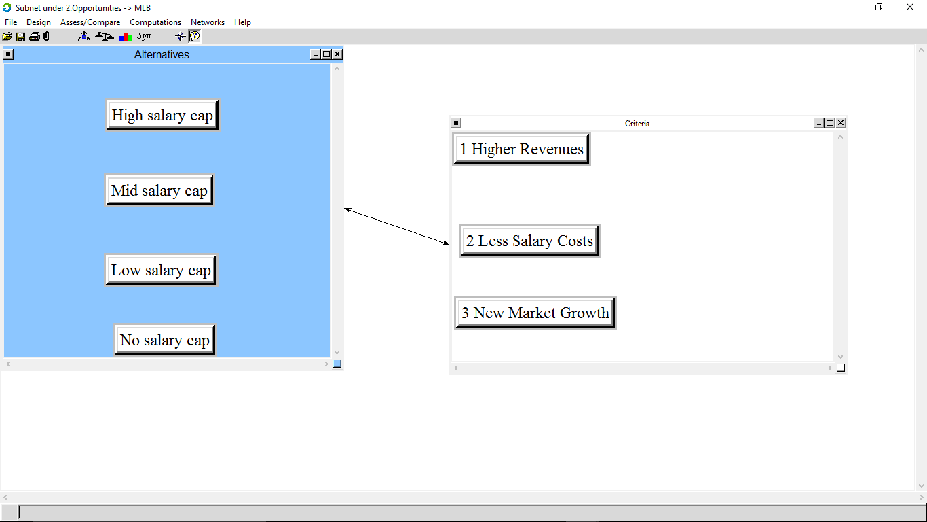
Subnets Cont’d
Opportunity criteria for the MLB included higher revenues, less salary costs, and new market growth stemming from increased competitive balance across the league.
This set of criteria was the most influential in the decision made by the model.

Slide 7
The Alternatives
Option 1 – Keep the existing rules where there is no salary cap.
Option 2 – Implement a high-level salary cap.
Option 3 – Implement a mid-level salary cap.
Option 4 – Implement a low-level salary cap.

Slide 8
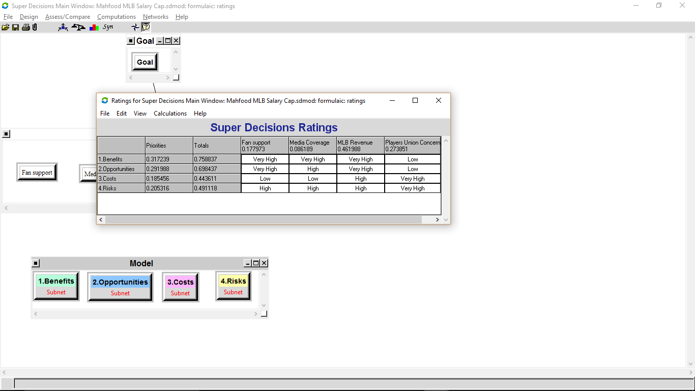
The Ratings…
The benefits of implementing a salary cap carry the most weight. This is due to the probability of increased revenue for the MLB.
The Opportunity of implementing a salary cap is the second most important factor due to opportunity at higher exposure and new market growth.

Slide 9
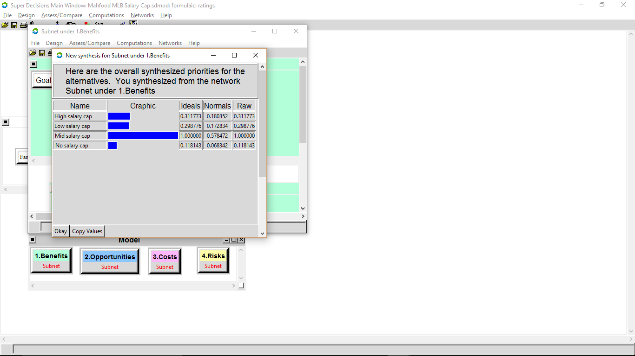
Benefits
: Mid-level salary cap Produces most benefits
Players
Better chance at winning championships.
MLB
Competitive Balance
Higher Revenue
Fans
More competitive balance
Increased interest

Slide 10
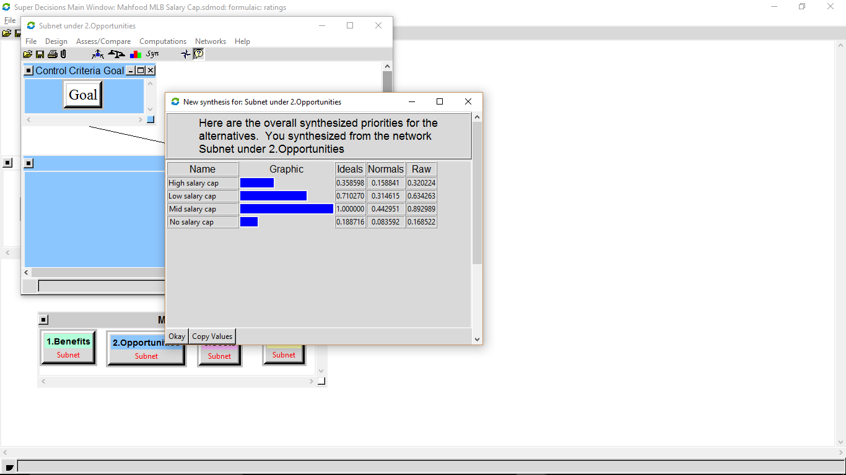
Opportunities
Mid-level salary cap is the best option for opportunities.
MLB
Market Growth
Revenues
Players
More exposure
Better championship chances.
Fans
More parity
Better on field product.

Slide 11
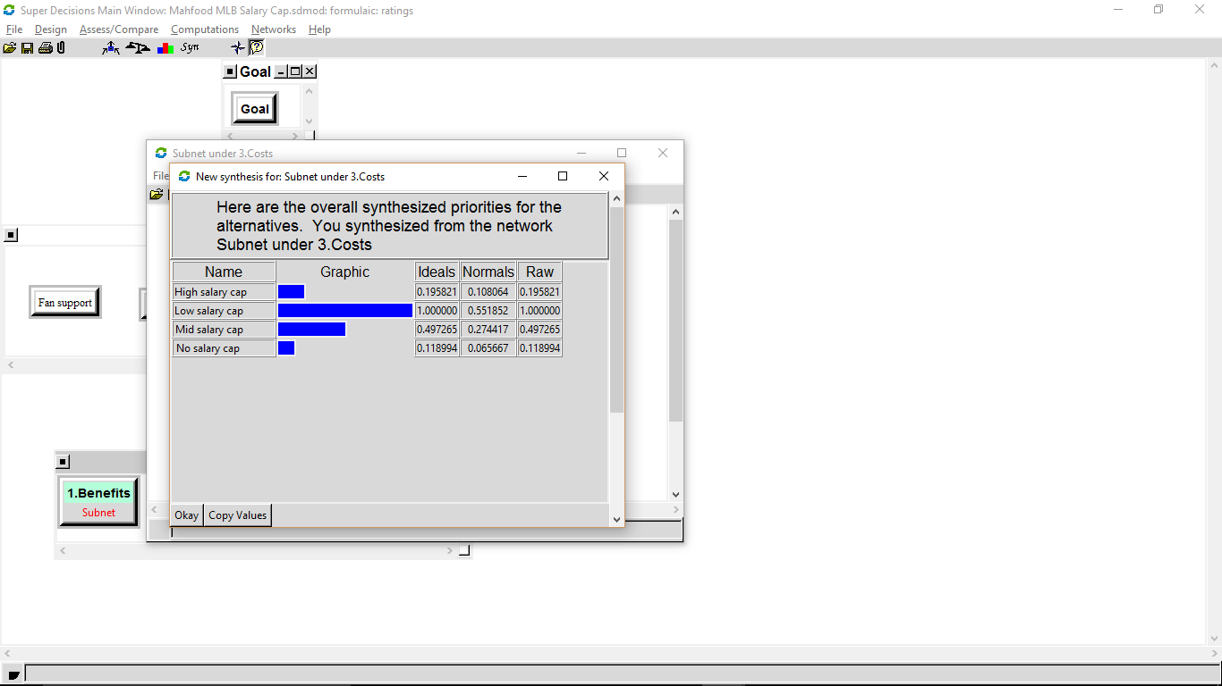
Costs
Low-level salary cap has highest costs
MLB
Increased revenue share for players.
Players
Lower salaries

Slide 12
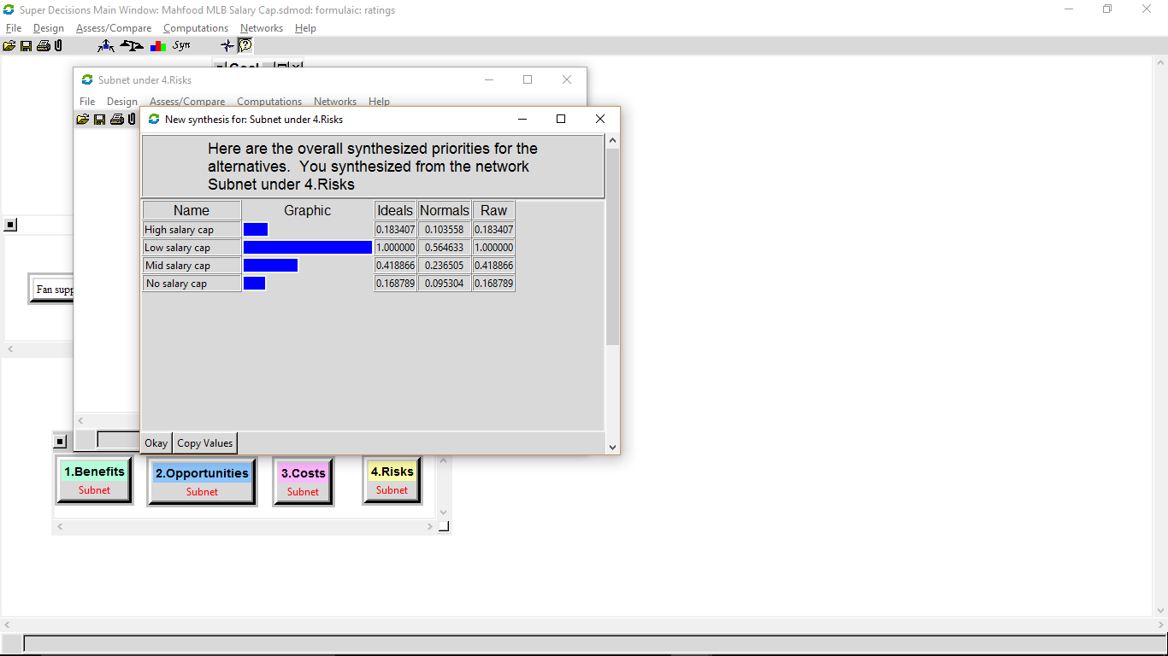
Risks
Low-level salary cap has highest risks.
Players
Salary cuts
Strike possibility
Replaced by cheaper players
MLB
Player’s strike
Loss of interest in already large markets.
Upset current fan base
Fans
Strike
Loss of favorite players

Slide 13
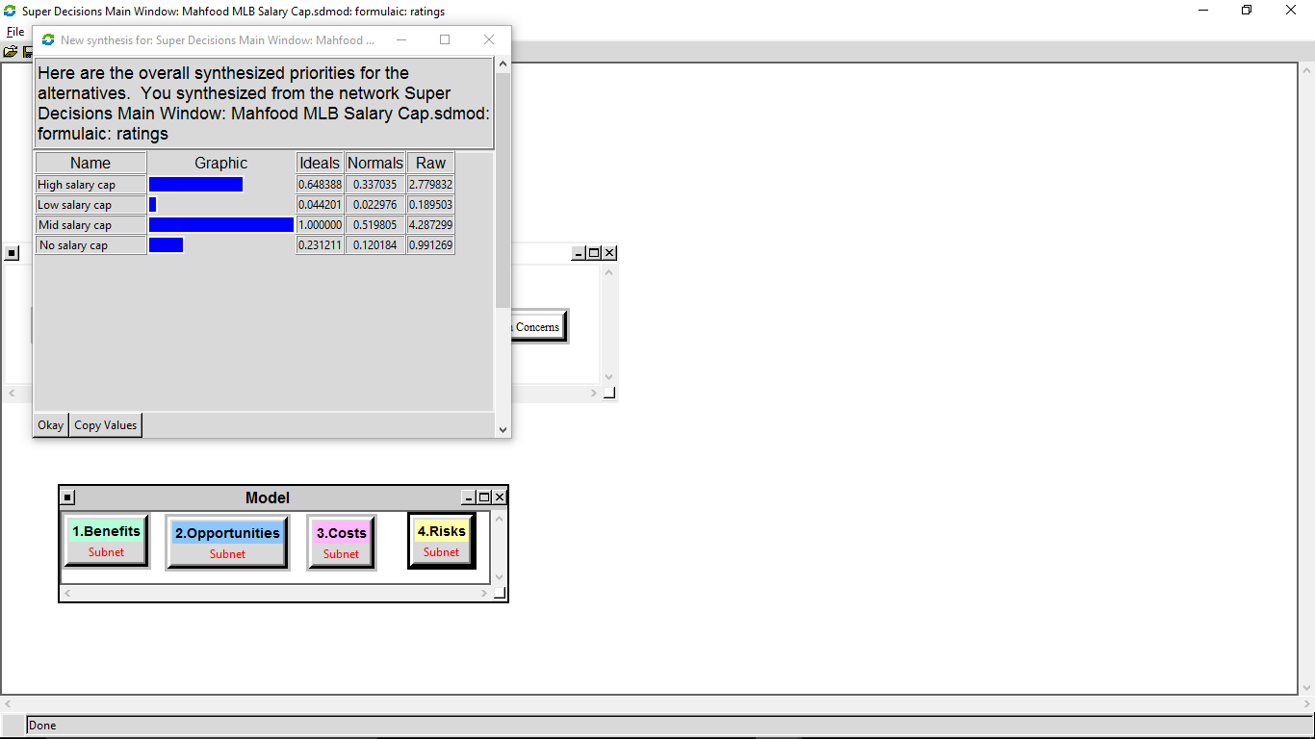
Overall Results
The Multiplicative formula shows that a high or mid cap would have a positive effect.
The ideal situation for our model is an mid-level cap.

Slide 14
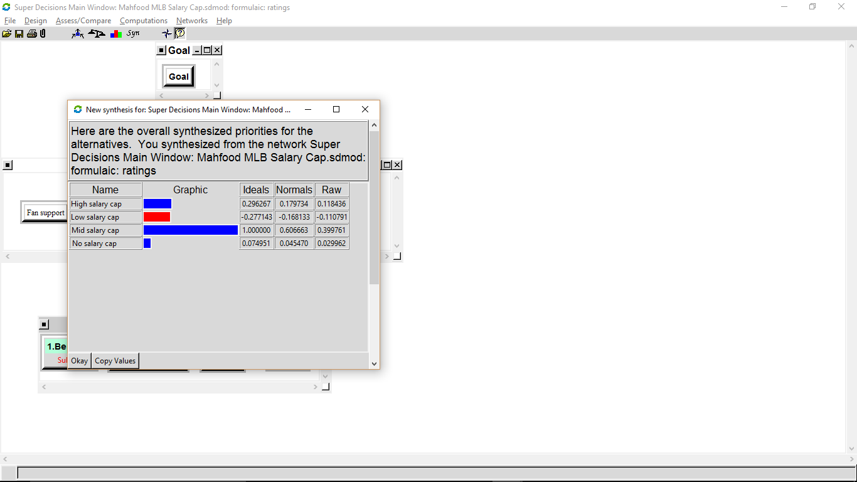
Results Cont’d…
The Additive formula puts more emphasis on the high risk factor.
The results are wider and show that a mid-level cap is the clear best option.

Slide 15
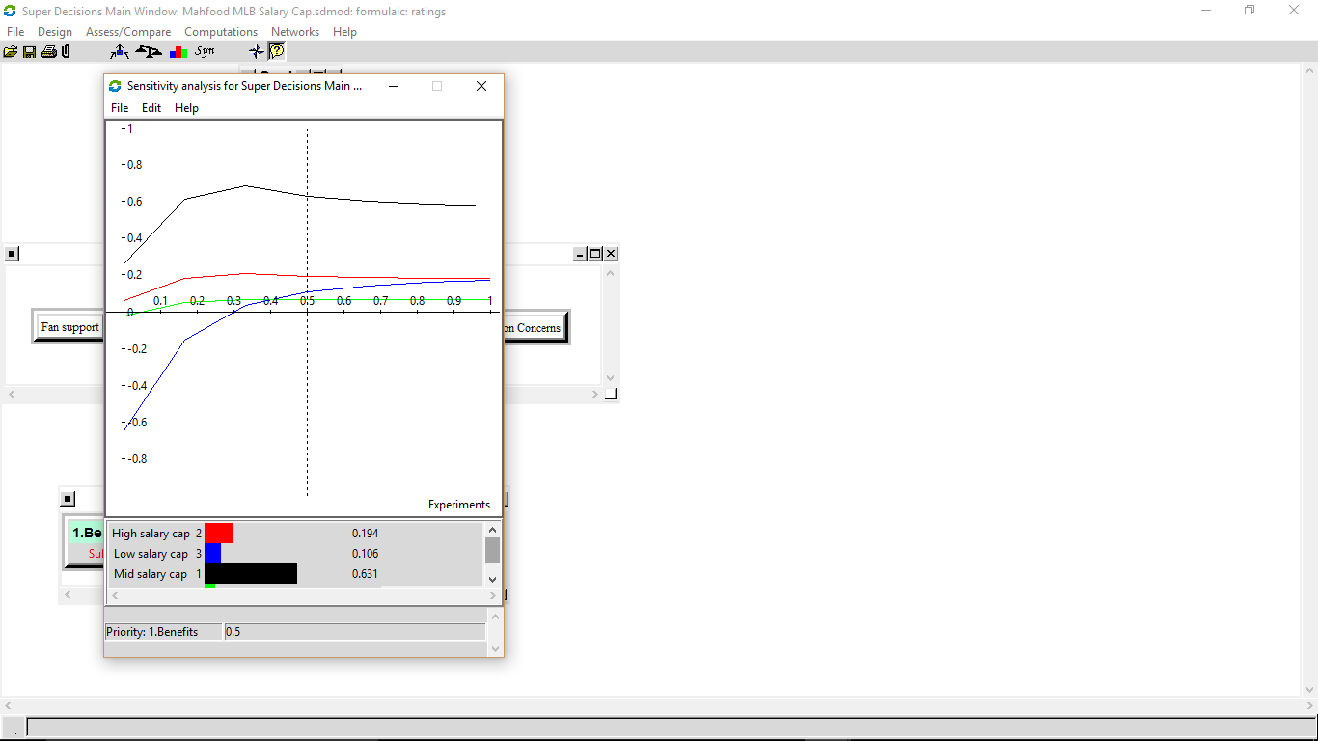
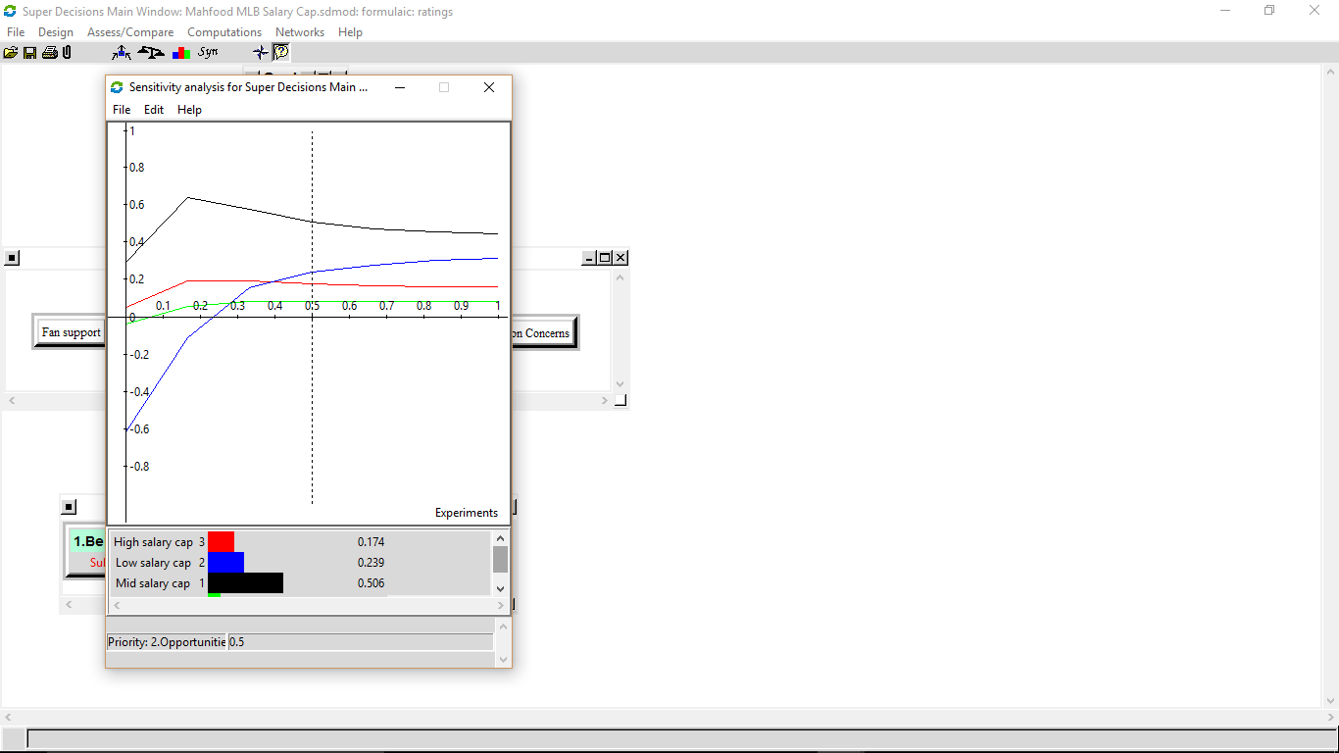
BOCR Sensitivity
Benefits
Opportunities

Slide 16
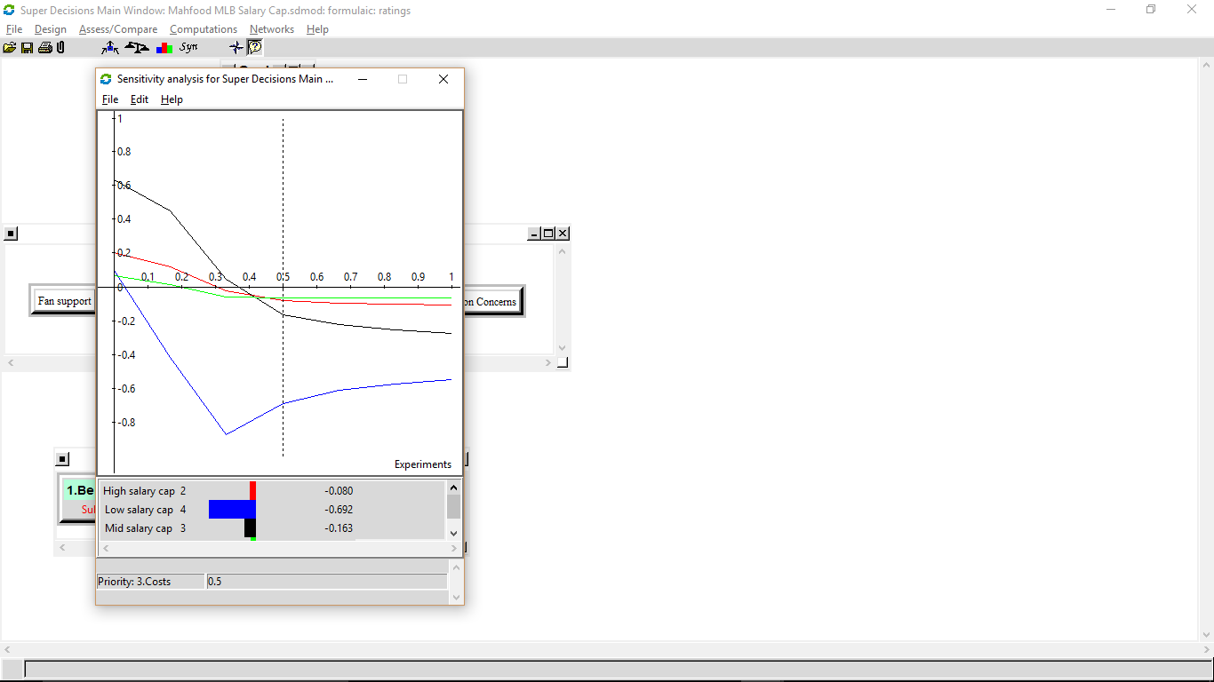

BOCR Sensitivity
Costs
Risks

Slide 17
References
https://en.wikipedia.org/wiki/List_of_World_Series_champions
http://www.usatoday.com/sports/mlb/salaries/2016/team/all/

