Slide 1
ANP BOCR - SHOULD PORSCHE INTRODUCE A SPORTS UTILITY VEHICLE
ALTERNATIVES:
Introduce SUV
Do not introduce SUV

Slide 2
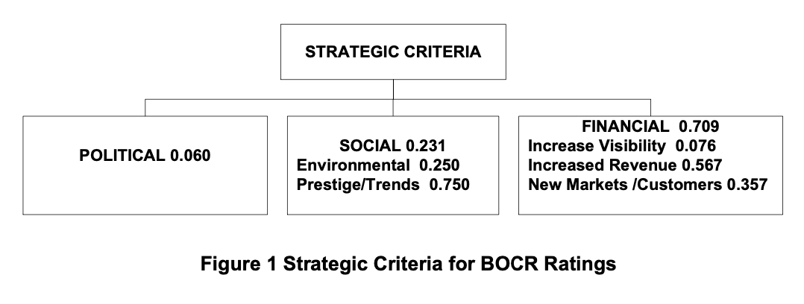
Strategic Criteria

Slide 3
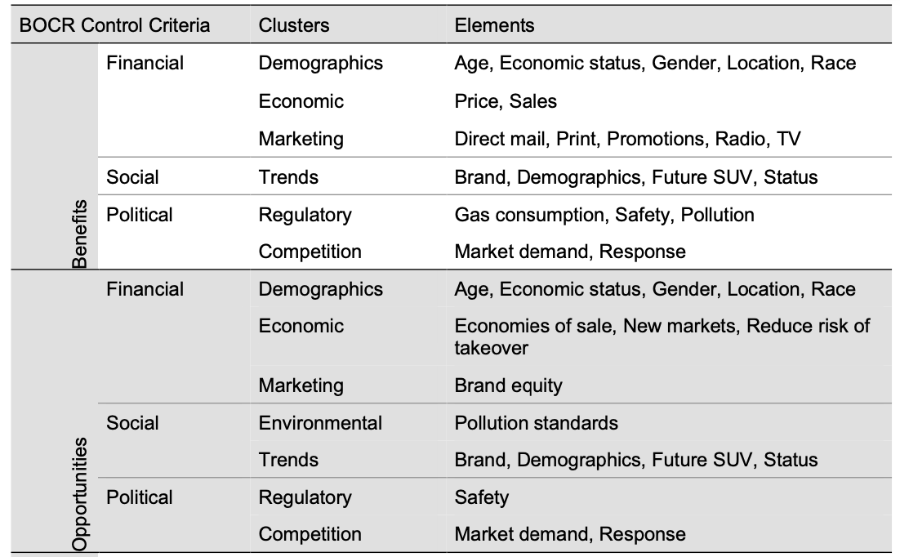
Model – BOCR subnets

Slide 4
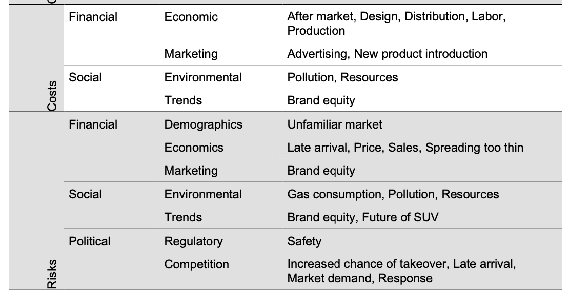
Model – BOCR subnets

Slide 5
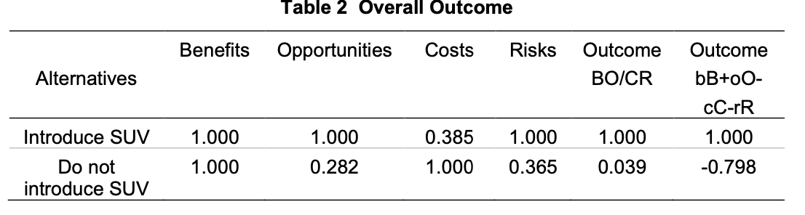
Results

