Slide 1
ANP BOCR - SELECTING THE HOST CITY FOR THE SUMMER OLYMPICS 2000
ALTERNATIVES:
Beijing
Berlin
Istanbul
Manchester
Sydney

Slide 2
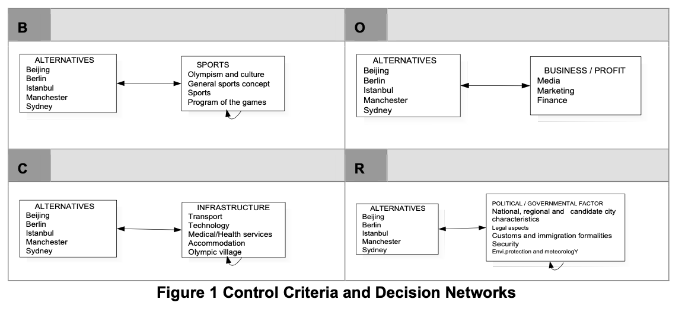
Model – BOCR subnets

Slide 3
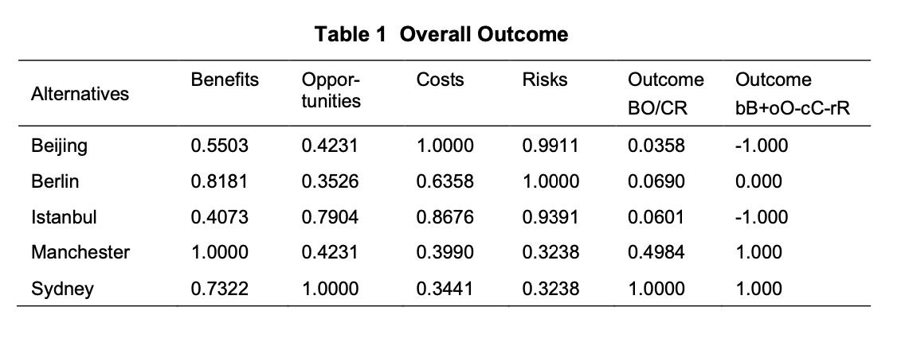
Results

