Slide 1

Should the NFL Add Games to Its Season?
BQOM 2521
Aaron Bulkley
Tom Charley
Jonathan Hasson

Slide 2
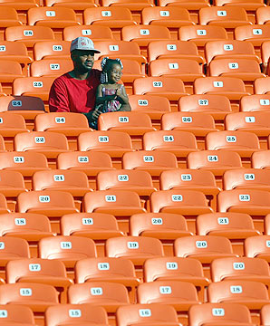
The Decision…
Current Season
16 regular season games
4 preseason games
Extension Proposal
17 or 18 regular season games
3 or 2 preseason games
Rationale
Collective Bargaining Agreement allots 59.5% of revenue to players’ salaries
Preseason attendance is low and media coverage is less
Owner’s want to add more regular season games to increase revenue

Slide 3
Criteria
Fan Support – Would fans be excited for a longer regular season? Would they be willing to pay to see more meaningful games?
NFL Revenue – Would the extra games provide significant revenue to the league? Would it be enough to offset the higher costs?
NFL Media Coverage- Is the NFL at risk of overexposure with the increased schedule?
Players Health- Would the stars of the league be able to withstand a longer schedule? What long-term effects could come from the prolonged season?

Slide 4
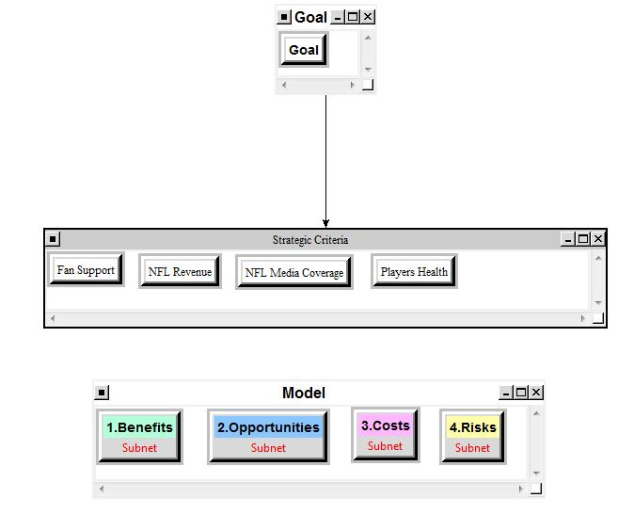
The Hierarchy

Slide 5
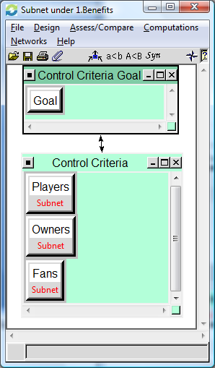
Subnets
The standard benefits, opportunities, costs, and risks criteria were used.
These criteria were judged accordingly with regards to the players, owners and fans of the NFL.

Slide 6
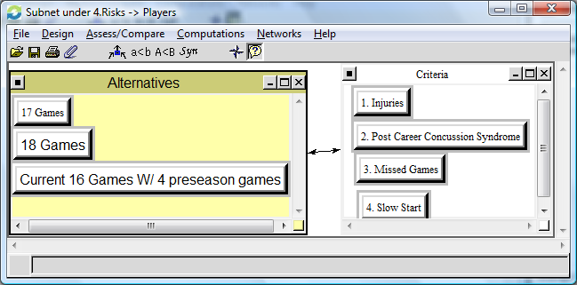
Subnets Cont’d
Risk Criteria for the players included injuries, post-career concussion syndrome, missed games, and slow start.
This set of criteria was the most influential in the decision made by the model.

Slide 7
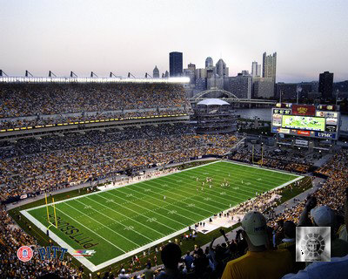
The Alternatives
Option 1 – Keep the existing 16 game schedule including 4 preseason games.
Option 2 – Increase the regular season to 17 games and decrease to 3 preseason games.
Option 3 – Increase the regular season to 18 games and decrease to 2 preseason games.

Slide 8
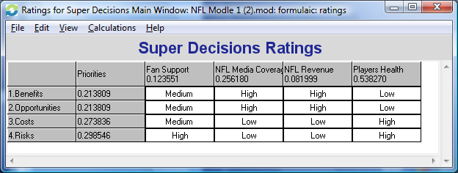
The Ratings…
The risks of increasing the season carry the most weight. This is due to the probability of increased player injury.
The Costs are the second most important factor due to the liabilities associated with the health insurance for players.

Slide 9
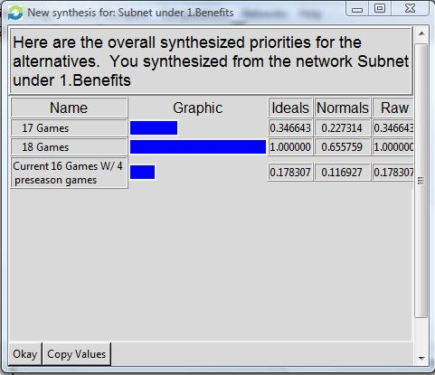
Benefits
: 18 Games Produces most benefits
Players
Salaries
Endorsements
Owners
Ticket sales
Ad Revenue
Fans
More Important games
Family Time

Slide 10
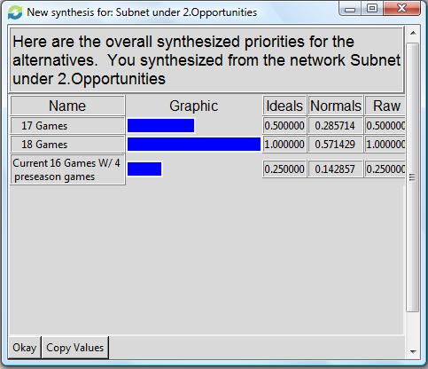
Opportunities
More opportunities for 18 game season
Owners
International Expansion
Revenues
Players
International Fame
Income
Fans
Better Games

Slide 11
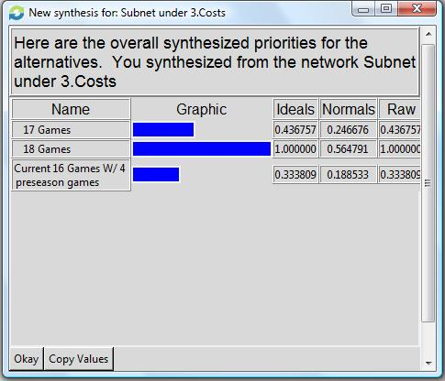
Costs
18 Game season highest costs
Owners
Overall Expenses Increased
Fans
Ticket Prices
Angry wives

Slide 12
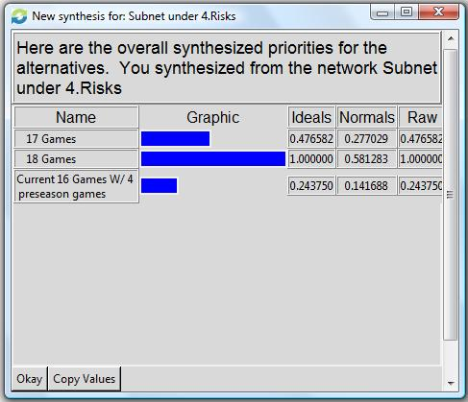
Risks
18 Games
Players
Injuries
Post Career Concussion Syndrome
Missed Games
Slow Start to Season
Owners
Loss of Key Players
Prolonged Bad Season
Over Saturation of Product

Slide 13
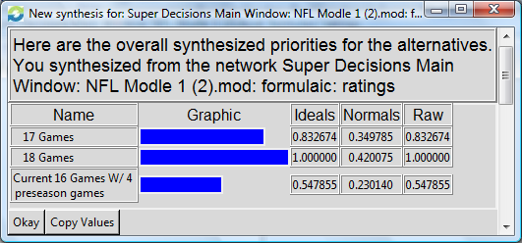
Overall Results
The Multiplicative formula shows that any increase in the season would have a positive effect.
The ideal situation for our model is an 18 game regular season with only two preseason games.

Slide 14
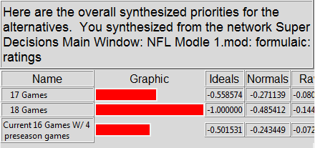
Results Cont’d…
The Additive formula puts more emphasis on the high risk factor.
The results are much closer but the current set up seems to be the proper choice.

Slide 15
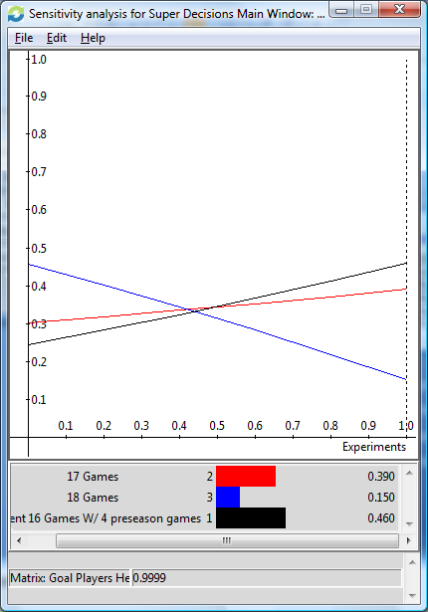
Sensitivity Analysis
Players Health – This model shows that the longer the season is extended the less attractive the new alternatives become.

Slide 16
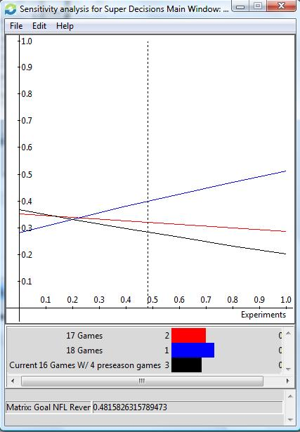
Sensitivity Cont’d…
NFL Revenues– This model shows that the longer the season is extended the more attractive the new alternatives become.

Slide 17
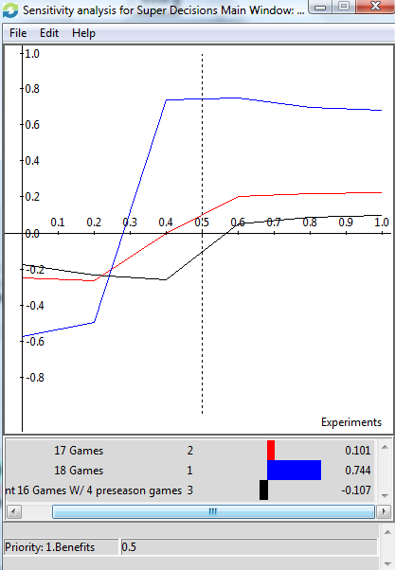
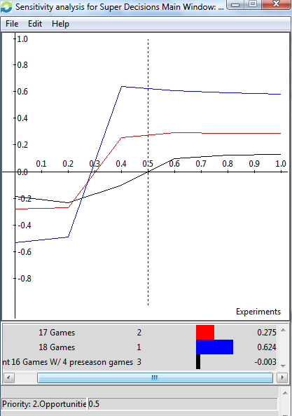
BOCR Sensitivity
Benefits
Opportunities

Slide 18
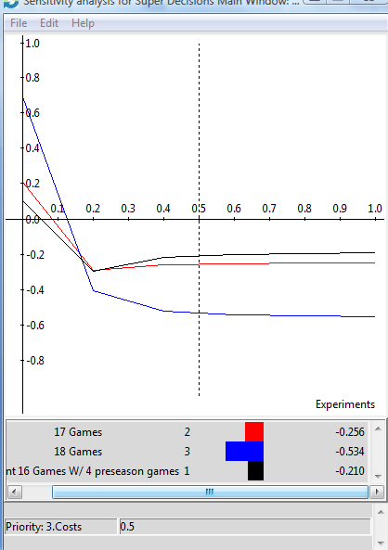
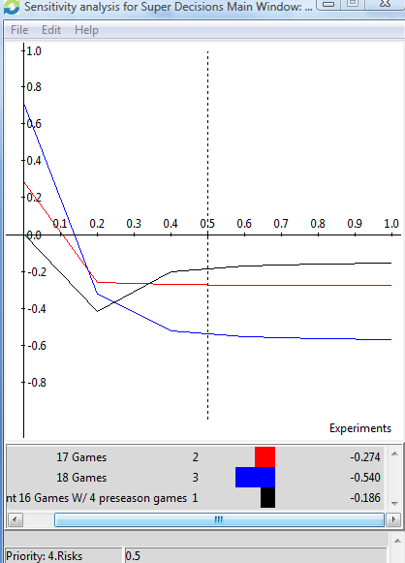
BOCR Sensitivity
Costs
Risks

Slide 19
References
http://www.midwestsportsfans.com/wp-content/uploads/2008/10/nfl-logo.jpg
http://sportsillustrated.cnn.com/2008/writers/ross_tucker/08/21/schedule/index.html

