Slide 1

Should the Pirates owners invest profits into the team?
Tom Glaser
Nathan Mancine

Slide 2
Alternatives
Continue putting profits into owner’s pockets
Re-invest money into the team
Retaining good players
Paying players better
Purchasing/trading for established players

Slide 3
Introduction
The Pirates last winning season was in 1992!
The Pirates fan attendance is 60% of the National Leagues Average attendance
2009 Pirates payroll 49 million, league average was 80 million a 31 million dollar difference.
Major League Baseball Revenue Sharing
Favors small market teams

Slide 4
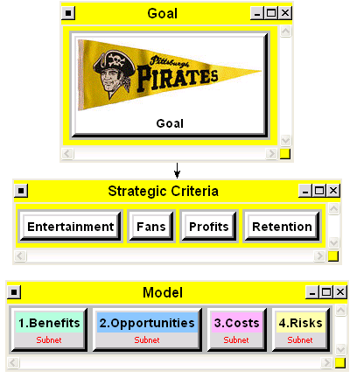
Strategic Criteria
Entertainment
.25 wrt goal
Fans
.07 wrt goal
Profits
.55 wrt goal
Retention
.13 wrt goal

Slide 5
BOCR
Under BOCR Control Criteria
Economic
Social
Used a consistent comparison and rating for all

Slide 6
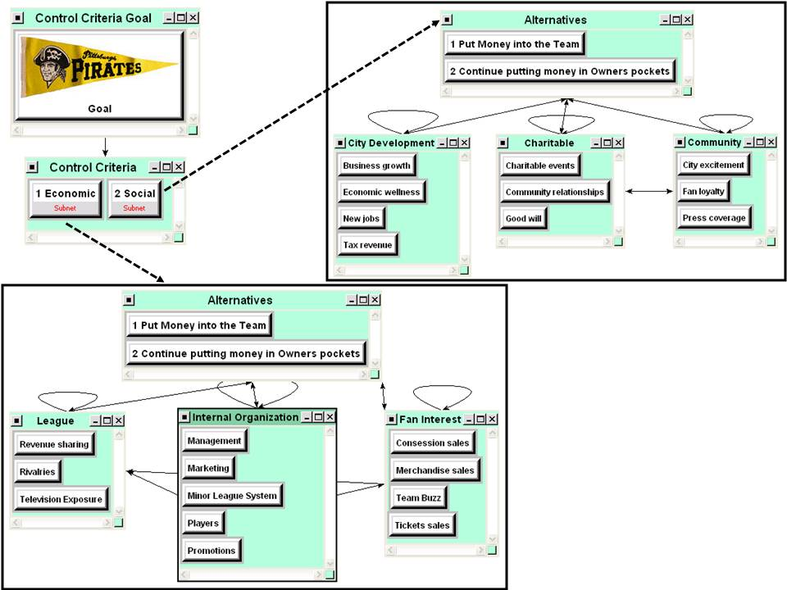

Slide 7
Control Criteria
Economic
League
Internal Organization
Fan Interest
Social
City Development
Charitable
Community

Slide 8
BOCR Results
Benefits: Money to Owners: 53.6%
Opportunities: Money in Team: 51.0%
Costs: Money in Team: 71.5%
Risks: Money in Team: 59.3%

Slide 9
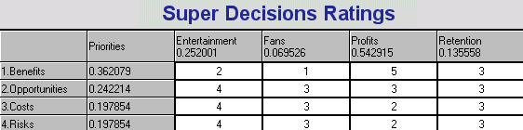
Ratings Model
Rating | Factor
1 | 0.147577
2 | 0.232364
3 | 0.382097
4 | 0.627223
5 | 1.000000

Slide 10
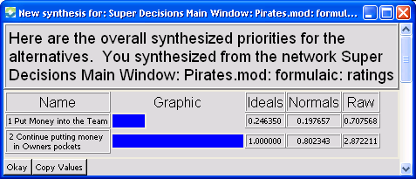
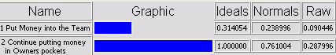
Results
Multiplicative Formula (Short Term)
Additive Formula (Long Term)

Slide 11
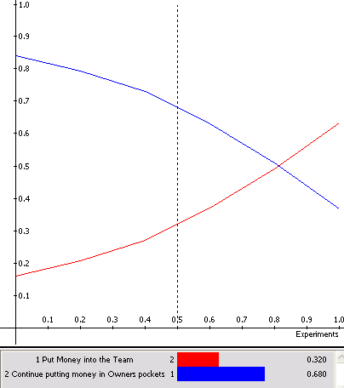
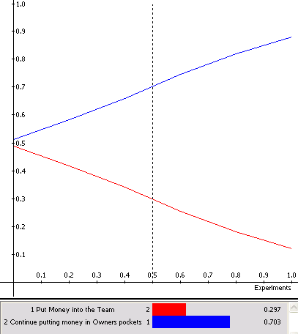
Sensitivity Analysis
Revenue Sharing
Benefits
Costs

Slide 12
Conclusion
MLB’s revenue sharing systems prevents the need for a winning team
Ownership is currently profitable
No threat of the Pirates leaving the city
People still attend the games
Costs and Risks adversely impact putting money into the Pirates
Under the current MLB structure, fielding a winning team doesn’t make financial sense in short term or long term

Slide 13
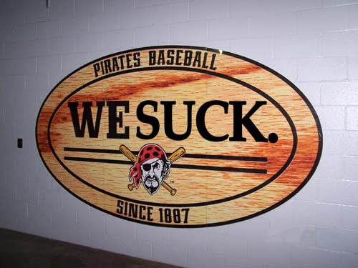
Questions?

