Slide 1

Best Location for
Olympic Games 2016
Presented by
Masamichi Yoda
Sattha Kohpisalsukwattana
Noriaki Obata

Slide 2

Agenda
Topic
Model
  Alternatives
  Strategic Model
  Network Analysis (BOCR)
Results
Sensitivity Analysis

Slide 3
Topic
Define the Best Location for the Olympic Games in summer 2016

Slide 4
Model-Alternatives

Slide 5
Model-Network Analysis
Strategic Criteria
1) Economic
2) Cultural
3) Political
4) Social

Slide 6
Rating and Priority

Slide 7
Subnet Overview

Slide 8


Slide 9
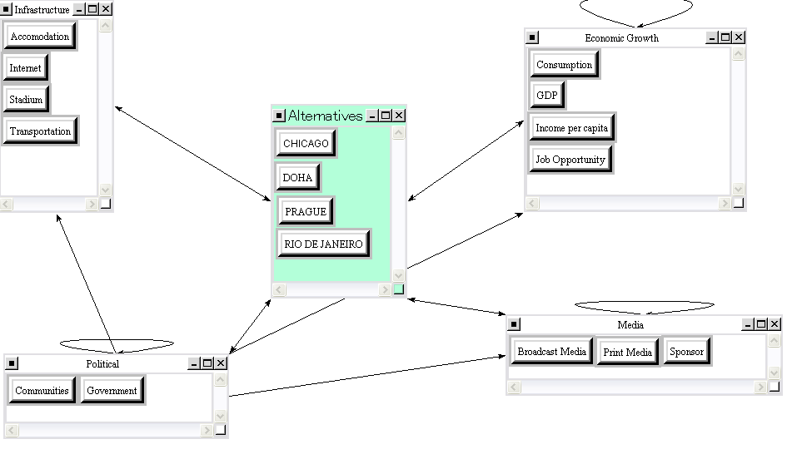
Inner Subnet (Example)
Benefits - Economic

Slide 10
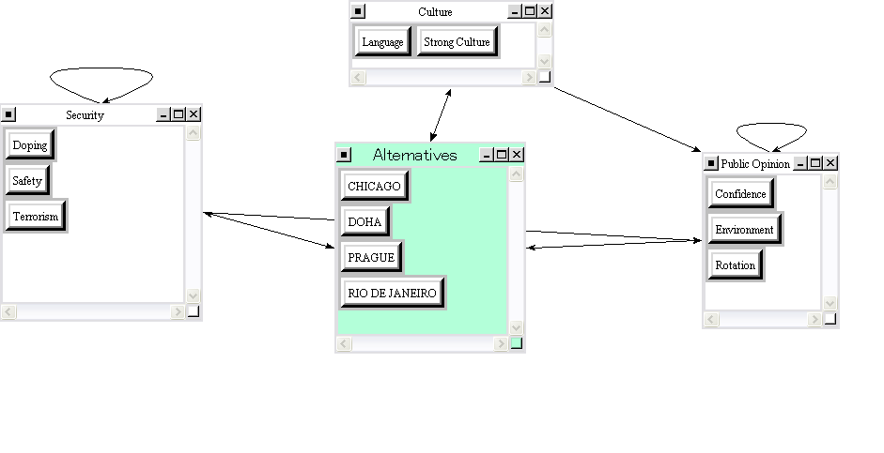
Inner Subnet (Example)
Benefits - Social

Slide 11
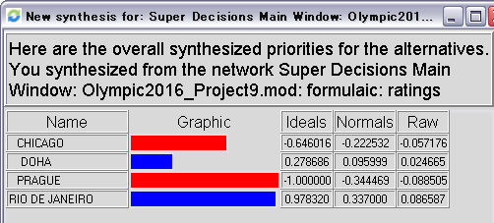
Results

Slide 12
Benefits(+)
Costs(-)

Slide 13
Opportunities(+)
Risks(-)

Slide 14
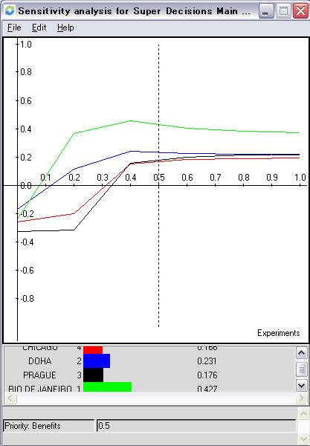
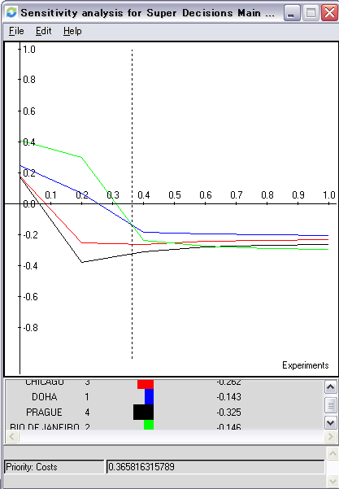
Sensitivity Analysis

Slide 15
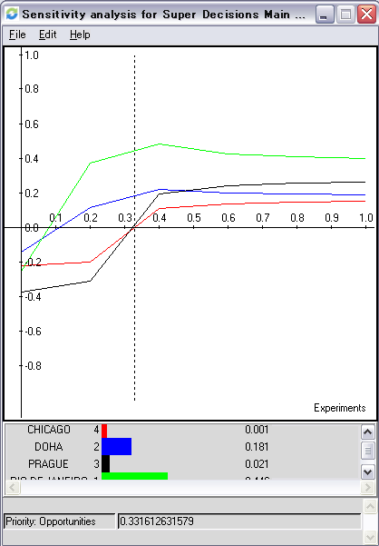
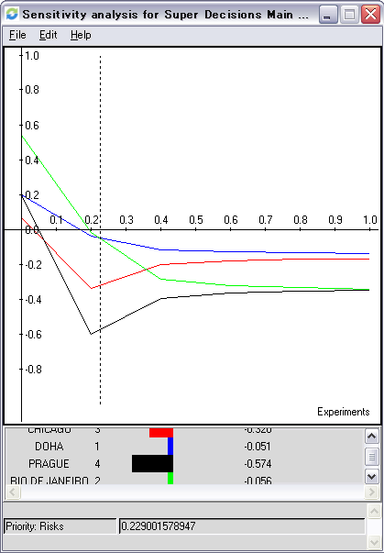
Sensitivity Analysis

Slide 16
Conclusion

