Slide 1
BOCR Model for 2012 Summer Olympics
Tim Joyce
6 Oct 2008

Slide 2
Model Consideration
Current Process
104 Voters select based on some knowledge & bias
4 Rounds of voting, eliminating one each round
Political bantering-Prime Minister Tony Blair
Prior Host penalty & Non-Capatilism penalty
Model Process
Many Factors to include:
Weather, Safety, Transportation, Infrastructure, Economic Status, Political System & Accomodations

Slide 3
Selection Results from Olympic Committee
Based on the 104 voters, the results:
London (selected in rd 4)
Paris (eliminated in rd 4)
Madrid (eliminated in rd 3)
New York (eliminated in rd 2)
Moscow (eliminated in rd 1)

Slide 4
Data considered in comparisons
Existing Stadiums, Arenas, Aqua centers
New York Strong, Moscow Weak
Car bombings, street violence
London-- New York & Moscow
Hotels, restaurants, stores
New York Strong, Moscow Weak
Transportation systems
London, New York Strong—Paris, Madrid Weak

Slide 5
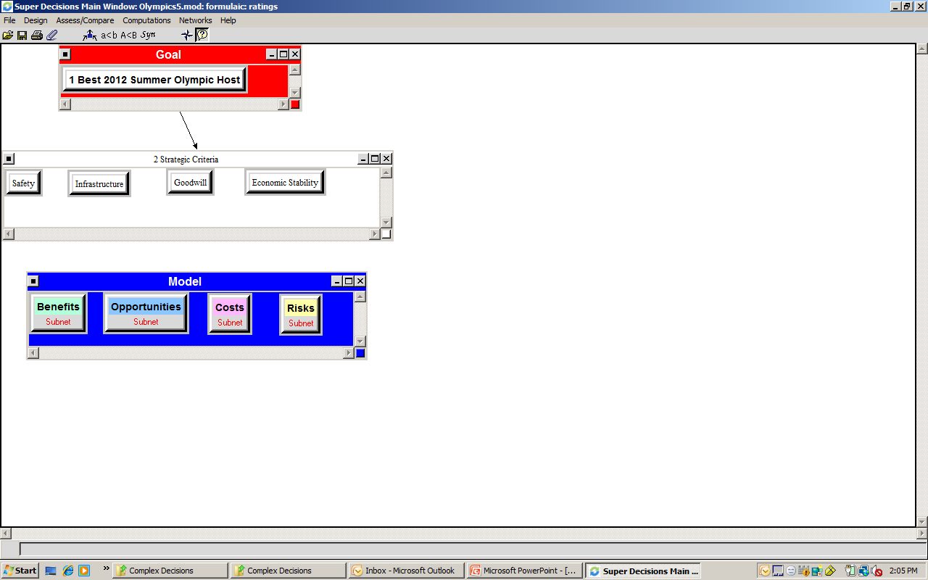
Model Overview

Slide 6
BOCR Criteria Cluster
Narrowed down to 4 main criteria
Safety (30%)
Economic Status (20%)
Infrastructure (35%)
Goodwill (15%)

Slide 7
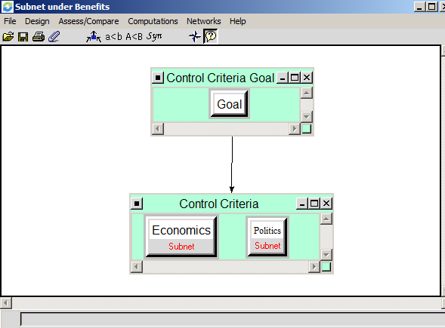
Benefits Cluster Criteria

Slide 8
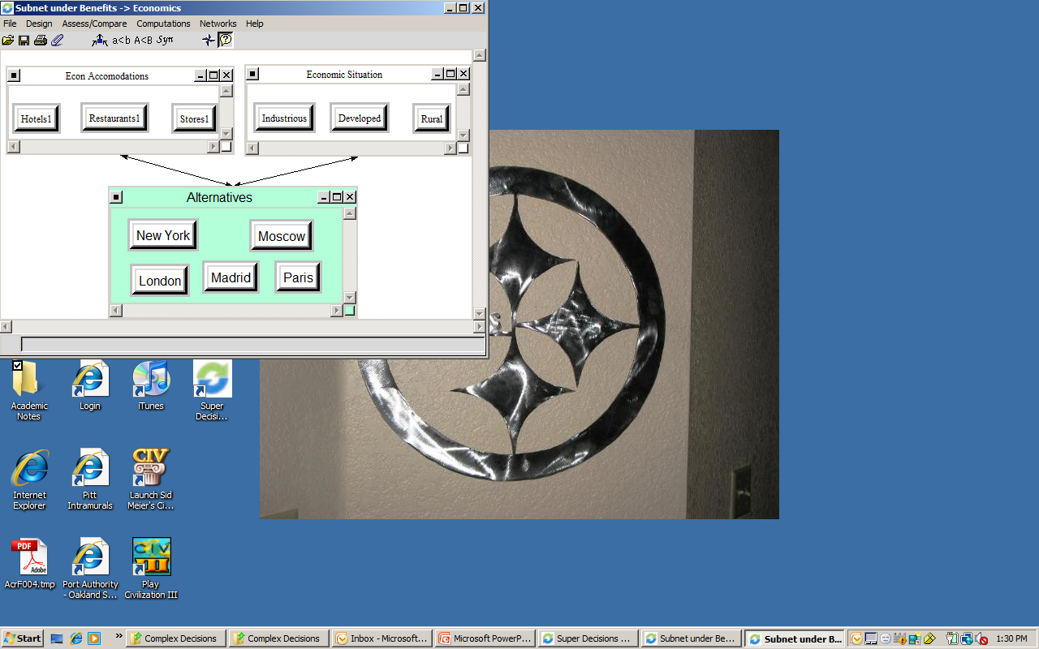
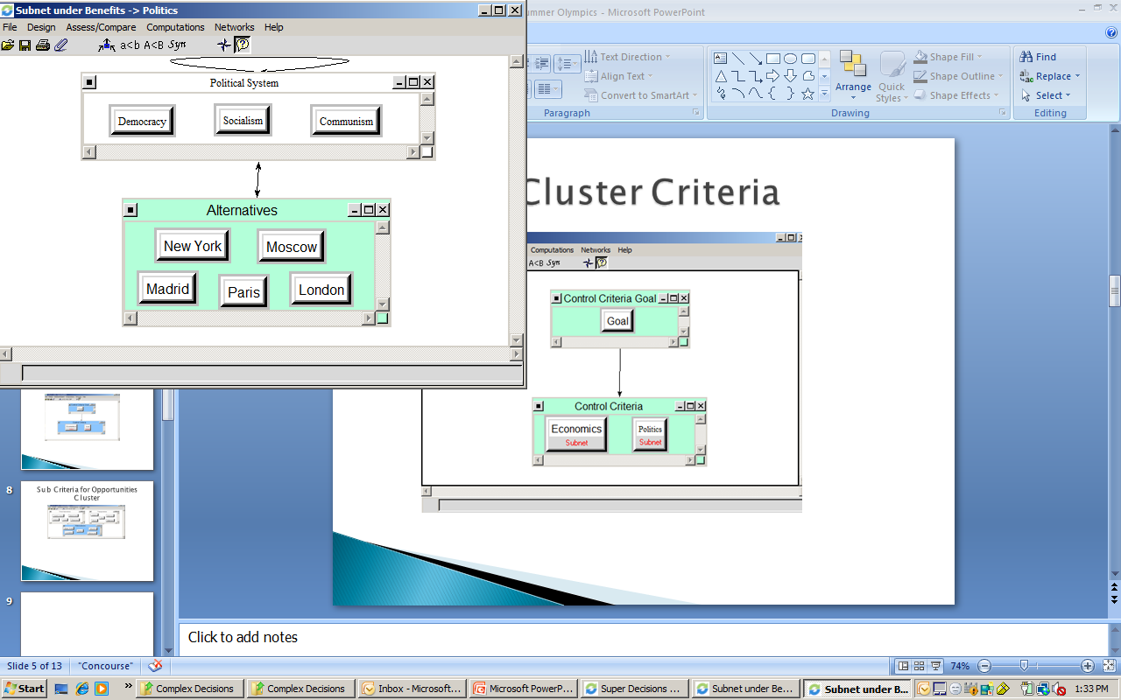
Sub Criteria for Benefits Cluster

Slide 9
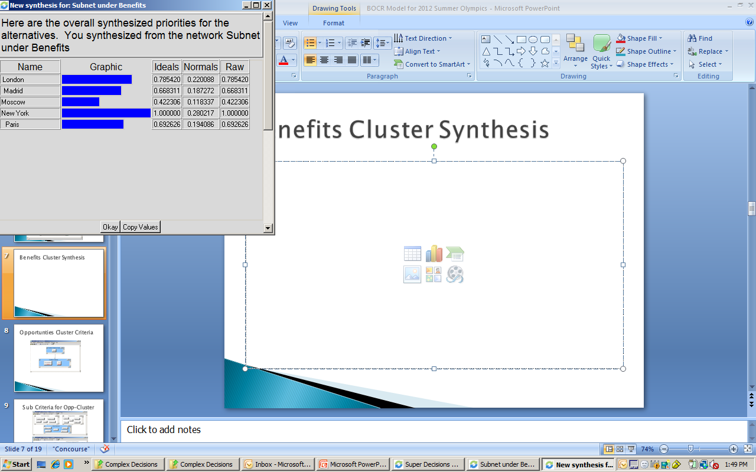
Benefits Cluster Synthesis

Slide 10
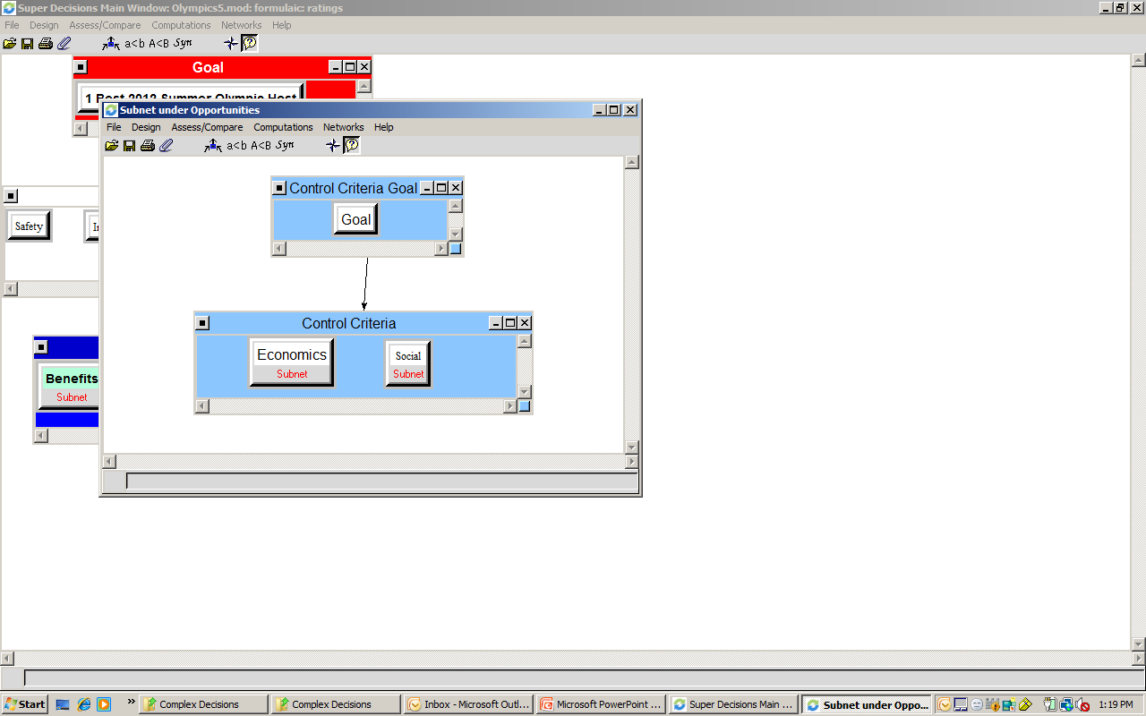
Opportunties Cluster Criteria

Slide 11
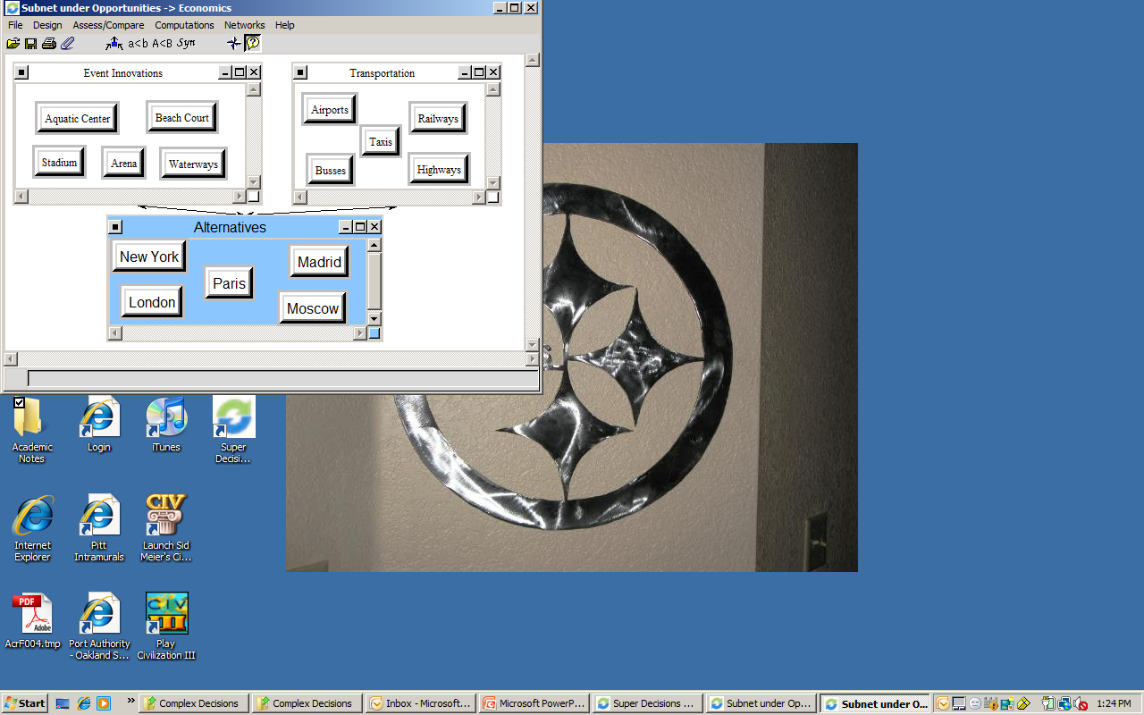
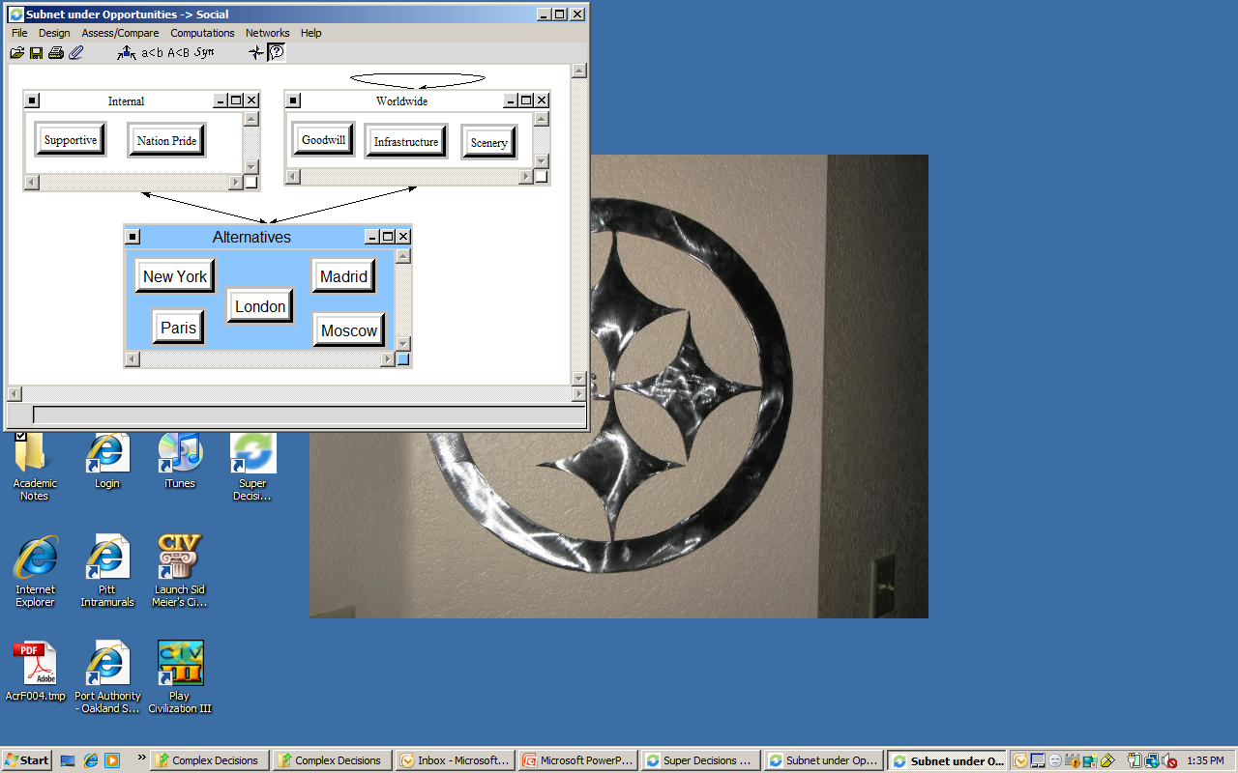
Sub Criteria for Opp-Cluster

Slide 12
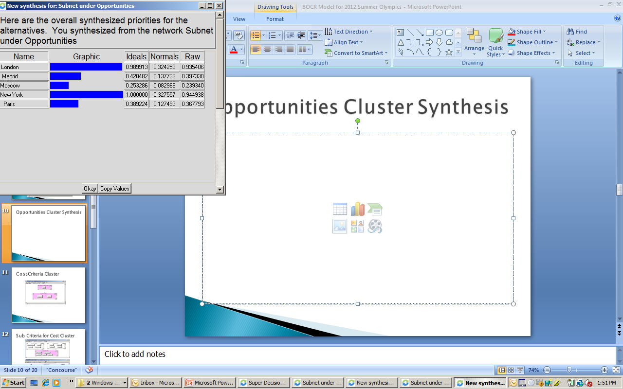
Opportunities Cluster Synthesis

Slide 13
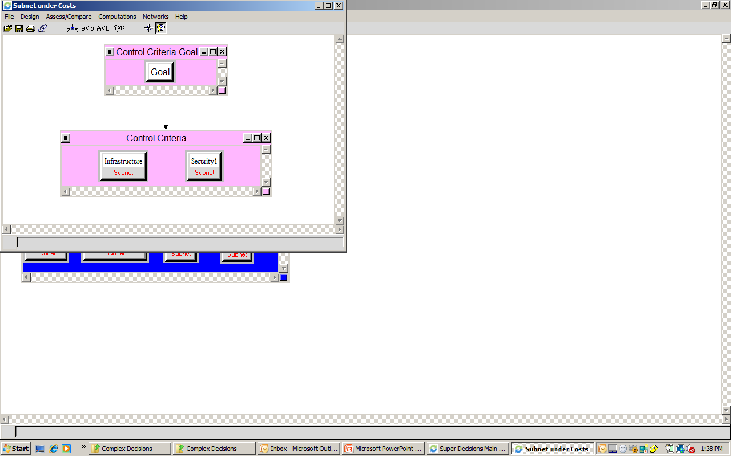
Cost Criteria Cluster

Slide 14
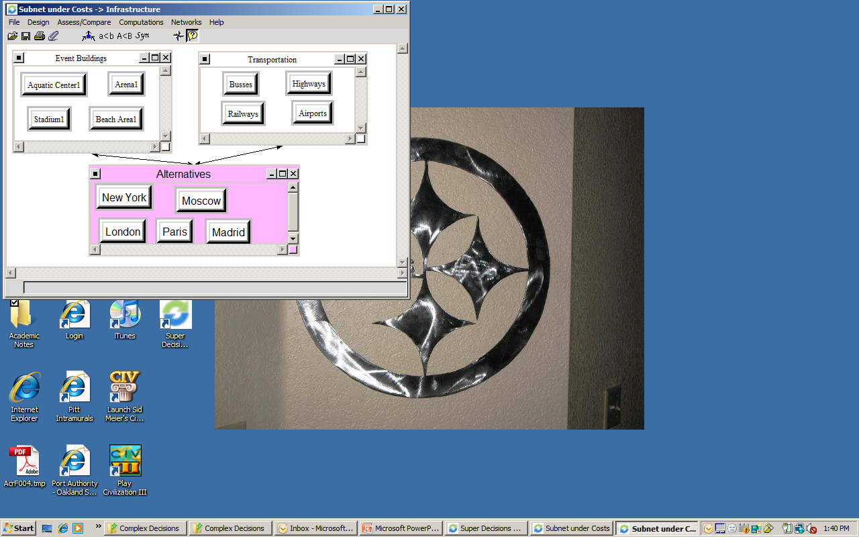
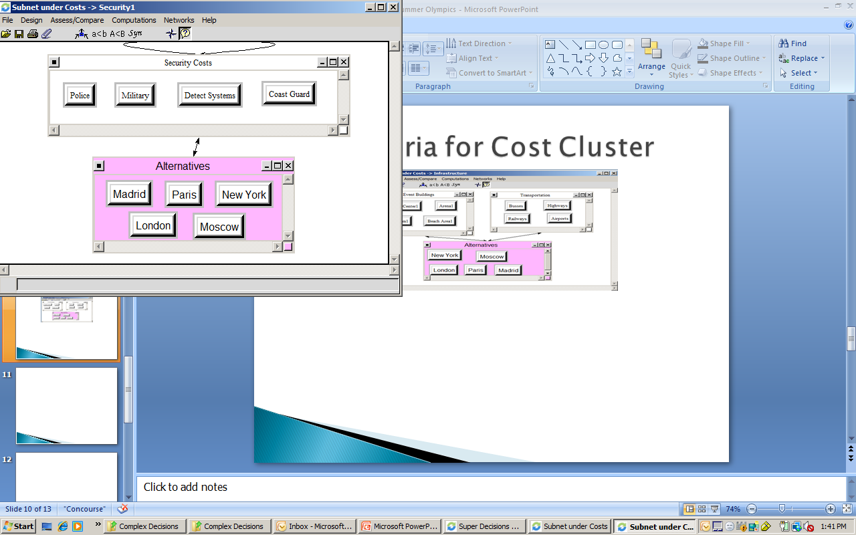
Sub Criteria for Cost Cluster

Slide 15
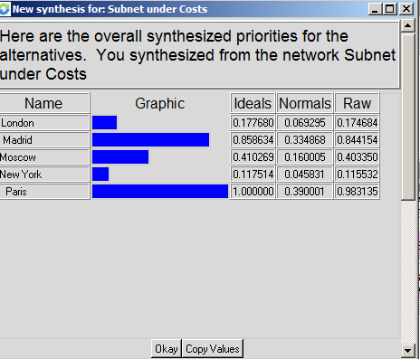
Synthesis for Cost Cluster

Slide 16
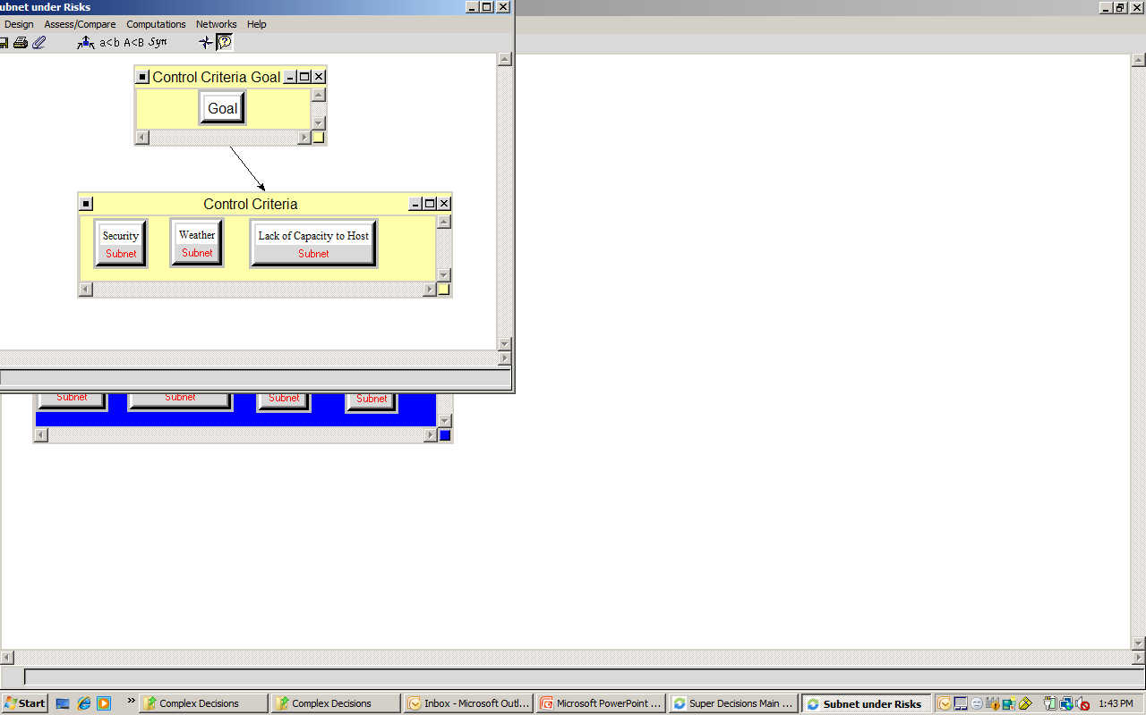
Risks Criteria Cluster

Slide 17
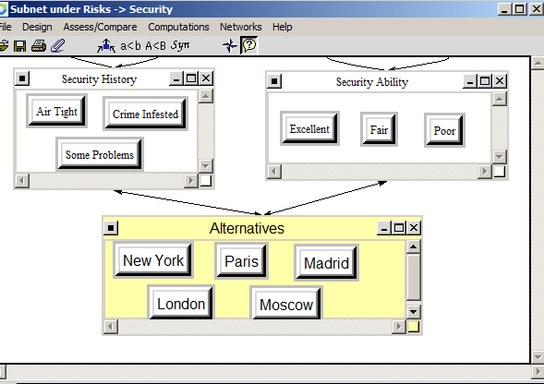
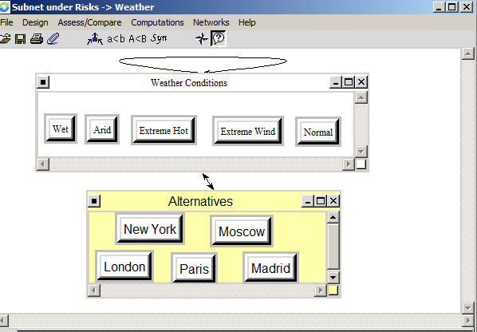
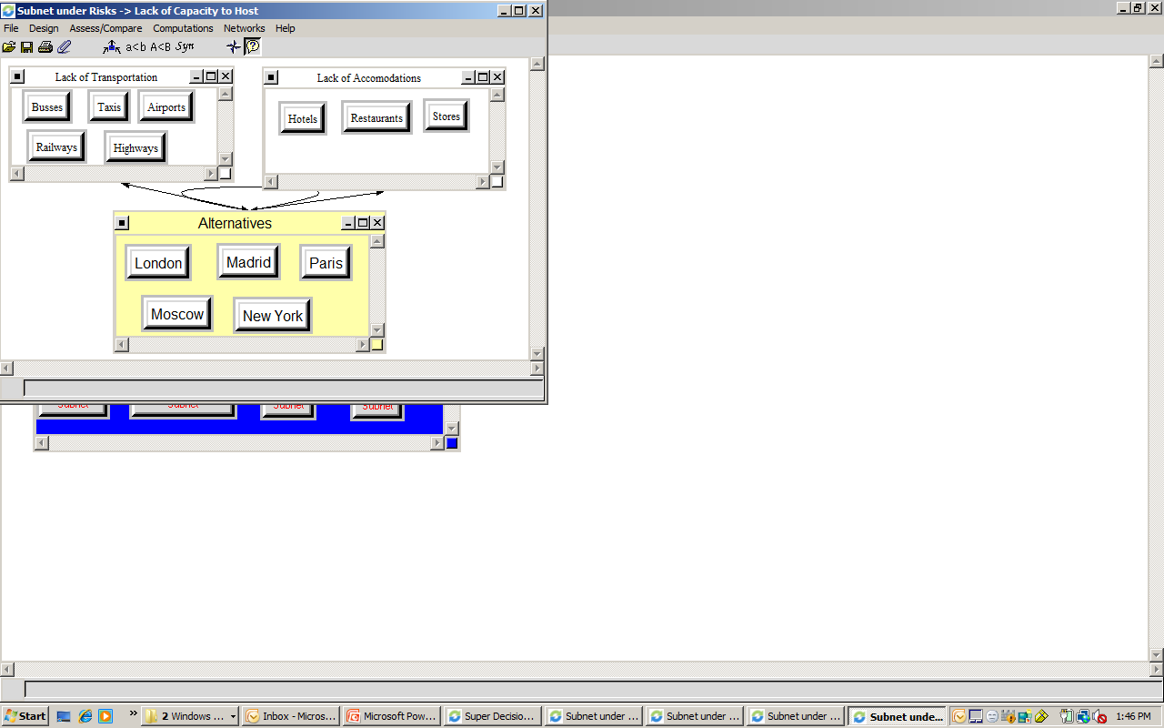
Sub Criteria for Risk Cluster

Slide 18
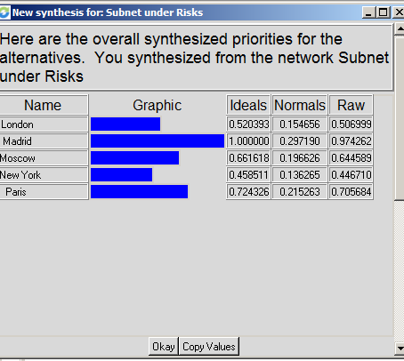
Synthesis for Risk Cluster

Slide 19
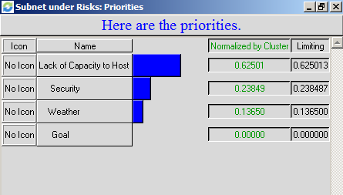
Example of Priorities: Risk

Slide 20
Additional Priorities
Benefits
Political 55% --Economics 45%
Opportunities
Economics 68%--Social 32%
Costs
Infrastructure 83.3%--Security 16.7%

Slide 21
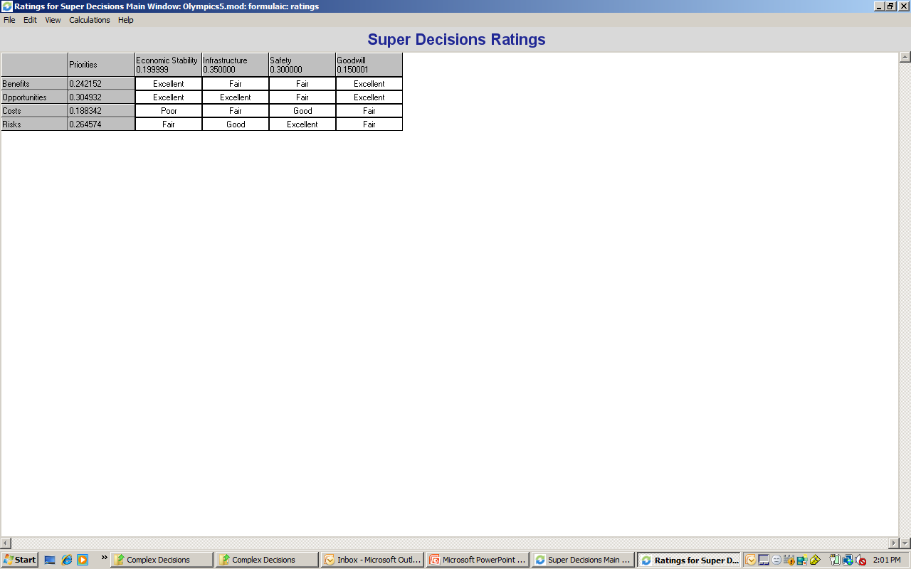
Ratings Model for 2012 Olympics

Slide 22
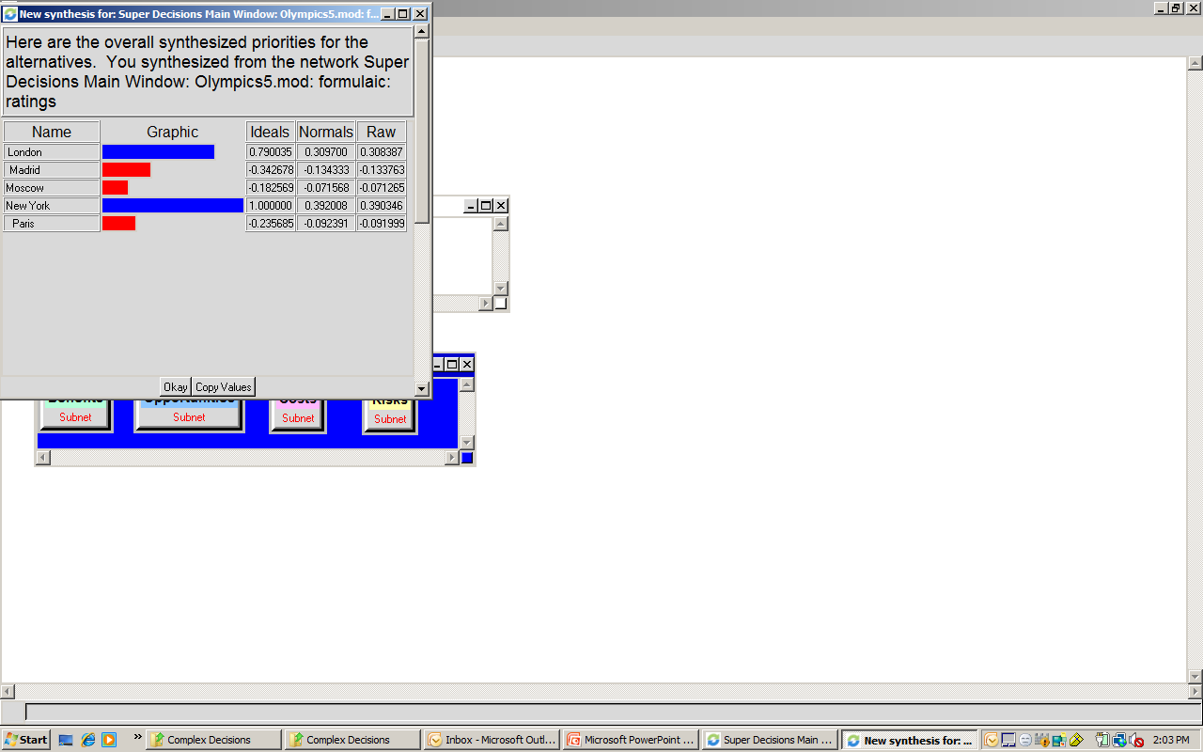
Best Alternative 2012 City

Slide 23
The End
Next!

