Slide 1
Most Likely NFL Franchise to move to Los Angeles
Presented by Patrick Shedlock
pjs59@pitt.edu

Slide 2
Project Summary
The National Football League has had a long history in Los Angeles
1946 – Cleveland Rams became the first NFL franchise to locate to Los Angeles to become the LA Rams
1960 – Los Angeles Chargers were founded only to move to San Diego the following year
1982 – Oakland Raiders moved to Los Angeles only to return back to Oakland in 1994
1995 – Los Angeles Rams left for St. Louis leaving LA without an NFL franchise for first time in 50 yrs

Slide 3
Project Summary (cont.)
Since 1995, Los Angeles has been by far the largest U.S. market without an NFL team
Currently located in the second largest media market in the United States
Main reason for prior NFL defections was due to lost revenue caused by TV blackouts in LA as a result of not filling the outdated 90,000 seat LA Coliseum
Construction of a new 75,000 seat stadium has been approved only if an NFL franchise agrees to move to LA

Slide 4





The Alternatives

Slide 5
BOCR Control Criteria & Clusters Summary

Slide 6
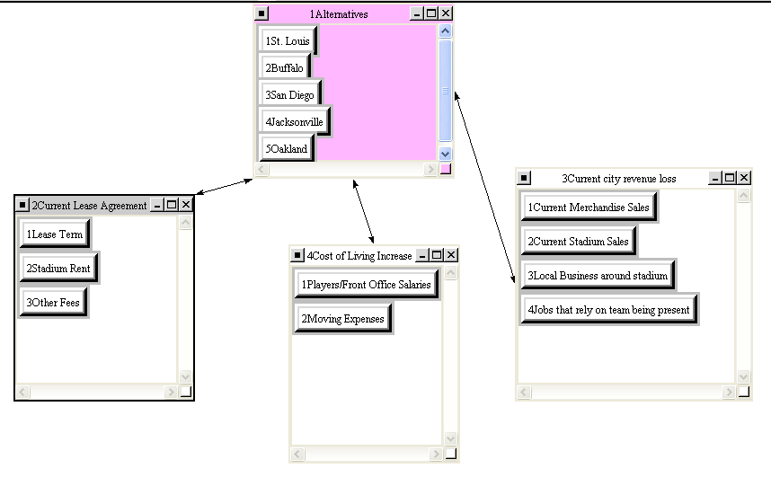
Cost Decision Network: Economic Criteria

Slide 7
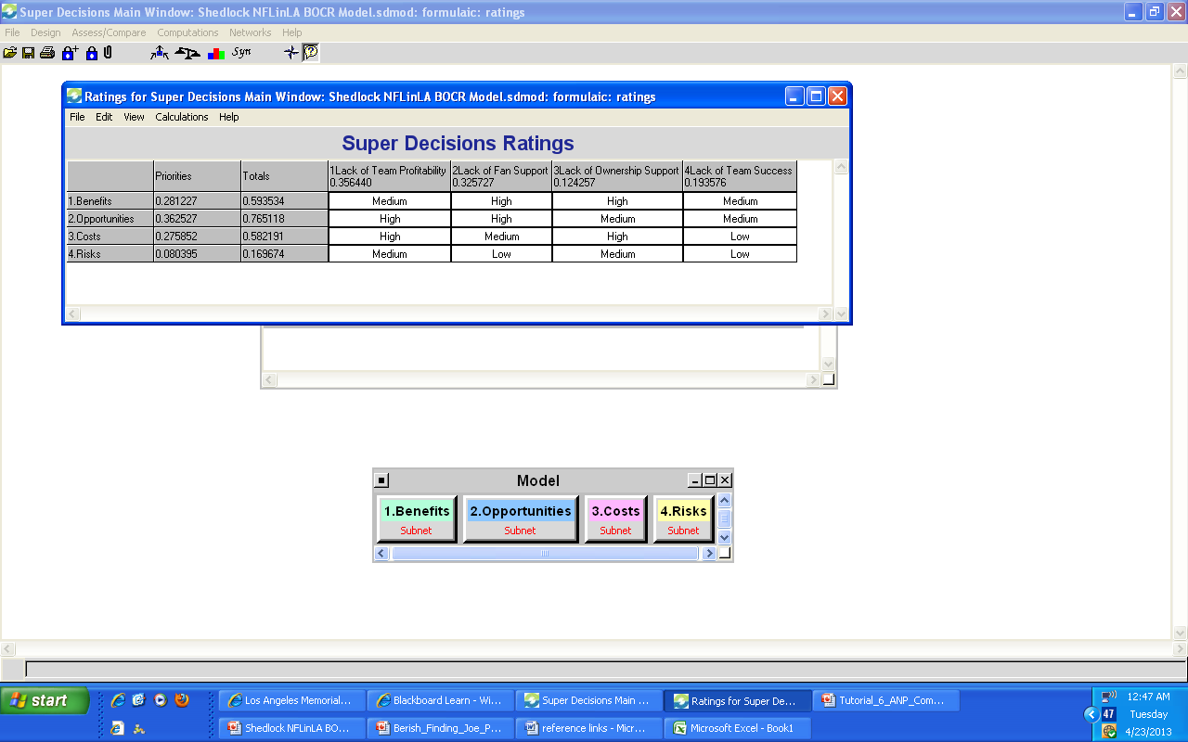
Super Decision Ratings
High = 1.0 | Medium = .26 | Low = .08

Slide 8
Who’s the most likely franchise to move to Los Angeles?

Slide 9

Oakland Raiders

Slide 10
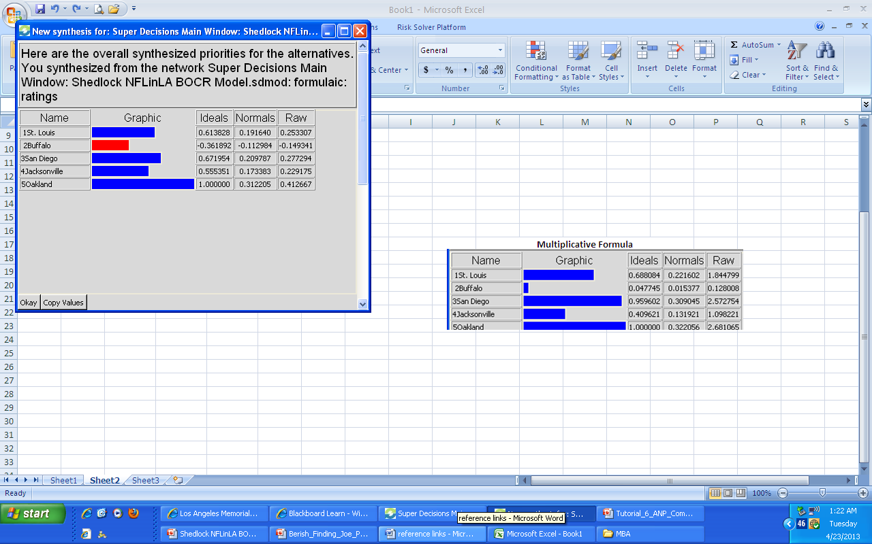
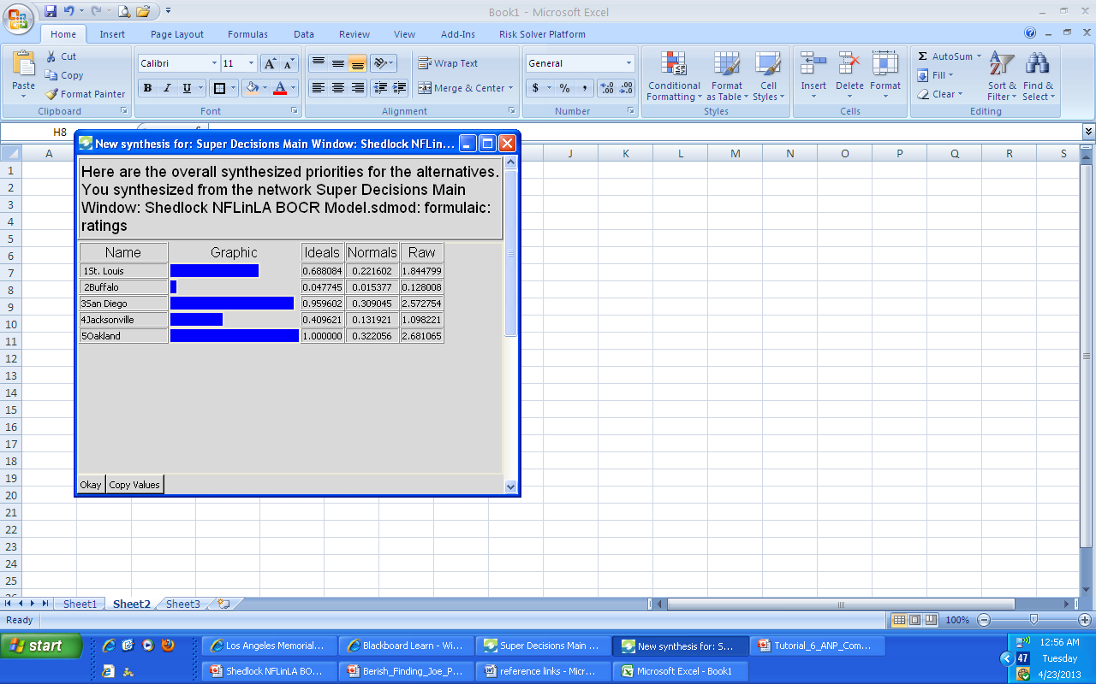
Synthesized Results
Additive Formula
Multiplicative Formula

Slide 11
Questions?

